Slide 1
Data & Mapping Update
March 2019

Slide 2

Census 2020

Slide 3



Complete Count Committee (CCC)
City of Columbus/Franklin County CCC launching March 6
Consists of numerous subcommittees
  Hard-to-Count populations – children under 5, immigrants, persons of color, renters
  Other groups at risk of undercounting – seniors, LGBTQ, veterans
  Key sectors – business, media, philanthropy
MORPC chairing Government Subcommittee & providing staff for others
Extending work of CCC to other Central Ohio counties
www.columbus.gov/columbuscounts

Slide 4
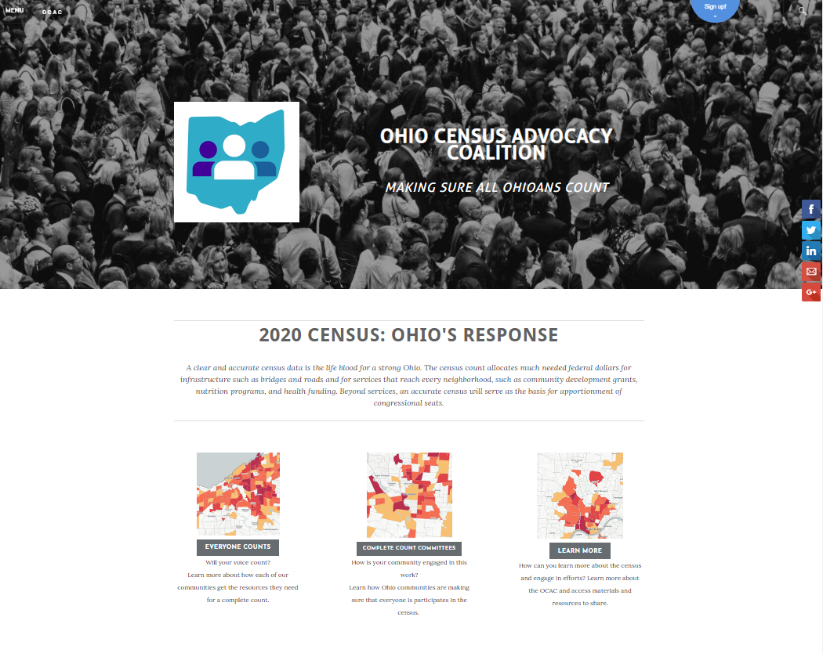
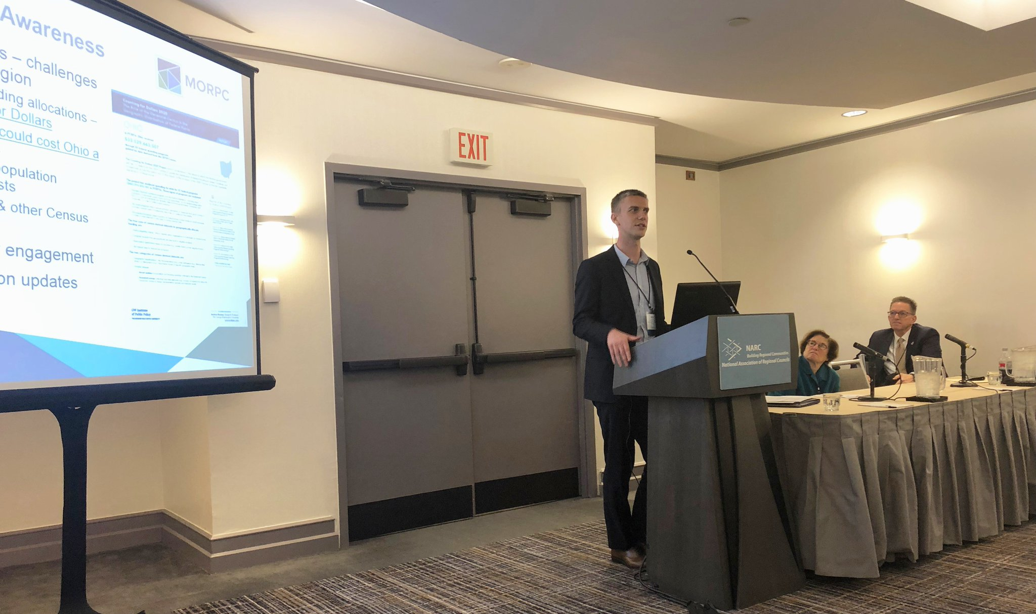
Advocacy Efforts
Ohio Census Advocacy Coalition
  www.ohiocensus.org
  @CensusOhio
Key messaging & information
  $33B in federal funding (George Washington University Report)
  Difference of 0.8% could cost Ohio a Congressional seat
Raising awareness & sharing strategies
  Glenn College Leadership Forum
  National Conference of Regions

Slide 5
Paving the Way

Slide 6
Paving the Way System Redesign
Key features
  Information on entire projects & individual closures
  Ability for local agencies & contractors to manage project information
  Detailed project mapping
  Enhanced notification options
  Expanded geographic coverage
Upcoming milestones
  Paving the Way annual meeting: Tuesday, April 9, 2019
  Beta & user acceptance testing: April 2019
  System launch: Spring 2019
  Training & onboarding throughout 2019

Slide 7
Aaron Schill
Director, Data & Mapping
Mid-Ohio Regional Planning Commission
T: 614.233.4154
aschill@morpc.org
111 Liberty Street, Suite 100
Columbus, OH 43215

