Slide 1
DRAFT STRATEGIES & PROJECTS
FEBRUARY 2020

Slide 2
WHAT ARE WE ASKING OF YOU?
Information only
Review & Comment
  Draft plan
  Comment period ends April 3, 2020
Contact
  mtp@morpc.org
  For hard copies or translated materials:
    bschneck@morpc.org
    614-233-4130
Information
  www.morpc.org/mtp
Provide comments by April 3

Slide 3
WHAT IS THE METROPOLITAN TRANSPORTATION PLAN (MTP)?
Identifies priority regional transportation strategies and projects
Long-range (20+ years)
Fiscally constrained
Formal document submitted to ODOT and USDOT every 4 years
Transportation projects must be on MTP to be eligible for federal funding
Notes:
Today I’m here to talk about the 2020-2050 Metropolitan Transportation Plan, or MTP for short, which sets the framework for regional transportation investments looking out 20 to 30 years.
The plan is fiscally constrained, meaning, the projects identified in the Plan must be cost feasible based on forecasted revenues and cost estimates.
This plan is completed every 4 years and submitted to ODOT and USDOT.

Slide 4






REGIONAL GOALS
REDUCE PER CAPITA ENERGY CONSUMPTION AND PROMOTE ALTERNATIVE FUEL RESOURCES TO INCREASE AFFORDABILITY AND RESILIENCE OF REGIONAL ENERGY SUPPLIES
PROTECT NATURAL RESOURCES AND MITIGATE INFRASTRUCTURE VULNERABILITIES TO MAINTAIN A HEALTHY ECOSYSTEM AND COMMUNITY
POSITION CENTRAL OHIO TO ATTRACT AND RETAIN ECONOMIC OPPORTUNITY TO PROSPER AS A REGION AND COMPETE GLOBALLY
CREATE SUSTAINABLE NEIGHBORHOODS TO IMPROVE RESIDENTS' QUALITY OF LIFE
INCREASE REGIONAL COLLABORATION AND EMPLOY INNOVATIVE TRANSPORTATION SOLUTIONS TO MAXIMIZE THE RETURN ON PUBLIC EXPENDITURES
USE PUBLIC INVESTMENTS TO BENEFIT THE HEALTH, SAFETY, AND WELFARE OF PEOPLE
Notes:
Keeping the growth and changing demographics and transportation demands in mind, a set of goals were established to guidethe development of the plan.
The are broad vision statements covering six topic areas including:
Energy
Natural Resources
Economic Opportunity
Sustainable neighborhoods
Regional collaboration
Health, Safety, and Welfare of people.

Slide 5
REGIONAL STRATEGIES
System Management
  Physical Preservation
  Operations
  Safety & Security
  Demand Management
System Development
  Bike & Pedestrian Infrastructure
  Transit Infrastructure
  Freight Rail Infrastructure
  Multimodal Infrastructure Connections
  Roadway Infrastructure
Notes:
The draft list of strategies is now available for public comment and review.
Identified 65 individual strategies or action items to advance the regional goals and objectives.
System Management strategies address the existing transportation system and managing the existing assets efficiently and safely.
System Development strategies pertain to developing and expanding modal networks and systems.

Slide 6
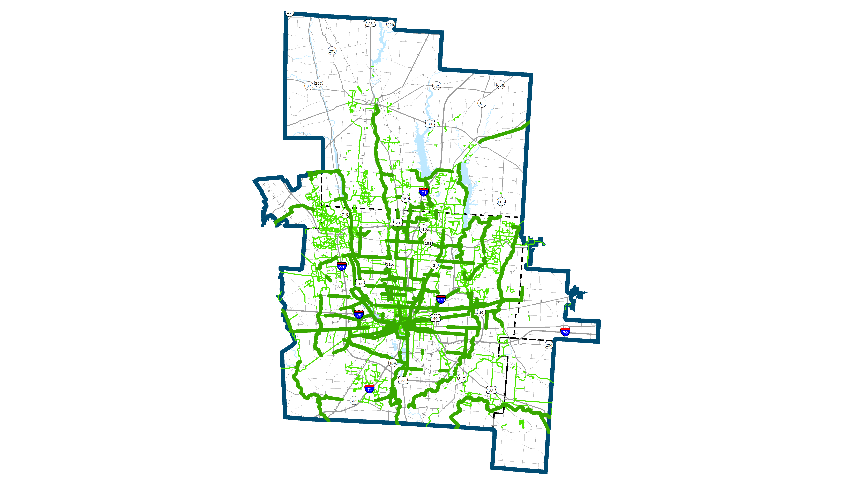
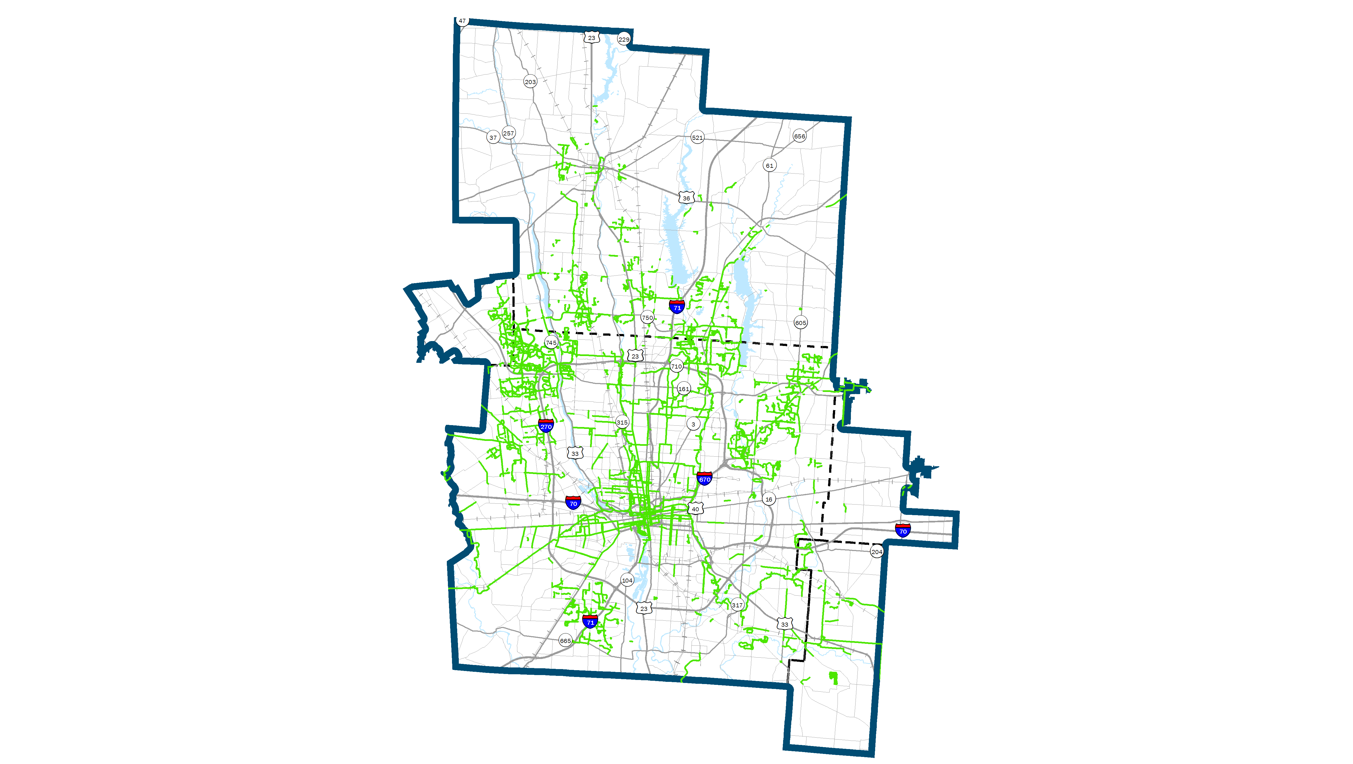
DRAFT STAND-ALONE
BIKE & PEDESTRIAN PROJECTS
Notes:
Keeping the growth and changing demographics and transportation demands in mind, a set of goals were established to guidethe development of the plan.
The are broad vision statements covering six topic areas including:
Energy
Natural Resources
Economic Opportunity
Sustainable neighborhoods
Regional collaboration
Health, Safety, and Welfare of people.

Slide 7
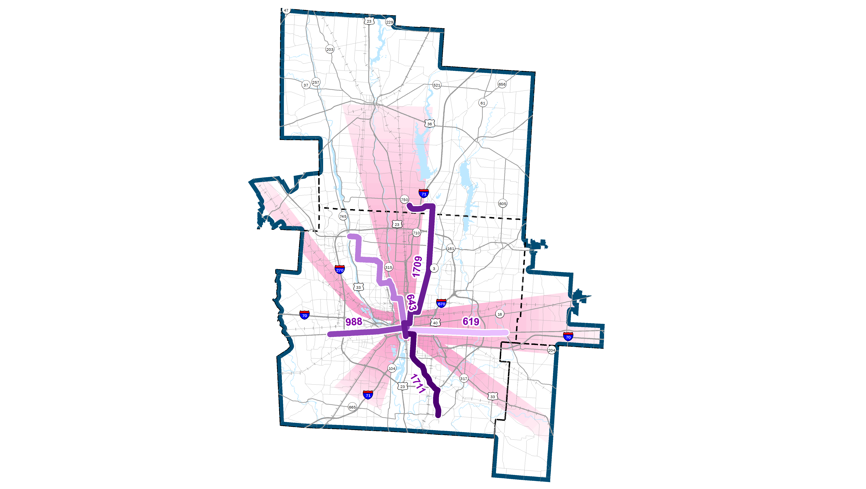
DRAFT HIGH CAPACITY
TRANSIT PROJECTS
Notes:
Keeping the growth and changing demographics and transportation demands in mind, a set of goals were established to guidethe development of the plan.
The are broad vision statements covering six topic areas including:
Energy
Natural Resources
Economic Opportunity
Sustainable neighborhoods
Regional collaboration
Health, Safety, and Welfare of people.

Slide 8
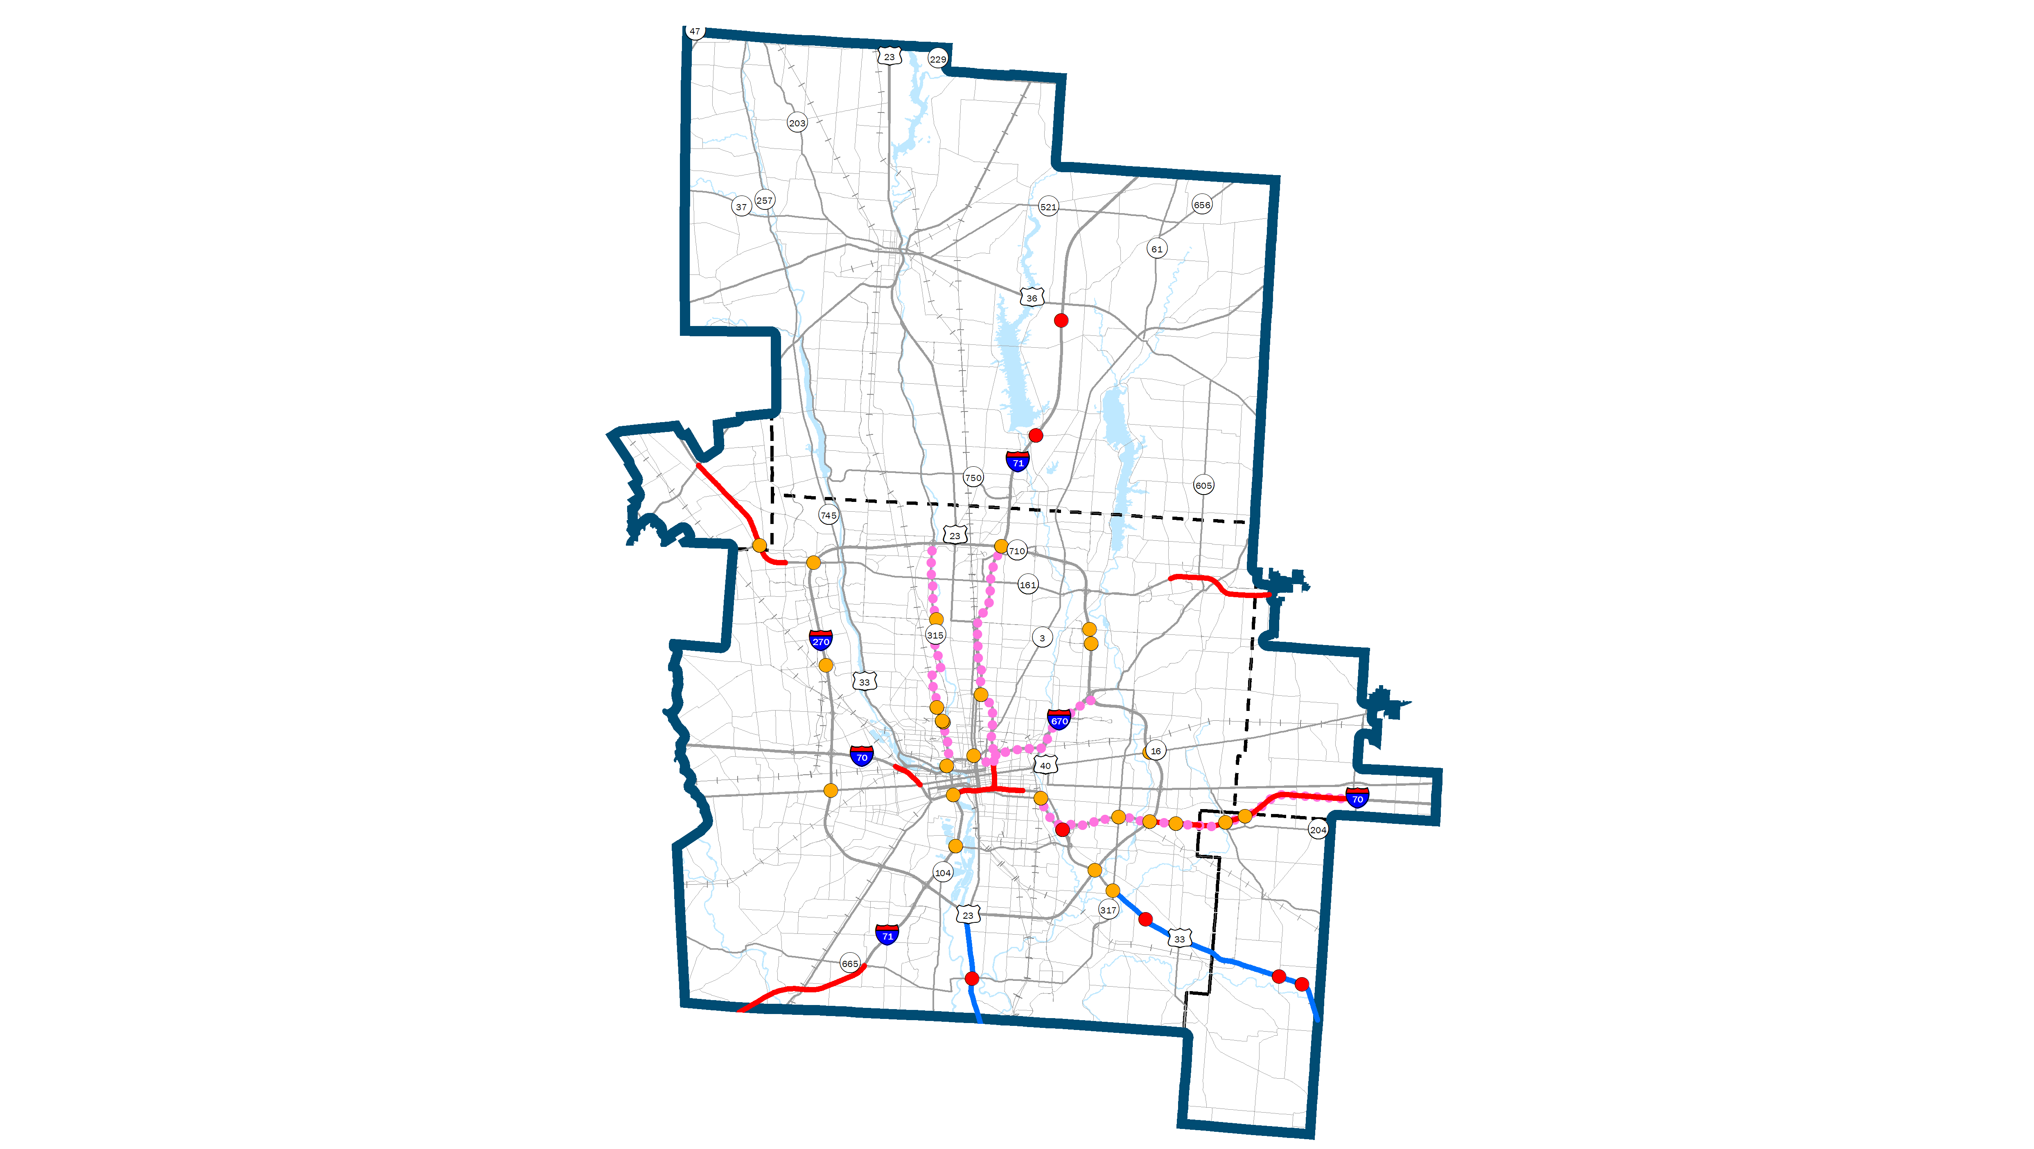
DRAFT FREEWAY PROJECTS
Notes:
Keeping the growth and changing demographics and transportation demands in mind, a set of goals were established to guidethe development of the plan.
The are broad vision statements covering six topic areas including:
Energy
Natural Resources
Economic Opportunity
Sustainable neighborhoods
Regional collaboration
Health, Safety, and Welfare of people.

Slide 9
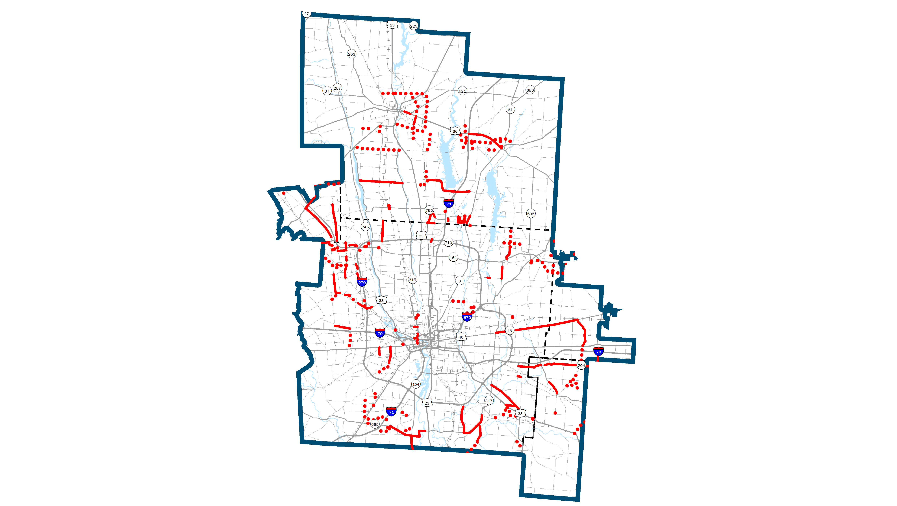
DRAFT MAJOR WIDENING &
NEW ROADWAY PROJECTS
Notes:
Keeping the growth and changing demographics and transportation demands in mind, a set of goals were established to guidethe development of the plan.
The are broad vision statements covering six topic areas including:
Energy
Natural Resources
Economic Opportunity
Sustainable neighborhoods
Regional collaboration
Health, Safety, and Welfare of people.

Slide 10
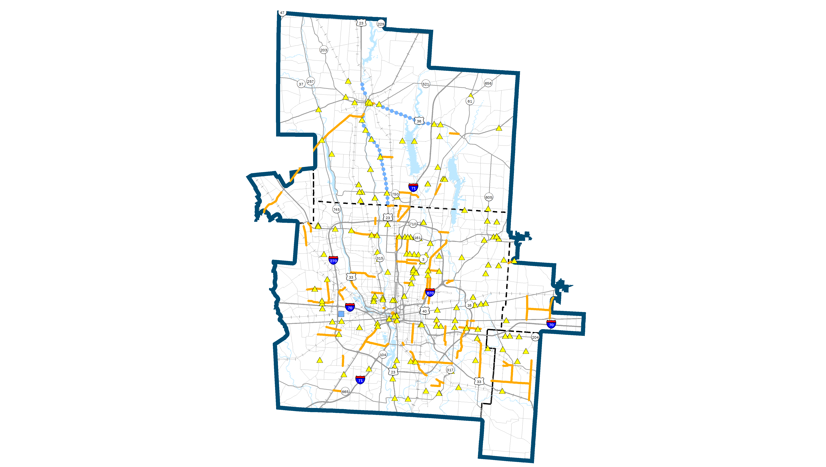
DRAFT MINOR WIDENING &
INTERSECTION PROJECTS
Notes:
Keeping the growth and changing demographics and transportation demands in mind, a set of goals were established to guidethe development of the plan.
The are broad vision statements covering six topic areas including:
Energy
Natural Resources
Economic Opportunity
Sustainable neighborhoods
Regional collaboration
Health, Safety, and Welfare of people.

Slide 11
DRAFT FISCAL
ANALYSIS
111 Projects
79 Projects
63 Projects
6 Access Management &
One-way Conversion projects
Maintenance & Preservation
ITS and other operations
Total: $29.6 billion
51 Projects
152 Projects
5 high capacity transit projects
Expand COTA & DCT service
Replacement vehicles and other
capital expenses
218 Projects
*cost includes activities in addition to specific projects
Notes:
Keeping the growth and changing demographics and transportation demands in mind, a set of goals were established to guidethe development of the plan.
The are broad vision statements covering six topic areas including:
Energy
Natural Resources
Economic Opportunity
Sustainable neighborhoods
Regional collaboration
Health, Safety, and Welfare of people.

Slide 12
MTP WEBMAP
Draft projects viewable on interactive webmap
  Zoom
  Pan
  Click for project info
www.morpc.org/mtp2050
Notes:
We are out making this presentation to as many communities and groups that will allow us until February.
A complete draft document will be available in February.
And there will be a public open house at MORPC on February 26.
We’ll take the plan to our Board for adoption in May.

Slide 13
NEXT STEPS
  December 2019 – March 2020
    Community presentations
    Draft document available in February
    Public Open House at MORPC
      February 26, 2020
      4:00-7:00 PM
      Formal presentation at 6:00 PM
  April 3, 2020 – Public comment period closes
  May 2020 – Plan Adoption
Notes:
We are out making this presentation to as many communities and groups that will allow us until February.
A complete draft document will be available in February.
And there will be a public open house at MORPC on February 26.
We’ll take the plan to our Board for adoption in May.

Slide 14
Maria Schaper, AICP
TRANSPORTATION PLANNING MANAGER
MSCHAPER@morpc.org
P. 614.233.4153
111 Liberty Street, Suite 100
Columbus, OH 43215
www.morpc.org

