Slide 1
Sustaining Scioto
Short Term Implementation Plan
October 2, 2019

Slide 2
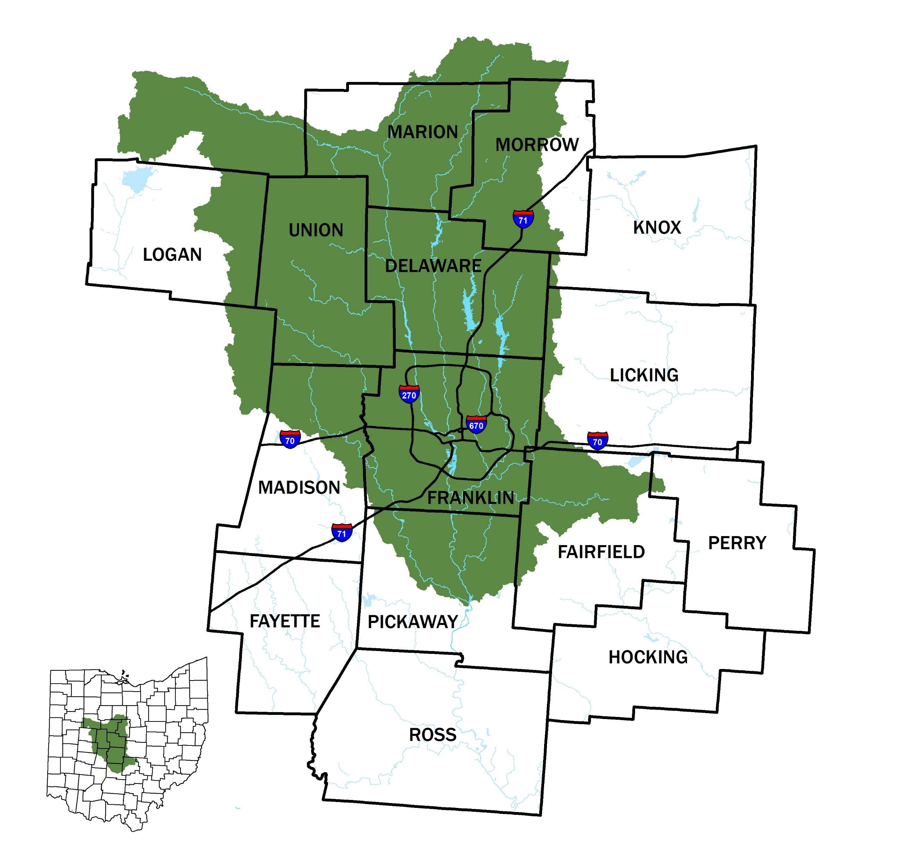
PURPOSE
Informational Only

Slide 3
CONNECTING THE DOTS
+ 1,000,000
Delaware
2050
Union
Licking
+ 610,000
Franklin
+ 420,000
Madison
1,921,000
985,000
Fairfield
777,000
Pickaway
2015
POPULATION
HOUSEHOLDS
JOBS
Notes:
Changing weather patterns
Aging infrastructure
Drinking Water Supply
Nutrient Management Issues

Slide 4
CHANGING WEATHER PATTERNS
Short Term
2015-2025
Mid Term 2026-2045
Long Term
2046-2090
Actual vs Projected
Annual
Mean
Temp (F)
Historical Average Temperature
SUSTAINING SCIOTO – Mid-Ohio Regional Planning Commission

Slide 5
CHANGING WEATHER PATTERNS
Short Term 2015-2025
Mid Term
2026-2045
Long Term
2046-2090
Actual vs Projected
Annual
Mean
Precip (in)
SUSTAINING SCIOTO – Mid-Ohio Regional Planning Commission
Historical Average Precip

Slide 6
ADAPTIVE MANAGEMENT OPTIONS
Short Term (10 Years)
2015 – 2025
Regional Collaborative Forum
Public Education
Improve Emergency Preparedness Capacities
Enhance Operational Procedures (WQ Monitoring & Treatment SOPs)
Resource Protection/Source Management
Mid Term (10-30 Years)
2026 – 2045
Regional Water Supply Planning
Groundwater Supply Planning
Water Reuse Planning
Reservoir Capacity Planning
Nutrient/Pollutant Reduction Planning and Implementation
Re-evaluate climatic conditions
Long Term (End of Century)
2046 – 2090
Implement Improvements from Mid Term Plans
Re-evaluate climatic conditions
Notes:
Changing weather patterns
Aging infrastructure
Drinking Water Supply
Nutrient Management Issues

Slide 7
OUTCOME
Short Term (10 Years)
2015 – 2025
Regional Collaborative Forum
Public Education
Improve Emergency Preparedness Capacities
Enhance Operational Procedures (WQ Monitoring & Treatment SOPs)
Resource Protection/Source Management
Informed Decision Making
Prepared & Connected Communities
LAYERS
Resilient Infrastructure
Protected Resources
Notes:
Mention case studies, specifically the “award winning climate ready boston”

Slide 8
Strategy 1
Establish a Leadership Body & Sustainable Funding
# | INITIATIVE | WHO
1.1 | Establish a formal Sustaining Scioto Leadership body | MORPC
1.2 | Develop a communications plan, including branding guidelines, marketing materials, and strategic guidance to advance all communications and outreach related initiatives | WORKING GROUP, MORPC
1.3 | Develop a sustainable funding strategy to support administrative staff and identify funding opportunities and strategies to advance implementation of initiatives included in this plan | WORKING GROUP, MORPC
Notes:
Changing weather patterns
Aging infrastructure
Drinking Water Supply
Nutrient Management Issues

Slide 9
APPROVED STRUCTURE
Sustainability Advisory Committee
Greenways & Water Resources Program
E&AQ Working Group
Sustaining Scioto Board
COG Board
Sustainable 2050
Public Education & Outreach
Infrastructure Coordination
Resource Protection

Slide 10
TIMELINE
September: SAC Consideration & WRWG Presentation
October: Commission Presentation October: Short Term Implementation Plan Released
September-December: Engage potential board members & funders
January 2020: Board Kickoff Meeting

Slide 11
KEY PARTNERS

Slide 12
Rachael Beeman
Associate Planner
Mid-Ohio Regional Planning Commission
T: 614.233.4123
rbeeman@morpc.org
111 Liberty Street, Suite 100
Columbus, OH 43215

