Slide 1
COTA Service
Community Update
November 2, 2020

Slide 2
COTA Service – through COVID and now
Date Implemented | Percentage of pre-COVID service hours (avg. 3,500)
3/17/2020 | 99.26%
3/19/2020 | 94.03%
3/20/2020 | 93.74%
3/23/2020 | 88.97%
3/24/2020 | 86.31%
3/25/2020 | 84.60%
3/30/2020 | 80.99%
4/27/2020 | 46.57%
5/4/2020 | 48.62%
6/1/2020 | 50.86%
9/21/2020 | 78.03%
1/4/2021 | 82%
Work from home order, essential travel only; masks required.
Service focused on priority
Lines 1, 2, 8, 10, 22 and CMAX.
Priority – operator & customer safety
Focused service to heavily used lines; add 5a
Most lines return, bus-on-demand NE; frequency added
Express lines reinstated

Slide 3
COTA Ridership

Slide 4
COTA – COVID Lessons Learned
Sufficient service to reduce pass-ups requires additional resources (dynamic routing).
Early morning service requires more resources now than pre-COVID to prevent overcrowding
Restoring late-evening and early-morning service is critical to our riders.
Operator availability is a driving factor in amount of service provided under emergency conditions.
COTA needs to understand how to value pass-ups vs other service enhancements (reinstituting lines, earlier/later service)

Slide 5
COTA Plus

Slide 6
COTA//Plus
Zone 1 – Grove City (expansion) – Oct 1
Zone 2 – Westerville – Aug 24
Zone 3 – South of Broad, Children’s Hospital – November 23
Zone 4 – Goal: 2021
- Funding – Operations & Capital: OTP2 grant application and MORPC Attributable Funds application for 2021/2022; shared operational costs with municipalities/corporate sponsors
- Coordinated efforts with Mainstream On-Demand and Bus-on-Demand efforts

Slide 7
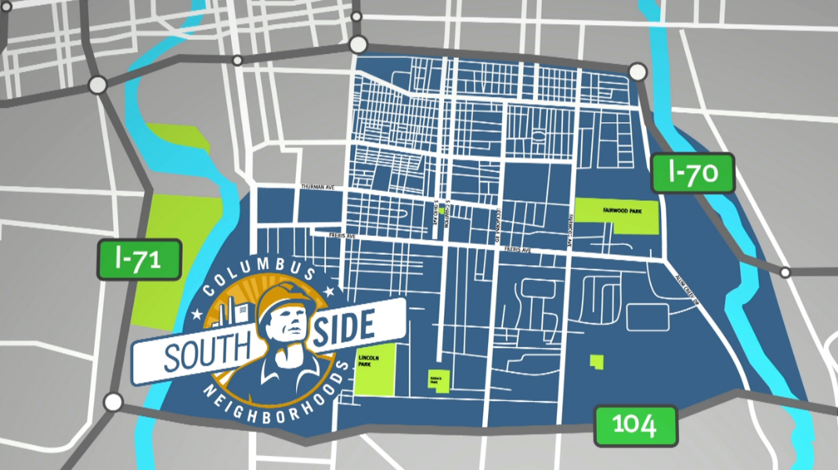
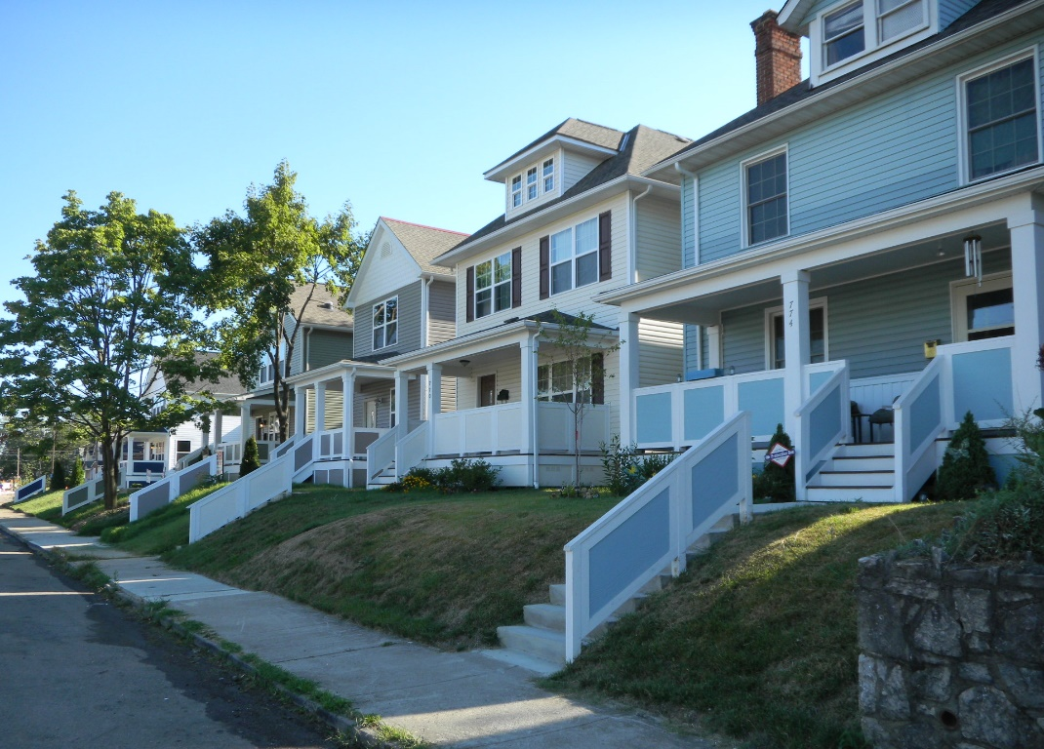
COTA Plus: Southside
Population: 47,656
Jobs: 25,218
Age 65+: 6,755 (14%) Age Under 18: 10,250 (22%)
Zero car HH: 2,372 (12.5%)
Demographics: 46% Black 44% White
Franklin County’s total population 22% Black and 67% White
Prior to the pandemic, 41% South Side residents with full-time, full-year employment (Franklin County: 66%)
The majority of South Side residents with jobs tend to be hourly in nature and have unpredictable work schedules
1 in 5 individuals have little to no confidence that they would be able to pay for next month’s rent or mortgage
Healthy Neighborhoods Healthy Families Realty Collaborative renovated these South Side of Columbus homes. The group intends to place enough housing in the neighborhood into nonprofit ownership to resist displacement. Photo courtesy of Sue Wolfe.

Slide 8
COTA Plus: Why launch?
Southside - disproportionally low-income, community of color
Significant side walk gaps
Workforce access to Rickenbacker & nearby employers
Access to Nationwide Children’s Hospital & childcare
Greater potential for high usage with established COTA riders or familiar with COTA
Community Meetings:
Aug. 18th Southside Thrive meeting, 40 + attendees Aug. 20th REEB Ave Partners meeting, 12 attendees
Sept. 15th Lutheran Social Services, 25 attendees
Sept. 23th CD4P & Reeb Ave, 30 attendees
Sept. 25th Men 4 Movement, 6 attendees
Oct. 7th Parson Ave Merchants Associations, 8 attendees

Slide 9
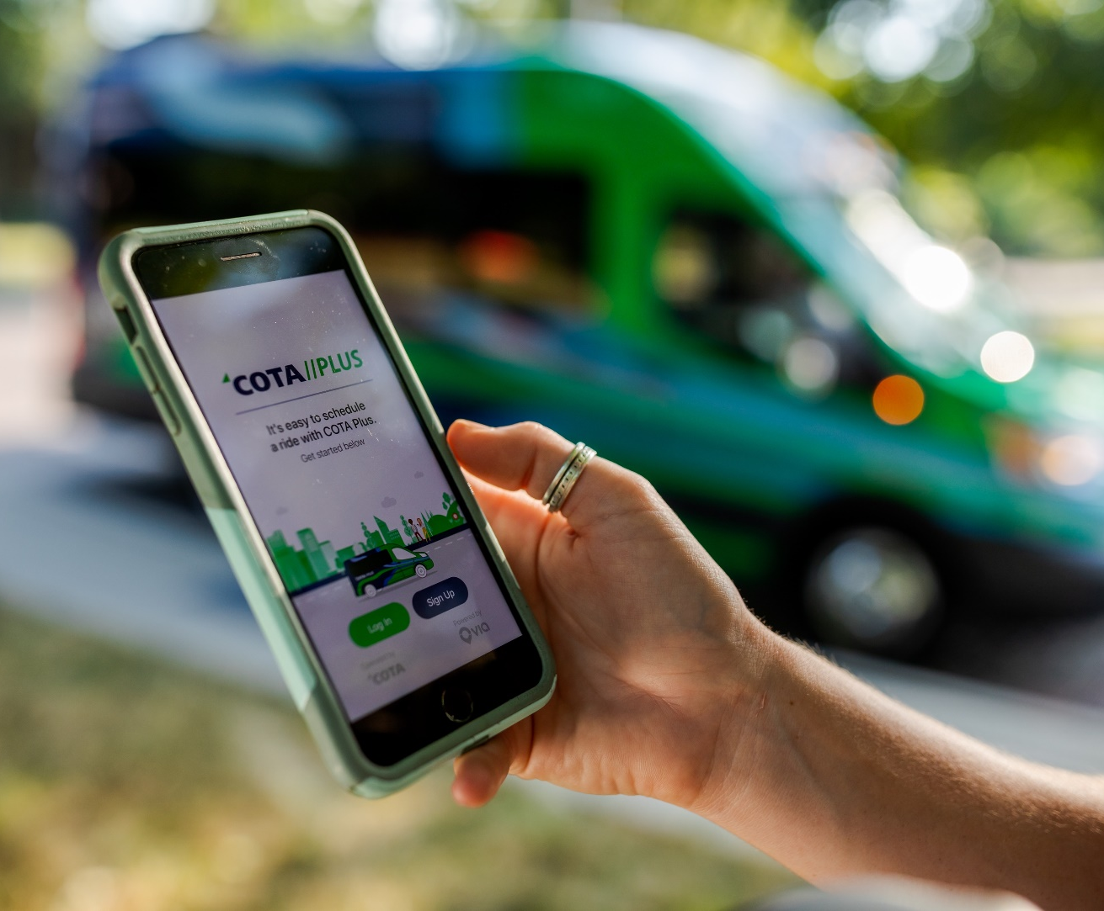
COTA Plus: Service Attributes
Trained customer service representatives available to assist residents establish an account and request a ride
On demand access, no need to pre-schedule
Guaranteed response/service within 15 minutes
Focus on safety and rider satisfaction
Affordable
Improved Access to:
Jobs
Healthcare
School/Internships
Quality of life activities

Slide 10
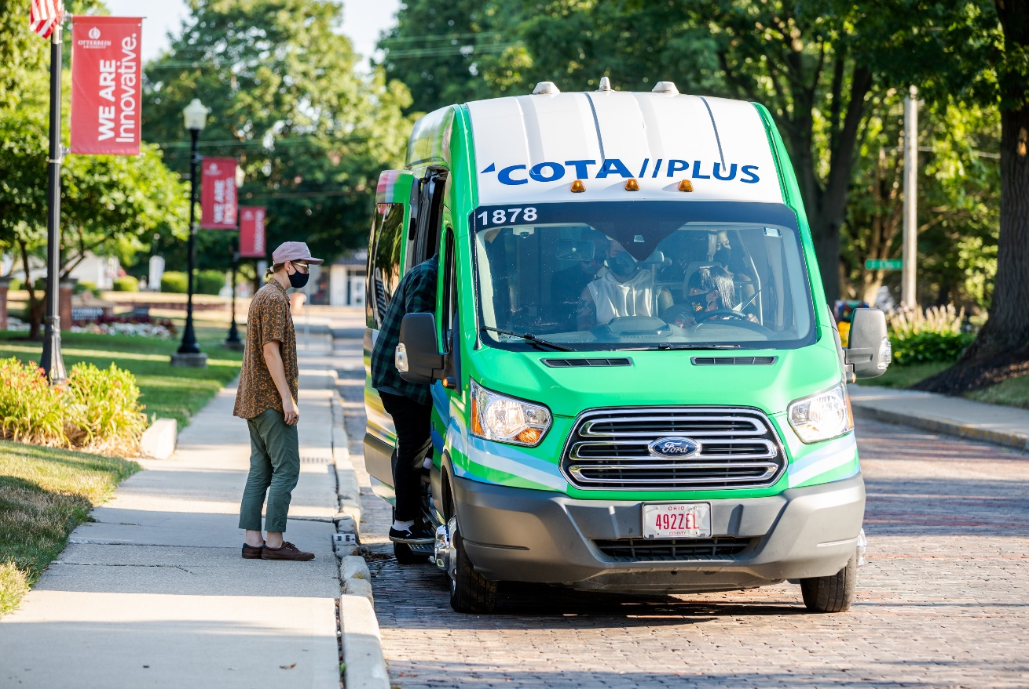
COTA Plus: Service Attributes
Affordable Fare Structure:
Base Fare (one way trip) $3.00/ride
1 Day Pass $6.00/day
5 Day Pass $20.00/week
Connections to/from bus stop No Fare
C-pass No Fare
Students No Fare
Discounts available for seniors (65+), riders
with disabilities, Medicare card holders, and
other qualified riders to just $2.00/ride and
similar reductions for the period passes

Slide 11
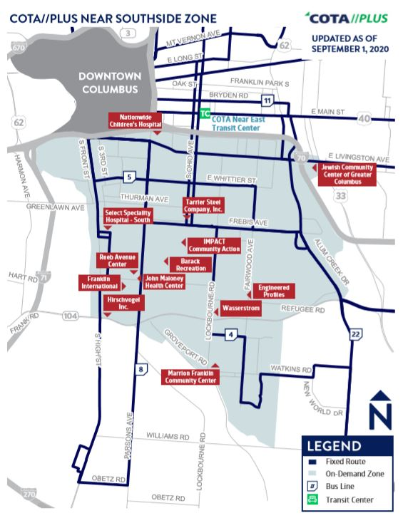
Southside Zone
Hours of operations: Monday-Sunday 5am-8pm
First zone to offer weekend service
First urban launch
Fares are free due to the COVID-19
We will return to fares by 2021
Zone outline
The zone was adjusted based on community input
Most notable: community members wanted access to food, recreation, and entertainment

Slide 12
LinkUS Mobility Corridors Initiative

Slide 13
Foundational Planning
Insight2050
(2014)
NextGen
(2017)
Insight2050 Corridor Concepts
(2019)

Slide 14
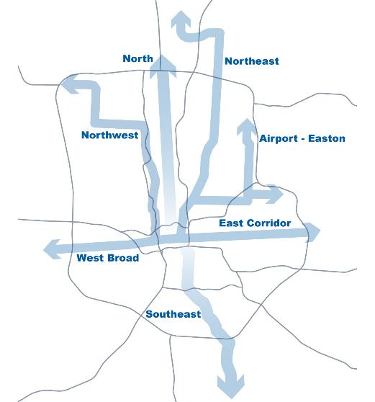
LinkUS is a comprehensive mobility corridors initiative for Central Ohio
LinkUS seeks to provide a complete mobility system along key regional corridors, including high capacity and advanced rapid transit, new transportation technology solutions, bicycle and pedestrian improvements, and new housing and job opportunities.
Principal sponsors:

Slide 15
Mobility corridors – Collaboration:
TEAM WORK
City of Columbus
MORPC
Franklin County
Columbus Partnership
ODOT
State Representatives
FTA
All jurisdictions
Aligned Efforts:
Zoning Code Update
Affordable Housing Strategy
Sustainable Columbus
Economic Development Policies
Annexation and Utility Policies
Vision Zero Columbus

Slide 16
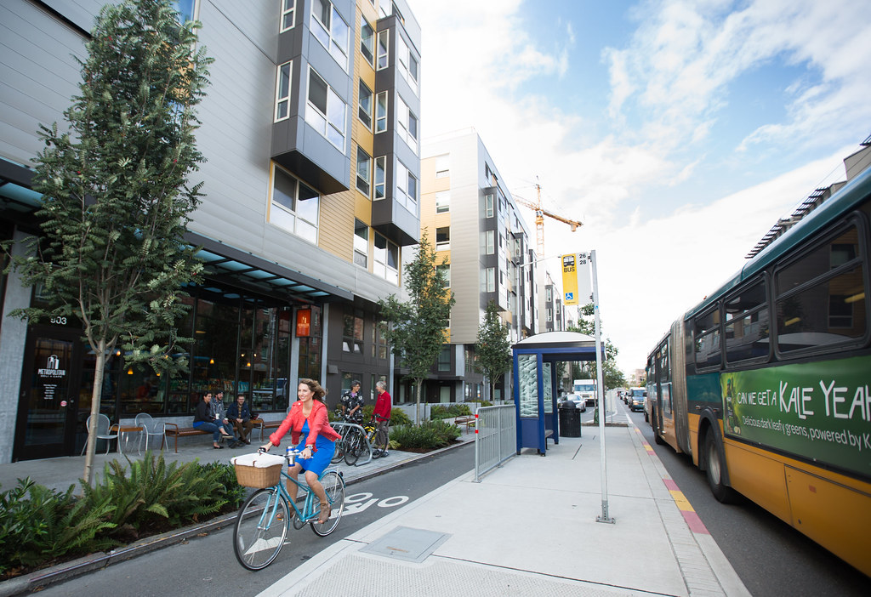
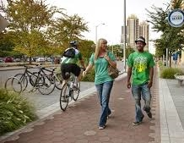
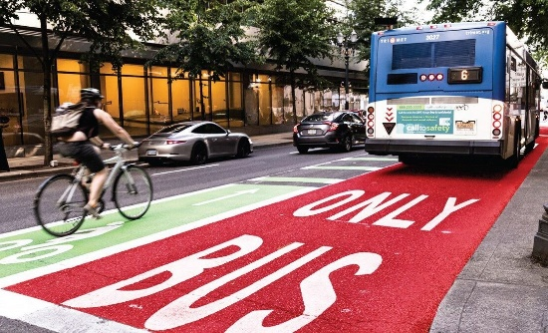
LinkUS will focus on advanced rapid transit . . .
. . . And multimodal infrastructure
Key Features of Premium
Transit
Level & Multi-Door Boarding
Off-Board Fare Collection
Dedicated Right-of-Way
Signal Priority & Intersection Control
Modern Vehicle Designs
Frequency & Capacity
Enhanced Stations
Adaptability
Notes:
But – is not just about transit

Slide 17
The Bigger Picture
LinkUS is about:
Creating Great Places
Increasing equitable access to opportunity
Accommodating future growth in productive ways
Improving Economic Vibrancy
Shaping the future and reimagining the region for shared prosperity

