Slide 1
TRANSPORTATION PLANNING
FOR THE FUTURE OF
CENTRAL OHIO

Slide 2
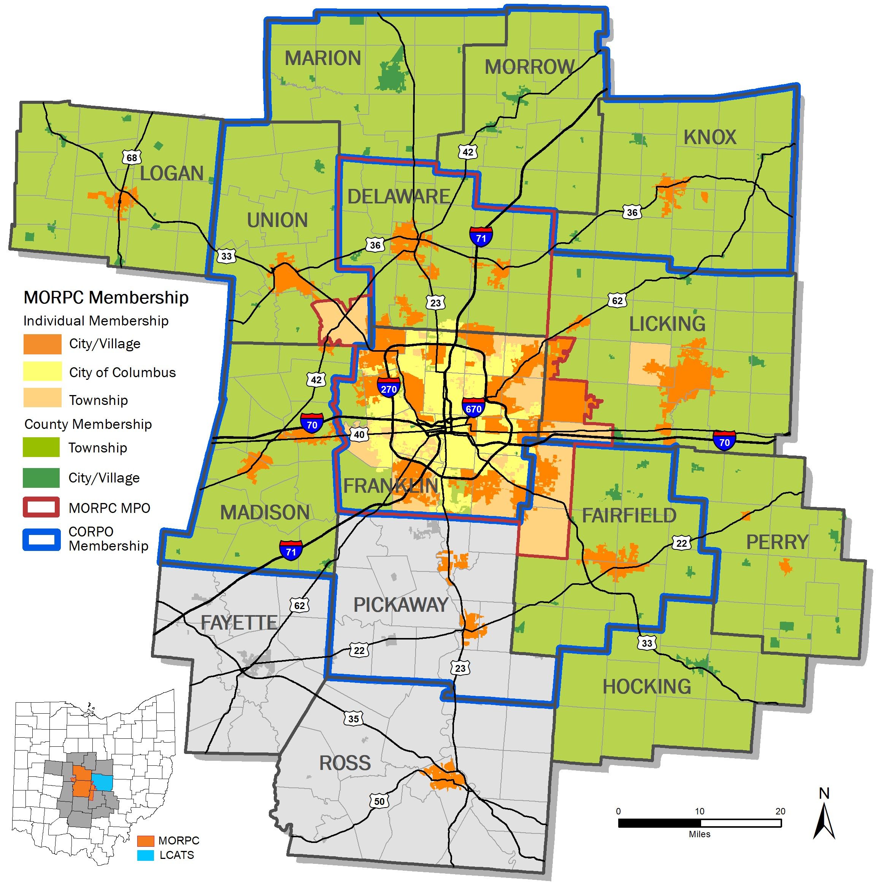
WHO IS MORPC?
MORPC is the regional voice, trusted convener, and catalyst, bringing Central Ohio communities together to collaborate on best practices and plan for the future growth and sustainability of the region.
Regional council for the Central Ohio region, with nearly 2.5 million residents and growing.
Nearly 90 urban, rural, and suburban member communities and organizations
MORPC's Focus Areas
Transportation & Mobility
Direct Service Programs
Community & Economic
Development
Planning & Sustainability
Data & Mapping
Engagement
Public Policy

Slide 3
HOW MORPC WORKS
Commission
MORPC’s board of commissioners determines the strategic direction of the agency.
Local government members appoint elected officials and staff to serve as their representatives to the commission.
Commission
MPO
Transportation Policy Committee
Community Advisory Committee
Transportation Advisory Committee
MORPC-Attributable Funds Committee
Regional Data Advisory Committee
Regional Policy Roundtable
Sustainability Advisory Committee
Central Ohio Rural Planning Organization
Notes:
(Explain top committees).

Slide 4
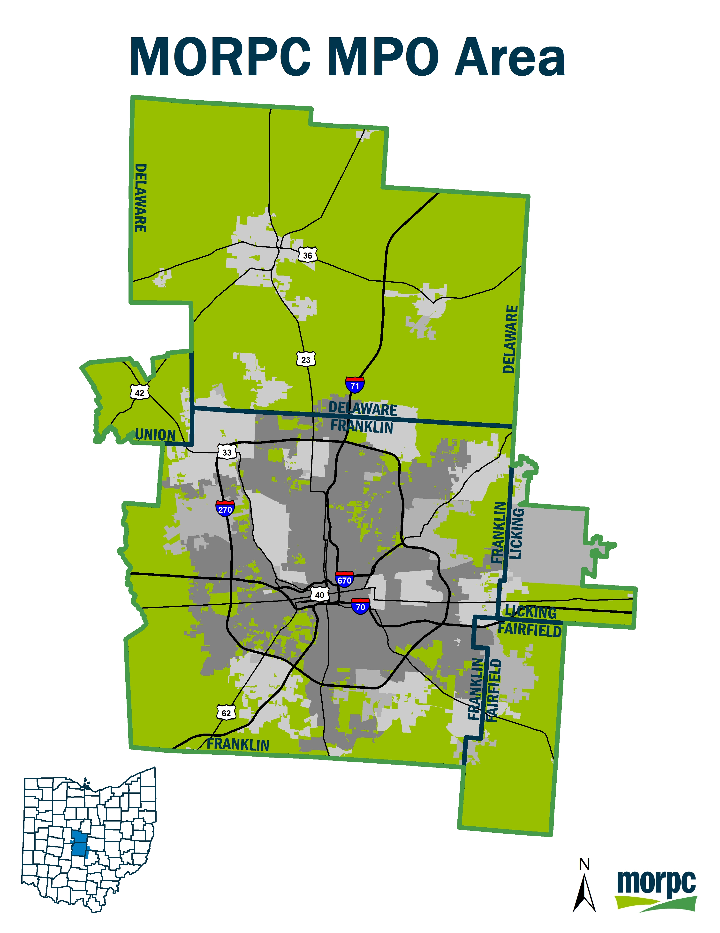
Metropolitan Planning Organization (MPO)
A metropolitan planning organization (MPO)
Federally mandated and federally funded transportation policy-making
Created to ensure regional cooperation in transportation planning
Urbanized areas over 50k per Federal-Aid Highway Act of 1962
Federal funding for transportation projects and programs are channeled through this planning process
Continuing, cooperative, and comprehensive (“3‑C”) planning process
Statewide & MPO transportation planning processes are governed by federal law
(23 U.S.C. §§ 134–135).
Transparency (participation in planning process & electronic publication of plans) required by federal law

Slide 5
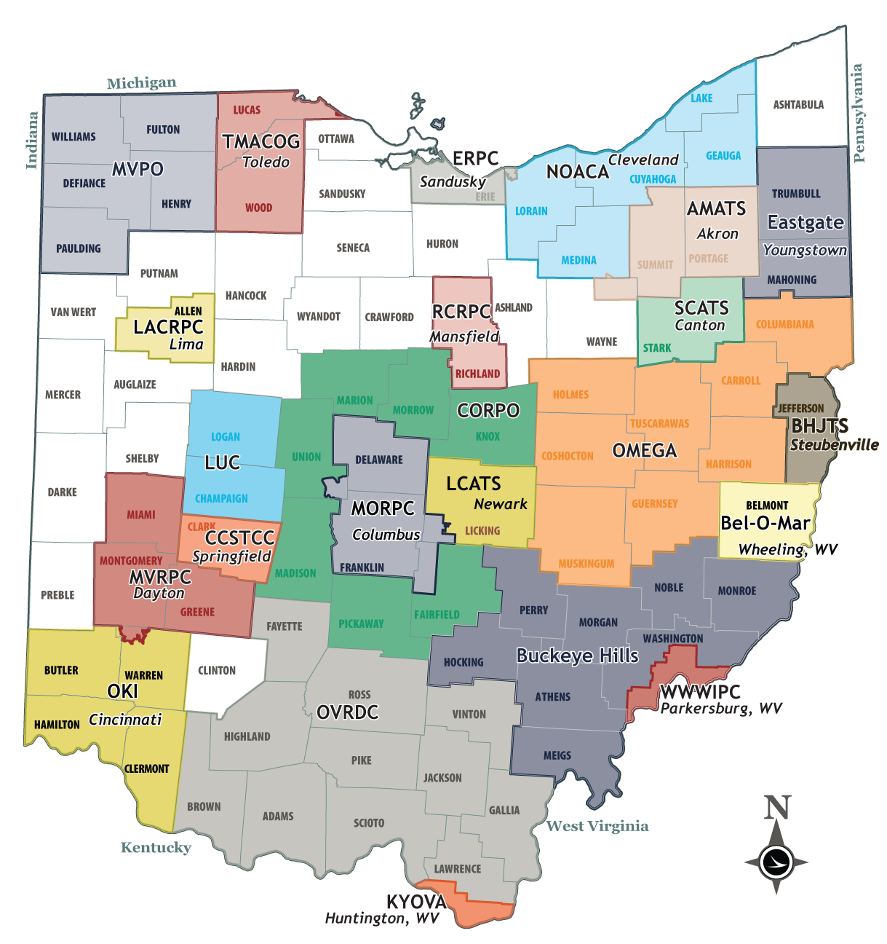
MPOs & RTPOs
State of Ohio
Ohio = $3.3 Billion Annually
ODOT Federal Core =
$1.5 Billion Annually
ODOT State Funds = $1.8 Billion Annually
MPOs Statewide = $291 Million

Slide 6
RURAL TRANSPORTATION PLANNING AREA
Notes:
The MTP includes only the communities within the official Metropolitan Planning Organization boundary (which is based upon the Census urbanized area, and corresponds with the area in which our federal transportation dollars can be spent).
For central Ohio, this includes all of Franklin and Delaware counties, and parts of Union, Licking, and Fairfield.

Slide 7
METROPOLITAN PLANNING AREA
Metropolitan Planning Organization
Required Products
Planning
Work
Program
Transportation Improvement Program
Metropolitan Transportation Plan
Notes:
The MTP includes only the communities within the official Metropolitan Planning Organization boundary (which is based upon the Census urbanized area, and corresponds with the area in which our federal transportation dollars can be spent).
For central Ohio, this includes all of Franklin and Delaware counties, and parts of Union, Licking, and Fairfield.

Slide 8
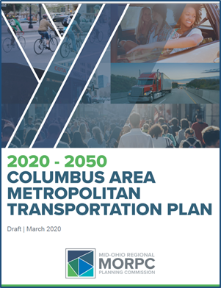
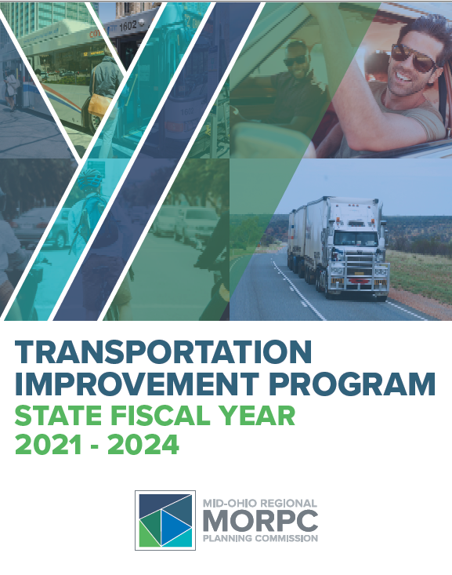
TRANSPORTATION PLANNING PROCESS
Stakeholders
Citizens
Decision Makers
Metropolitan Transportation Plan
Transportation Improvement Program
Projects
Evaluation Metric

Slide 9
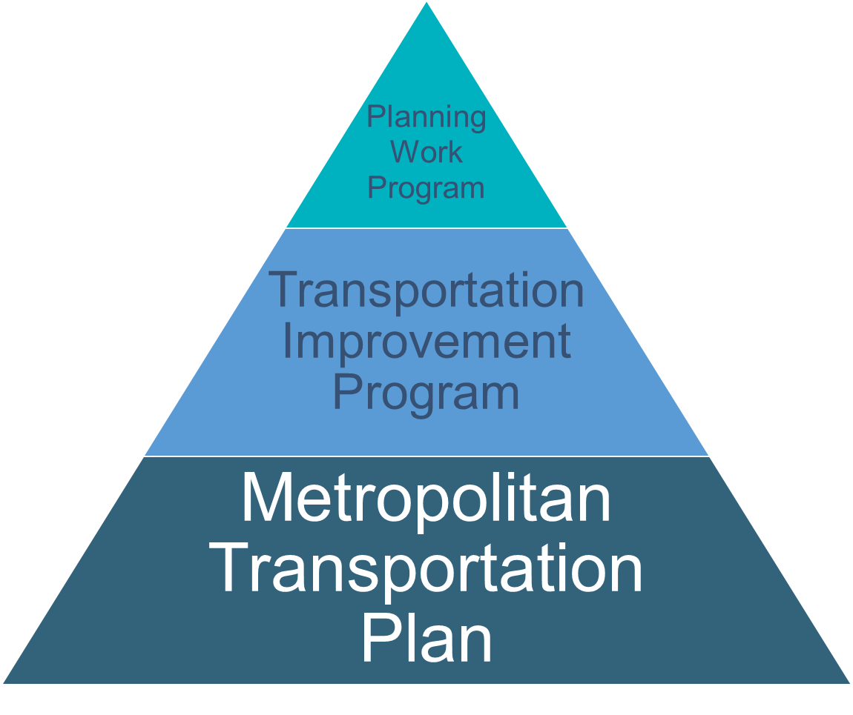

Metropolitan Planning Organization
Required Products
The 2020-2050 Metropolitan Transportation Plan (MTP) establishes a set of regional transportation goals and objectives and recommends strategies—including projects— that will maintain, manage, and develop Central Ohio’s transportation system through 2050.
Notes:
The MTP includes only the communities within the official Metropolitan Planning Organization boundary (which is based upon the Census urbanized area, and corresponds with the area in which our federal transportation dollars can be spent).
For central Ohio, this includes all of Franklin and Delaware counties, and parts of Union, Licking, and Fairfield.

Slide 10






REGIONAL GOALS
REDUCE PER CAPITA ENERGY CONSUMPTION AND PROMOTE ALTERNATIVE FUEL RESOURCES TO INCREASE AFFORDABILITY AND RESILIENCE OF REGIONAL ENERGY SUPPLIES
PROTECT NATURAL RESOURCES AND MITIGATE INFRASTRUCTURE VULNERABILITIES TO MAINTAIN A HEALTHY ECOSYSTEM AND COMMUNITY
POSITION CENTRAL OHIO TO ATTRACT AND RETAIN ECONOMIC OPPORTUNITY TO PROSPER AS A REGION AND COMPETE GLOBALLY
CREATE SUSTAINABLE NEIGHBORHOODS TO IMPROVE RESIDENTS' QUALITY OF LIFE
INCREASE REGIONAL COLLABORATION AND EMPLOY INNOVATIVE TRANSPORTATION SOLUTIONS TO MAXIMIZE THE RETURN ON PUBLIC EXPENDITURES
USE PUBLIC INVESTMENTS TO BENEFIT THE HEALTH, SAFETY, AND WELFARE OF PEOPLE
Notes:
Keeping the growth and changing demographics and transportation demands in mind, a set of goals were established to guidethe development of the plan.
The are broad vision statements covering six topic areas including:
Energy
Natural Resources
Economic Opportunity
Sustainable neighborhoods
Regional collaboration
Health, Safety, and Welfare of people.

Slide 11
INPUT
Local Plans
Data
Public Engagement
Goals, Objectives & Targets
Evaluation Criteria
Fiscal Analysis
Impact Analysis
Regional Strategies
Priority Projects
Documentation
Local Plans
Data
Public Engagement
Goals, Objectives & Targets
Evaluation Criteria
Fiscal Analysis
Impact Analysis
Regional Strategies
Priority Projects
Documentation
PROCESS
OUTPUT
Local Plans
Data
Public Engagement
Goals, Objectives & Targets
Evaluation Criteria
Fiscal Analysis
Impact Analysis
Regional Strategies
Priority Projects
Documentation
Notes:
This shows a general overview of the process MORPC staff works through with our advisory committees to develop the MTP, and represents about 2 years worth of work.
We use local plans and data, do extensive public engagement to develop goals and objectives to base the plan upon, and to identify candidate projects to potentially include.
We then evaluate candidate projects using a set of criteria that helps identify which projects will best help advance the goals and objectives, and we also consider the project costs and environmental impacts.
The final product is a document detailing a set of regional strategies and priority transportation projects for regional and local partners to work on together.
This is the region’s plan, not just MORPC’s plan.

Slide 12
FISCAL ANALYSIS – RESOURCES
Federal – generally controlled through ODOT or MORPC program
State – ODOT programs, Ohio Public Works Commission, or County Engineers Association of Ohio
Local agency or private
Assumes modest growth of current funding levels with some new funding in the region
Notes:
The draft fiscal analysis forecasts about $30 billion dollars to be available for transportation investment through 2050.
The pie chart shows how the proposed breakdown of how that money will be spent
The largest category is on transit
This includes 5 high capacity transit projects, which as of now, are consistent with the 5 corridors identified in MORPC’s Corridor Concepts study
The transit category also includes the expansion of COTA and Delaware County Transit servces
And replacement vehicles and other capital expenses
For a total of about $13 billion in regional transit investments
The next larget category of expenditure is Management and Operations, at about 47.8 billion
This includes a handful of access management and one-way conversion projects
As well as the physical preservation and maintenance of facilities
And Intelligent Transportation Systems and other management tools
Freeway System projects are another significant category, with about $3.6 billion in investment in 51 different projects.
These are the most expensive project types
Compared to the Stand-along Bike and pedestrian projects, which make up a much smaller slice of the forecasted investment at about $830 million, but that includes 218 specific projects
Same goes for intersection projects, at $300 million for 152 projects.
The non-freeway projects consist of:
major widenings (adding a lane in each direction)
Minor widenings (adding turn lanes)
New Roadway connections
These all assume appropriate bike and pedestrian facilities will be included as part of the roadway project.
Minor

Slide 13
FISCAL ANALYSIS –
EXPENDITURES
Maintain and manage existing system
Expand the system
Total: $29.6 billion
*cost includes activities in addition to specific projects
Notes:
The draft fiscal analysis forecasts about $30 billion dollars to be available for transportation investment through 2050.
The pie chart shows how the proposed breakdown of how that money will be spent
The largest category is on transit
This includes 5 high capacity transit projects, which as of now, are consistent with the 5 corridors identified in MORPC’s Corridor Concepts study
The transit category also includes the expansion of COTA and Delaware County Transit servces
And replacement vehicles and other capital expenses
For a total of about $13 billion in regional transit investments
The next larget category of expenditure is Management and Operations, at about 47.8 billion
This includes a handful of access management and one-way conversion projects
As well as the physical preservation and maintenance of facilities
And Intelligent Transportation Systems and other management tools
Freeway System projects are another significant category, with about $3.6 billion in investment in 51 different projects.
These are the most expensive project types
Compared to the Stand-along Bike and pedestrian projects, which make up a much smaller slice of the forecasted investment at about $830 million, but that includes 218 specific projects
Same goes for intersection projects, at $300 million for 152 projects.
The non-freeway projects consist of:
major widenings (adding a lane in each direction)
Minor widenings (adding turn lanes)
New Roadway connections
These all assume appropriate bike and pedestrian facilities will be included as part of the roadway project.
Minor

Slide 14
SYSTEM DEVELOPMENT
Transit - $12.4 billion
  Five high-capacity transit projects covering 36 miles
  Maintain and expand COTA and DCT service
  Replacement vehicles and other capital expenses
Bicycle & Pedestrian - $830 million
  415 miles of stand-alone bike and/or pedestrian facilities
Freeways - $3.4 billion
  26 miles of freeways widened
  17 miles of four-lane divided roadways converted to freeways
  42 miles with lane management along freeways
  25 interchange modifications
  6 new interchanges
  Non-Freeway Roadways - $4 billion
  98 miles of new roadway connections
  81 miles with through lane additions
  120 miles with minor widening/safety improvements
  149 intersection modifications
Notes:
The draft list of strategies is now available for public comment and review.
Identified 65 individual strategies or action items to advance the regional goals and objectives.
System Management strategies address the existing transportation system and managing the existing assets efficiently and safely.
System Development strategies pertain to developing and expanding modal networks and systems.

Slide 15
Planning
Work
Program
Transportation Improvement Program
Metropolitan Transportation Plan
Metropolitan Planning Organization
Required Products
Through our Transportation Improvement Program (TIP), residents and communities can see what transportation projects in their area are receiving funding during the next four years.
It includes:
Listing of the projects and programs
Specific funding sources we have committed to each
All projects receiving federal funding
Prioritizes the actions for performance targets established in the MTP
Notes:
The MTP includes only the communities within the official Metropolitan Planning Organization boundary (which is based upon the Census urbanized area, and corresponds with the area in which our federal transportation dollars can be spent).
For central Ohio, this includes all of Franklin and Delaware counties, and parts of Union, Licking, and Fairfield.

Slide 16
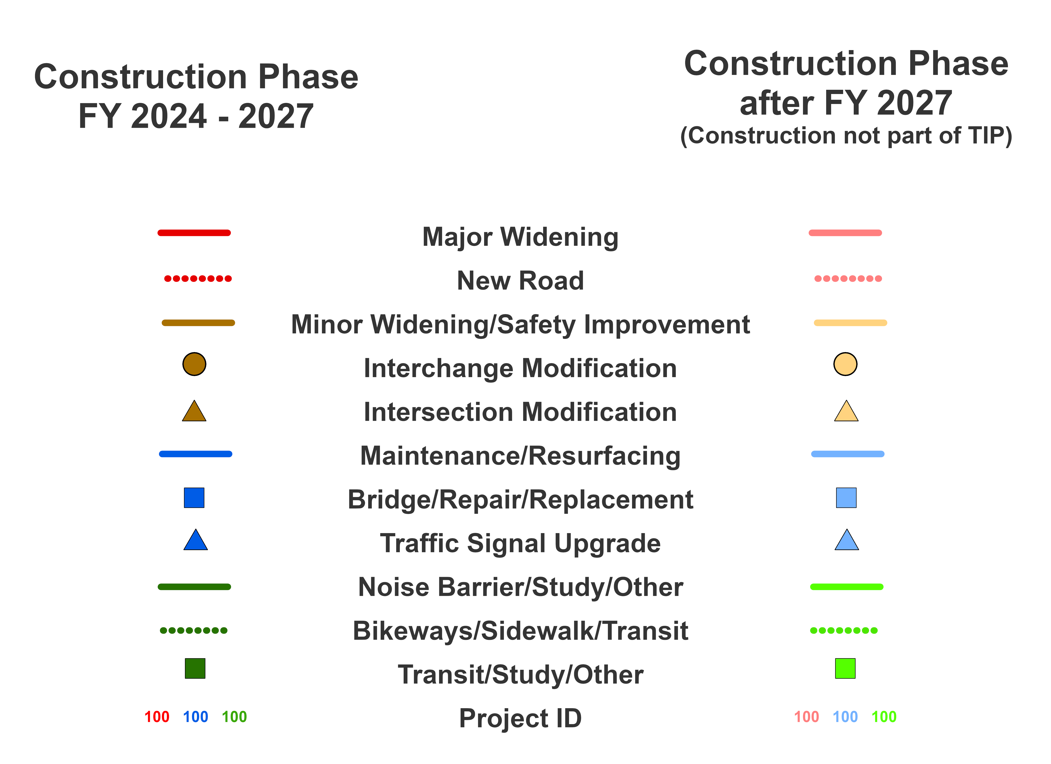
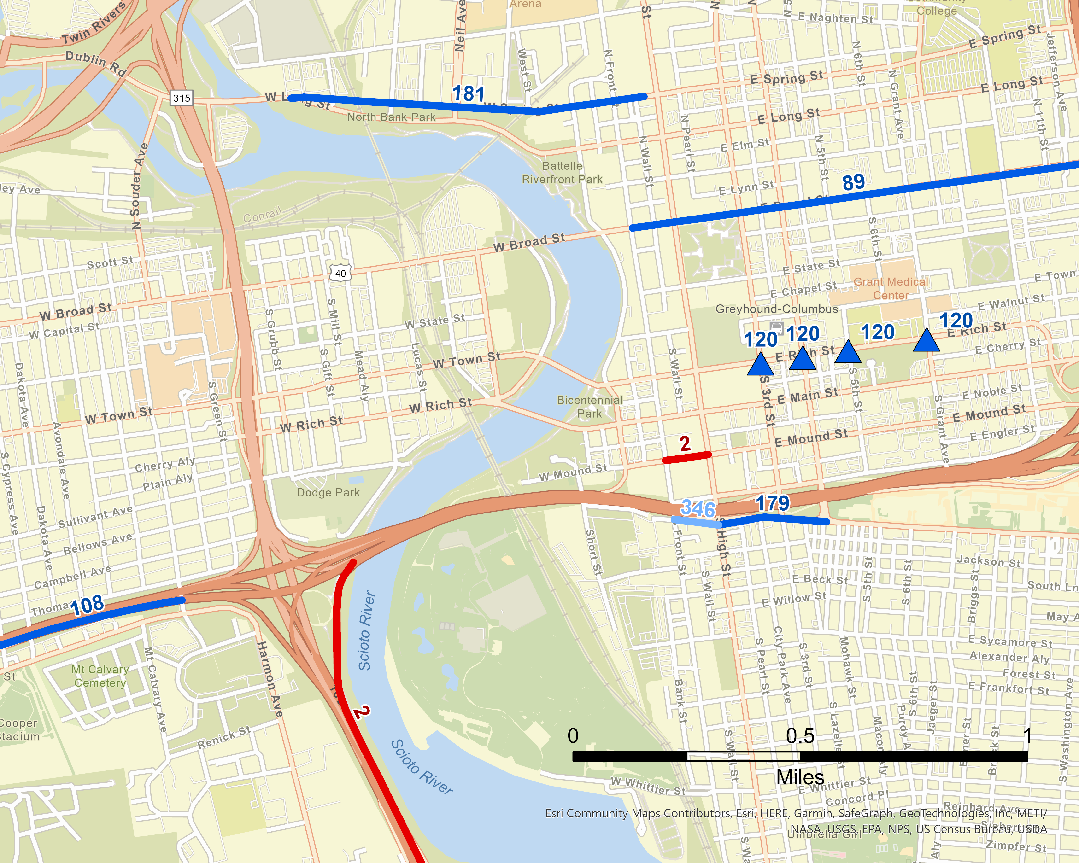
TIP PROJECT MAP

Slide 17
TIP CONTENTS
Description of TIP process & public participation
Project selection process
Progress toward performance targets
Analysis of impacts
  Air quality
  Disadvantaged populations
Detailed listing of projects
  Individual projects
  Grouped projects
Status of projects from previous TIP

Slide 18
TIP BY THE NUMBERS
$2.7B
4 Year Total
$850M
Federal
$225M
State
Transit
$212M
$1.2B
MORPC (federal)
Notes:
The MTP includes only the communities within the official Metropolitan Planning Organization boundary (which is based upon the Census urbanized area, and corresponds with the area in which our federal transportation dollars can be spent).
For central Ohio, this includes all of Franklin and Delaware counties, and parts of Union, Licking, and Fairfield.

Slide 19
TIP BY THE NUMBERS
$2.7B
4 Year Total
$850M
Federal
$225M
State
Transit
$212M
$1.2B
MORPC (federal)
Notes:
The MTP includes only the communities within the official Metropolitan Planning Organization boundary (which is based upon the Census urbanized area, and corresponds with the area in which our federal transportation dollars can be spent).
For central Ohio, this includes all of Franklin and Delaware counties, and parts of Union, Licking, and Fairfield.

Slide 20
MTP VS. TIP
MTP | vs. |  |  | TIP
Both part of the continuing, cooperative, & comprehensive (3-C) planning process
Sets transportation goals & policies through 2050 |  |  | Identifies specific projects & activities in each year through 2027
Estimates available resources through 2050 |  |  | Identifies specific funding sources committed to each project & activity
Identifies desired changes to the system (projects) within available resources |  |  | Projects must be in the MTP
Updated entirely every 4 years, rarely amended |  |  | Updated entirely every 2 years, amended quarterly or more often

Slide 21
REVISING THE TIP
Applies to individual projects
Amendments
  Major changes to scope or funding amount
  Add or delete projects
  Affects fiscal balance or air quality analysis
  Approved by resolution
Administrative Modifications
  Minor changes to scope or funding amount
  Split or combine projects
  Change of fiscal year
  Approved by MORPC staff

Slide 22
PERFORMANCE MONITORING
https://www.morpc.org/wordpress/wp-content/uploads/2019/07/Report-Card-Digital-2019.pdf

Slide 23
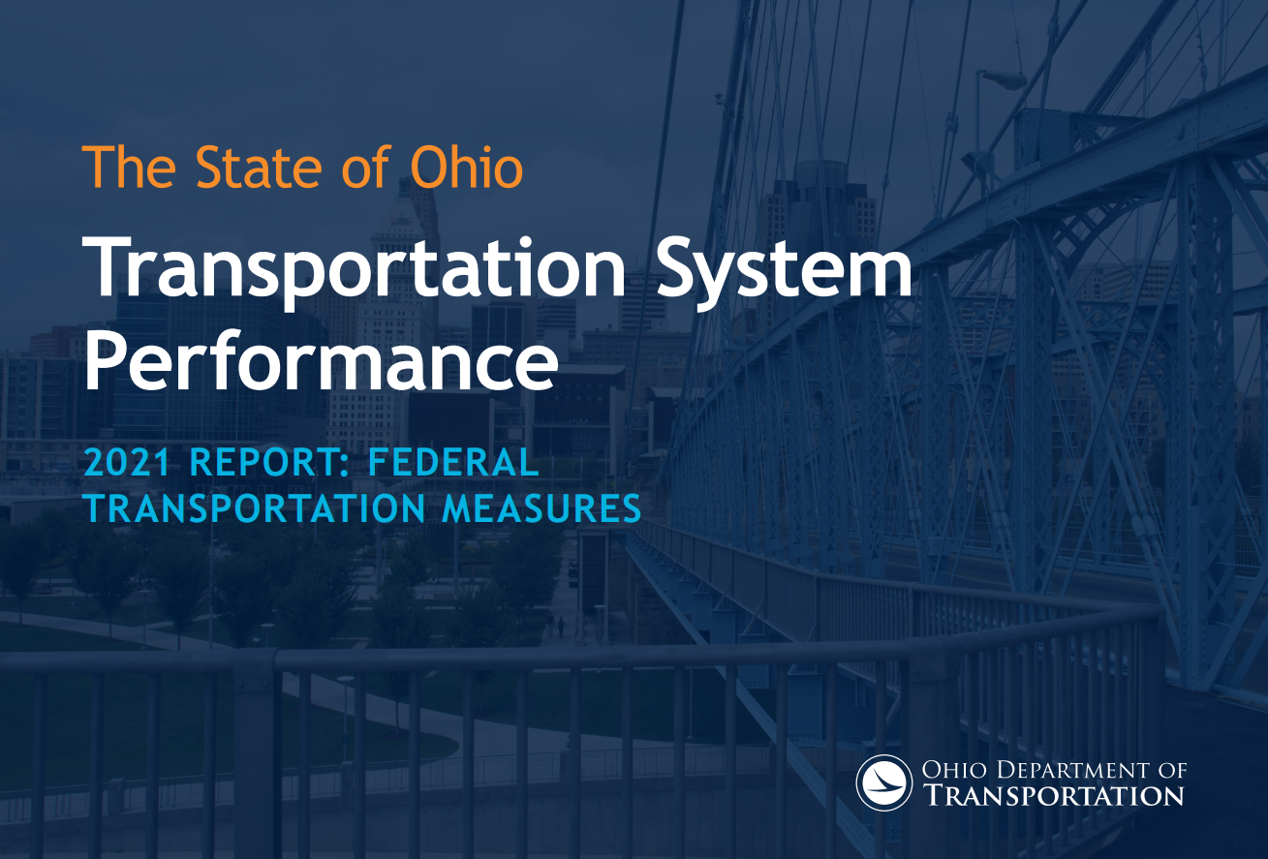
MORPC
PERFORMANCE MONITORING
https://www.transportation.ohio.gov/wps/wcm/connect/gov/4e742895-2ccf-46d7-a5f4-d10598dc91da/2021+TSPR+Federal+Only+-+Final+Draft+11-18-21.pdf?MOD=AJPERES&CONVERT_TO=url&CACHEID=ROOTWORKSPACE.Z18_M1HGGIK0N0JO00QO9DDDDM3000-4e742895-2ccf-46d7-a5f4-d10598dc91da-nROo7DJ
https://www.morpc.org/wordpress/wp-content/uploads/2019/07/Report-Card-Digital-2019.pdf

Slide 24
Metropolitan Planning Organization
Required Products
Planning
Work
Program
Transportation Improvement Program
Metropolitan Transportation Plan
The Planning Work Program (PWP) describes the transportation planning, projects and studies we conduct during the state fiscal year running from July 1 through June 30. It is one of three major planning documents mandated by the federal government for metropolitan planning organizations.
Notes:
The MTP includes only the communities within the official Metropolitan Planning Organization boundary (which is based upon the Census urbanized area, and corresponds with the area in which our federal transportation dollars can be spent).
For central Ohio, this includes all of Franklin and Delaware counties, and parts of Union, Licking, and Fairfield.

Slide 25
PLANNING WORK PROGRAM
FORMULA FUNDED ACTIVITIES $3.5M
  Active Transportation Planning
  Safety
  Traffic Forecasting & Modeling
  Transportation Improvement Program (TIP)
  Metropolitan Transportation Plan (MTP)
SPECIAL STUDIES $1.5M
  LinkUS
  Greenways Wayfinding
  Technical Assistance
RIDESHARE/ AIR QUALITY $1.2M
  Gohio
  Air Quality Alerts & More

Slide 26
LET’S TALK ABOUT
FEDERAL FUNDING….

Slide 27
Intermodal Transportation Authorization Bills
Intermodal Surface Transportation Efficiency Act (ISTEA)
1991
Transportation Equity Act for the 21st Century (TEA-21)
1998
Safe, Accountable, Flexible, Efficient Transportation Equity Act: A Legacy for Users (SAFETEA-LU) 2005
Moving Ahead for Progress in the 21st Century Act, (MAP-21)
2012
Fixing America’s Surface Transportation Act (FAST-Act)
2015
Infrastructure Investment and Jobs Act (IIJA) [also referred to as Bipartisan Infrastructure Law (BIL)]
2021

Slide 28
The Infrastructure Investment and Jobs Act (IIJA)
$ 660 Billion
  FFY2022 – FFY2026
New programs
New federal competitive programs

Slide 29
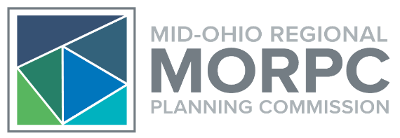
NICK GILL, PE
Transportation Director
Mid-Ohio Regional Planning Commission
T: 614.233.4151
ngill@morpc.org
111 Liberty Street, Suite 100
Columbus, OH 43215

