Slide 1

Air Quality Update
CAC/TAC
February 4th/6th, 2018

Slide 2
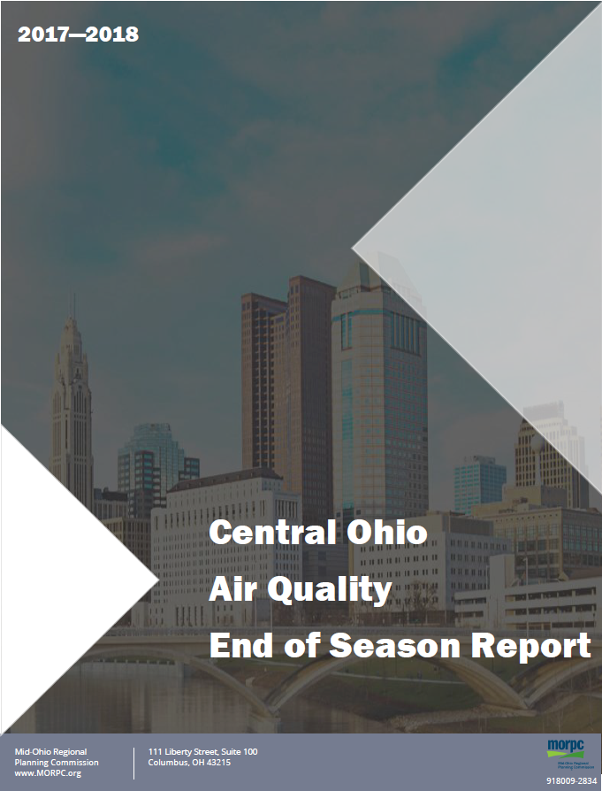
Notes:
The annual air quality monitoring end of season report will be released on Monday, December 17th and available on MORPC’s air quality webpage.
This is a report we release every year providing an overview of what air quality was like over the past year for both ozone and particle pollution.
It compares this years air quality with other recent years as well as looking at trends over the last few decades and comparing Columbus to other Midwestern metropolitan regions.

Slide 3

Fine Particle Pollution
Ozone pollution levels continue downward trend
Notes:
Particulate matter pollution levels were maintained below the National Standards
Slight increase in number of days with moderate instead of good air quality from last year: 11% (2018) vs. 7% (2017)
Days with highest pm levels were due to wildfire smoke transported here from outside of Ohio

Slide 4

Ozone Pollution
Notes:
Regional ozone levels continued to improve in Central Ohio during 2018 summer ozone season
This is due in large part to the very rainy year that we’ve had, especially in the summer, despite higher than average temperatures for the year
There were 3 exceedances of the National standards for ozone pollution
The number of good days increased for ozone: 81% (2018) vs 68% (2017)
This means that the design value is now 69 ppb which means Central Ohio is meeting the current federal ozone standard (70 ppb). Within the last year we had been designated as non-attainment, but now Ohio EPA will request redesignation of the region to attainment status and will submit a maintenance plan to US EPA. Draft documentation will be released for public comment prior to submission to US EPA.

Slide 5
Average: 30 days per year
Average: 30 days per year
Average: 37 days per year
Average: 31 days per year
Notes:
For past 26 years, ozone levels have generally declined in Central Ohio.
Year to year ups and downs reflect patterns in annual weather (hotter/cooler year, rainier/drier year)
We see this trend across Midwestern metropolitan regions

Slide 6
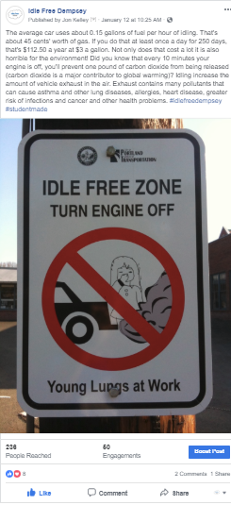
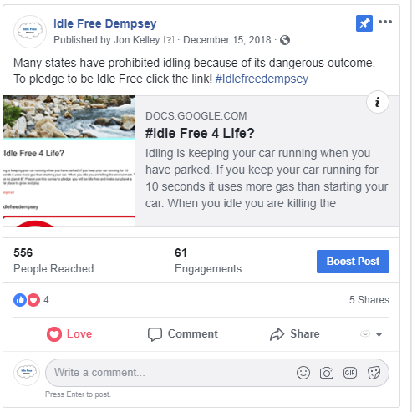

Slide 7

Brooke White
Air Quality Program Coordinator
bwhite@morpc.org
Phone: 614.233.4168
111 Liberty Street, Suite 100
Columbus, Ohio 43215
www.morpc.org

