Slide 1
Midwest Connect Hyperloop Feasibility Study
MORPC Community Advisory Committee
February 3, 2020

Slide 2
PURPOSE
For information only
Recap Rapid Speed Transportation Initiative (RSTI)
Share updates and study findings
Discuss next steps
Notes:
Tonight we’re here to….

Slide 3
WHAT IS RSTI?
Notes:
First – let me recap what the Rapid Speed Transportation Initiative is.

Slide 4
ABOUT RSTI
$2.5-million studies of rapid-speed technology options (traditional rail and hyperloop)
Chicago-Columbus-Pittsburgh Corridor
Two initial phases:
Hyperloop Feasibility Study
Components of Tier 1 EIS

Slide 5
RSTI: TWO MODAL OPTIONS
Passenger rail
Conduct preliminary environmental analysis
Identify route & station alternatives
Minimize impacts & costs
Hyperloop
Determine feasibility of new technology; leverage rail environmental analysis
Identify routes & station alternatives
Minimize impacts & costs
Explore freight & economic impacts
Notes:
So the RSTI initiative is looking at two modal options: passenger rail and hyperloop.
Passenger rail (see slide)
And hyperloop (see slide)

Slide 6
HYPERLOOP FEASIBILITY STUDY
Task 1 – Visioning and Technology Application
Task 2 – Route Planning
Task 3 – Transportation Demand and Economic Benefit Analysis
Task 4 – Regulatory Framework and Implementation Strategy
Project Management, Stakeholder, and Public Engagement
Consultant selected:
AECOM

Slide 7
COMPONENTS OF A TIER I EIS
Task 1 – Project Management
Task 2 – Preliminary Data Collection
Task 3 – Purpose and Need Statement
Task 4 – Route Alternatives
Task 5 – Service Alternatives
Task 6 – Infrastructure Investments
Task 7 – Public Involvement
Consultant selected:
WSP USA, Inc

Slide 8
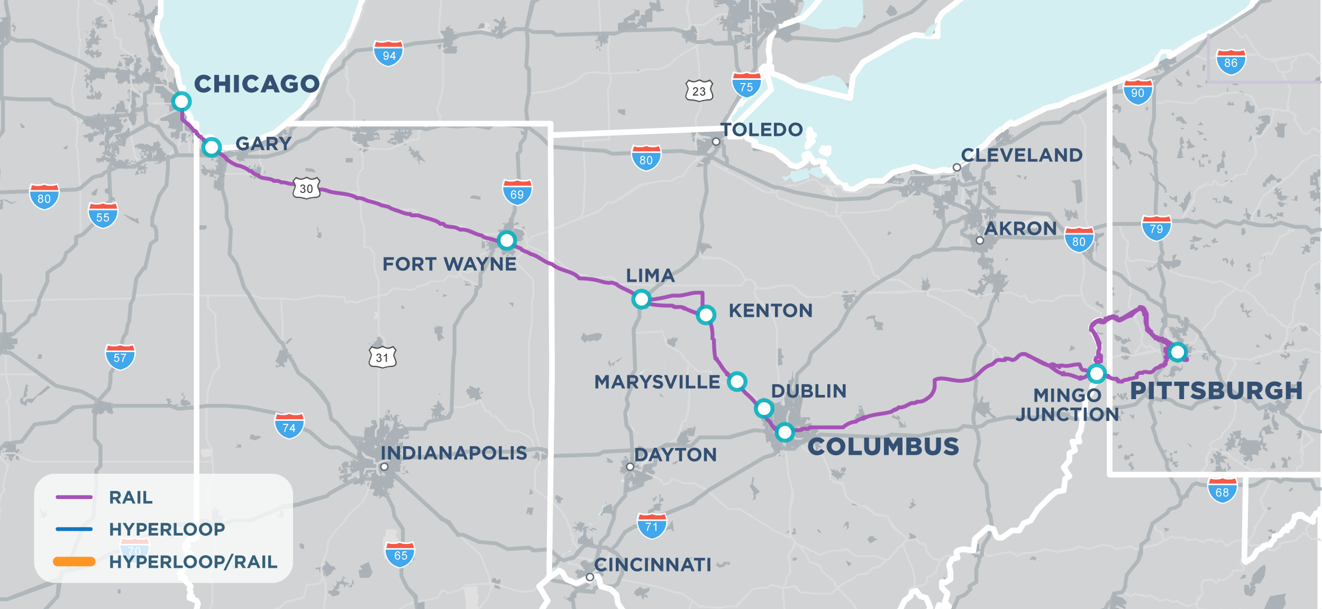
RAPID SPEED TRANSPORTATION

Slide 9
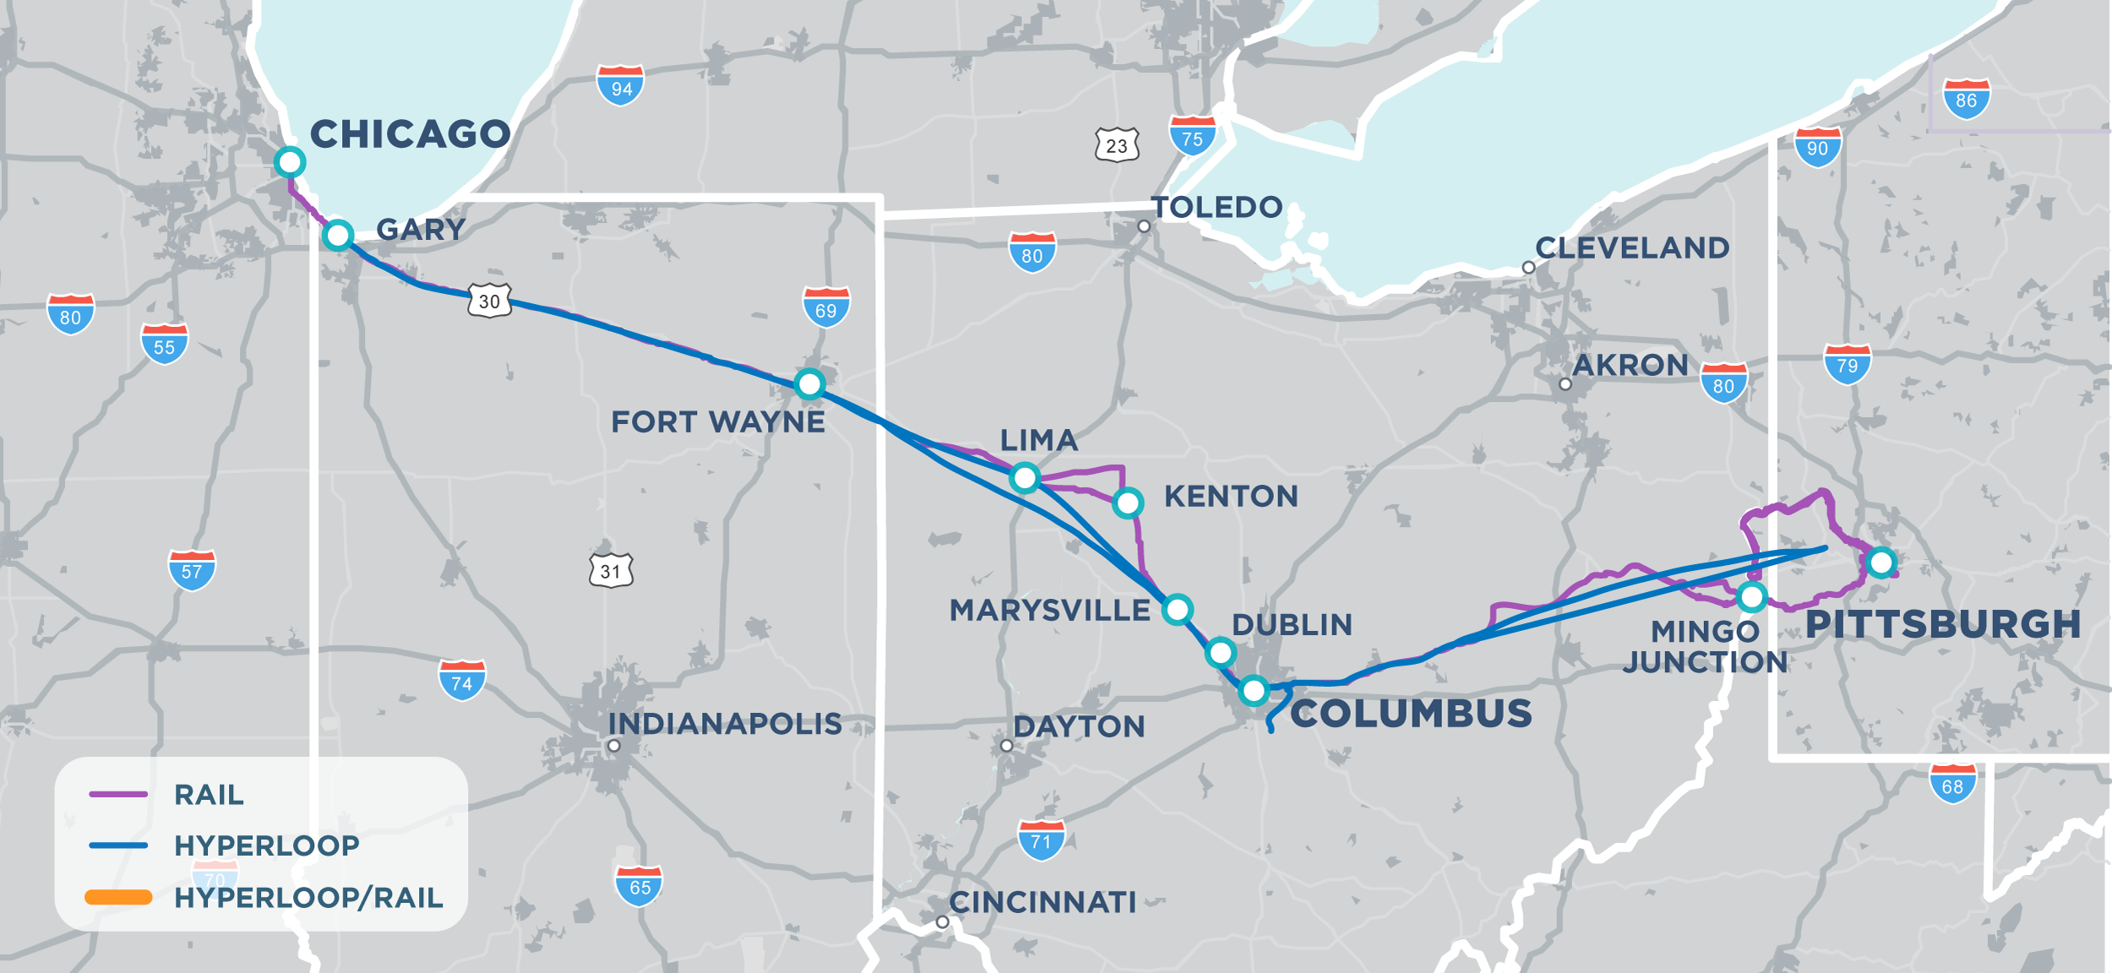
RAPID SPEED TRANSPORTATION
Notes:
So what is the Rapid Speed Transportation Initiative? It’s a look at how to introduce high speed connections between Chicago, Columbus and Pittsburgh.

Slide 10
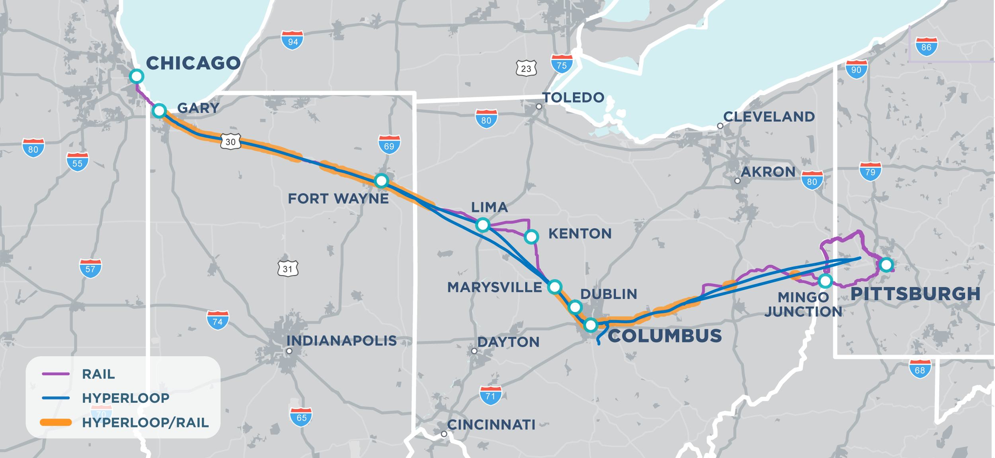
RAPID SPEED TRANSPORTATION
Notes:
So what is the Rapid Speed Transportation Initiative? It’s a look at how to introduce high speed connections between Chicago, Columbus and Pittsburgh.

Slide 11
ROUTE ALTERNATIVES

Slide 12
Route Screening Criteria
For Hyperloop and Rail
Route circuity
Corridor communities & land use
Environmental constraints
Comparative cost
Engineering complexity
Right-of-way and railroad ownership
Right of way width and availability
Number of bridge, underpass, or tunnel structures
For Rail Only
Track class/speed
Track ownership
Train volumes
Track capacity
Number of at-grade crossings
Signaling
Notes:
FOR both modes we considered these route screening criteria to determine the most viable routes. Hyperloop had a few more criteria because of its engineering complexity.
Howard – Please emphasize engineering complexity as a high ranking criteria for the hyperloop project

Slide 13
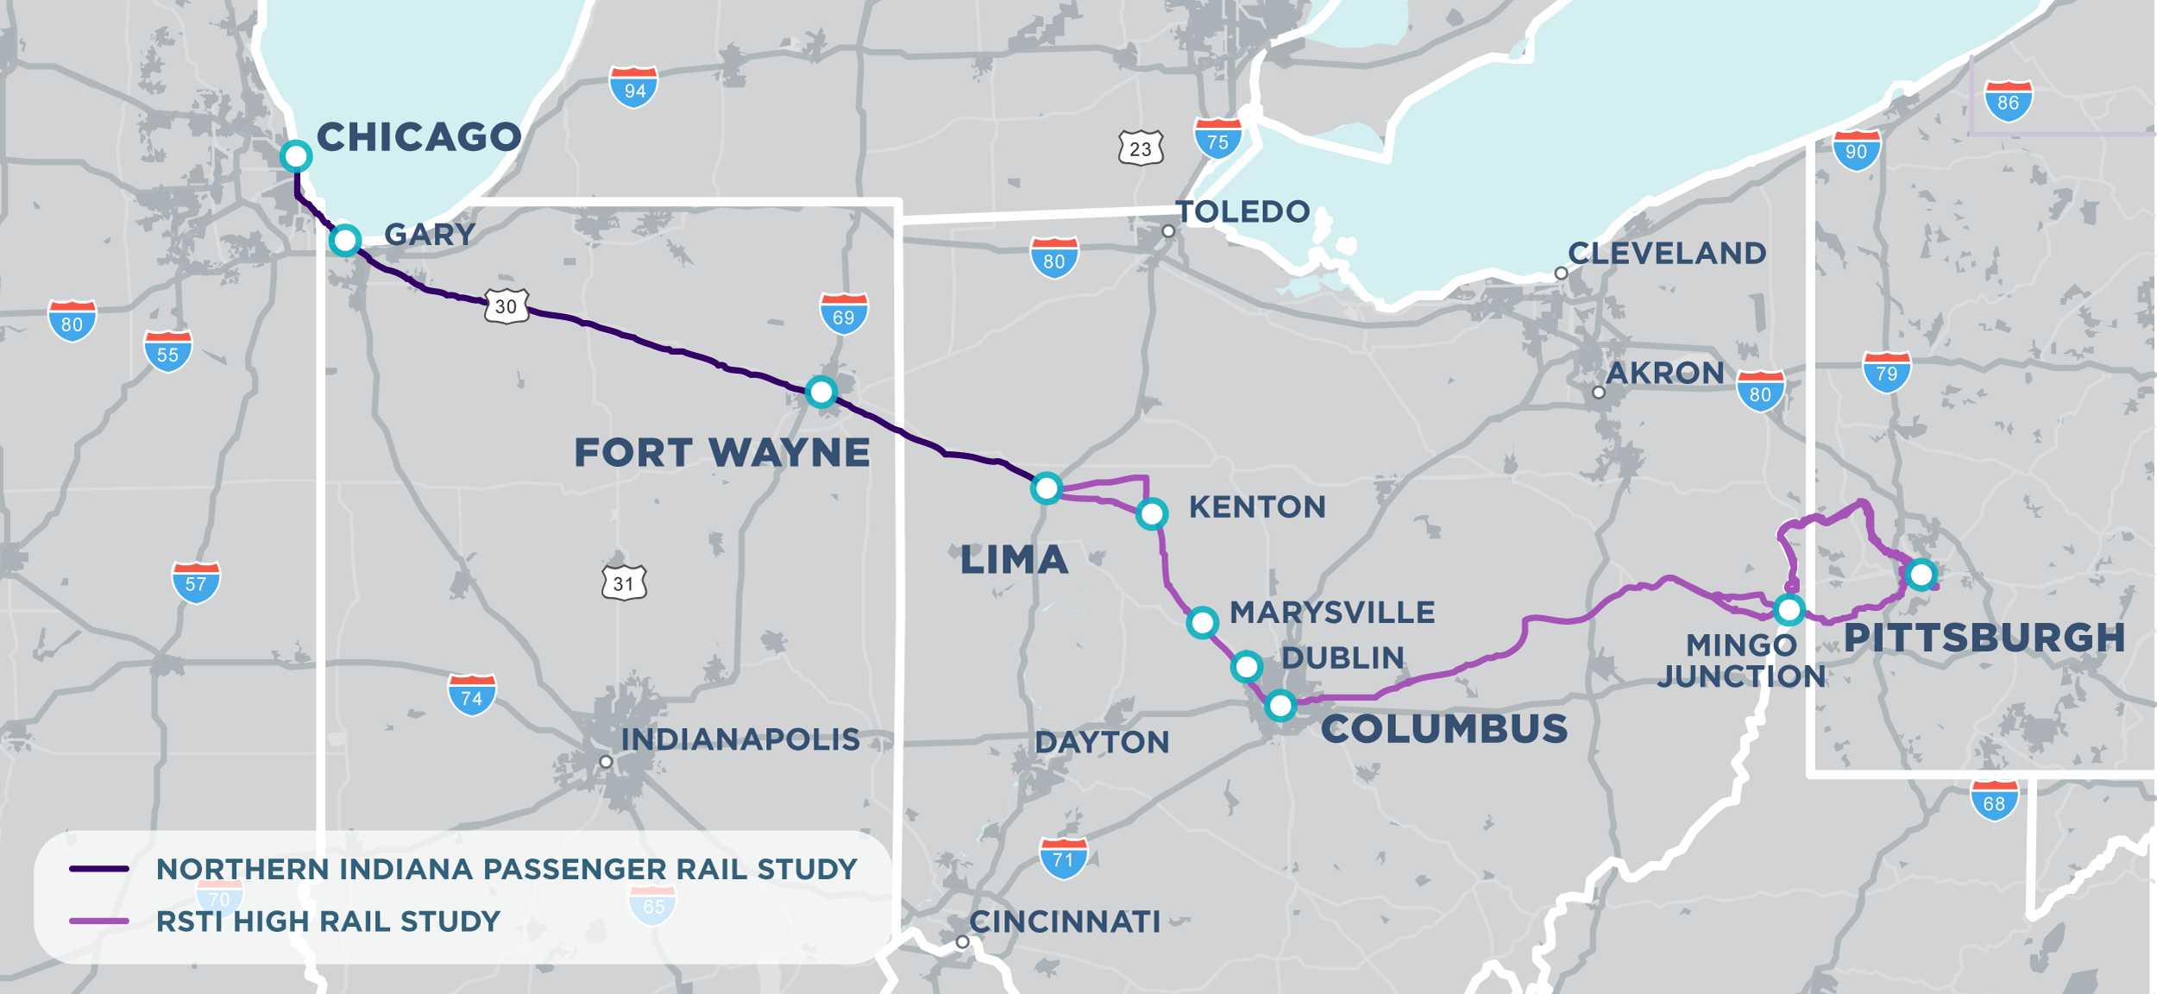
route ALTERNATIVES
Notes:
Recall the route screening criteria I mentioned earlier. Here are the most promising route alternatives for passenger rail.

Slide 14
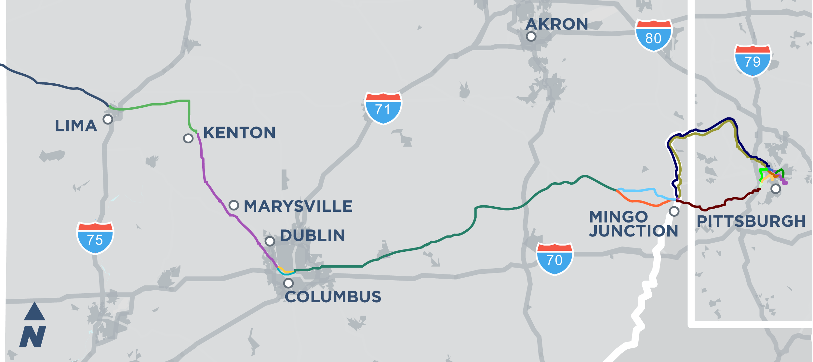
route ALTERNATIVES
Notes:
The RSTI study identified 15 potential corridor segments from Lima to Pittsburgh, some of which are options, like the north and south corridors through Columbus.

Slide 15
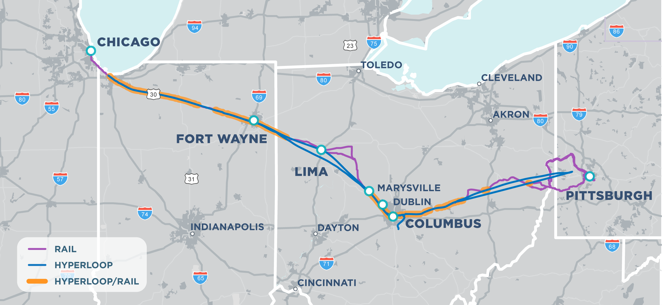
route ALTERNATIVES
Notes:
NOTE: The community insert maps show more than one potential location for a station. We need to make this more clear in the public information – that we have not narrowed down station location at this phase of the project.

Slide 16
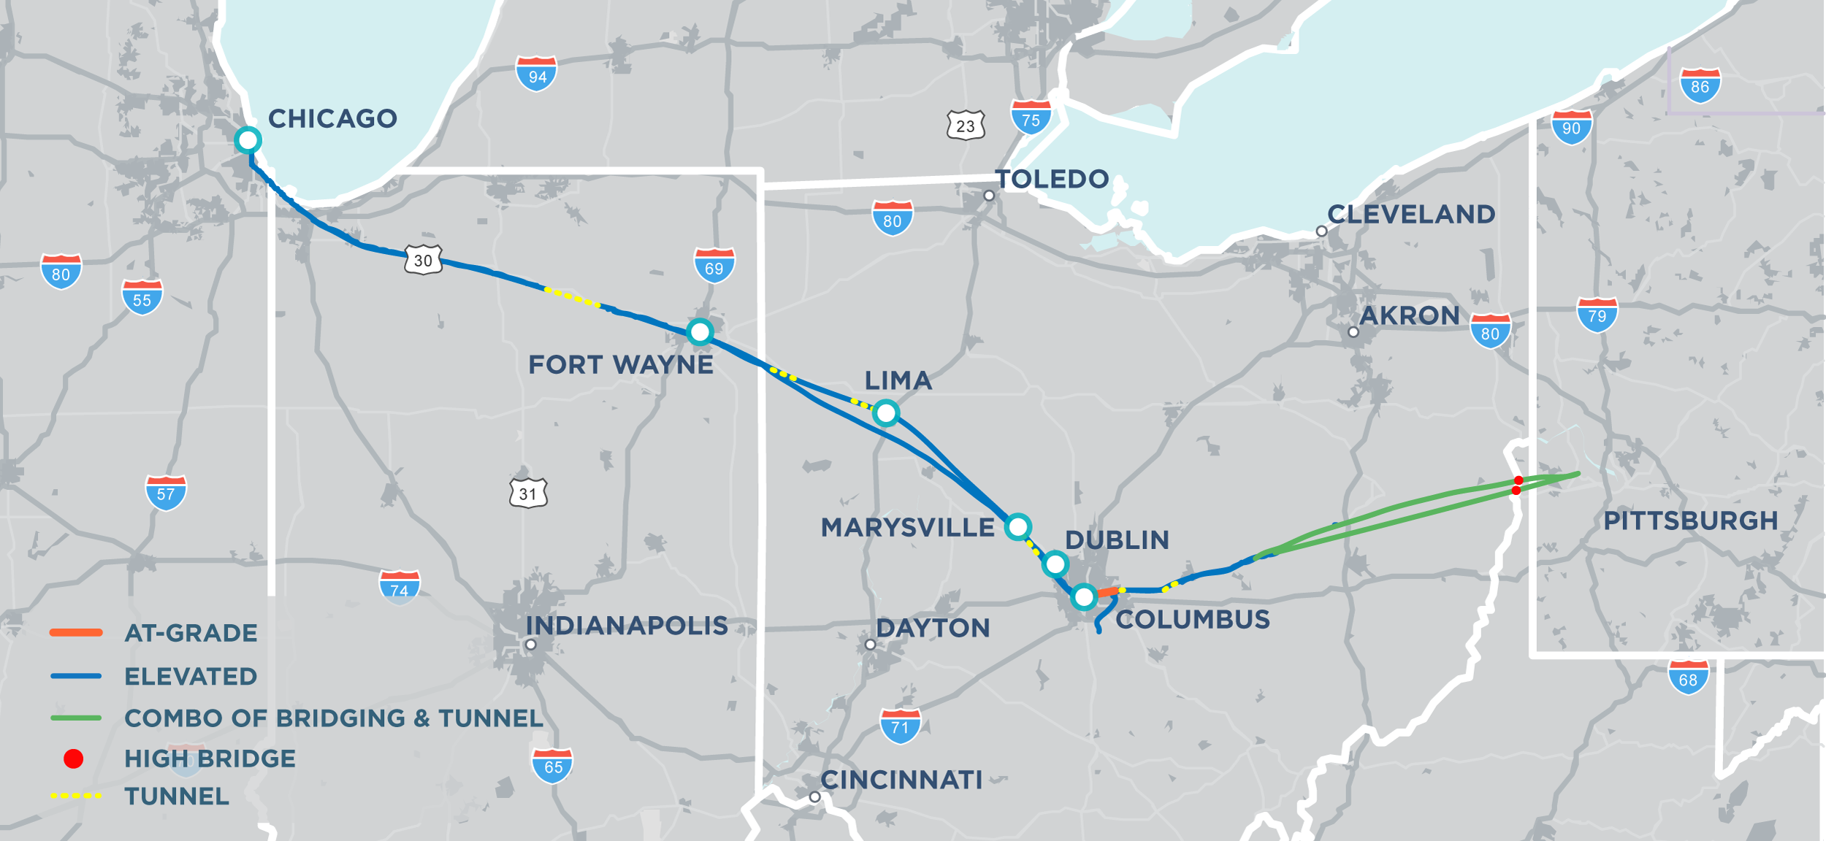
route ALTERNATIVES

Slide 17
STATION/PORTAL ALTERNATIVES

Slide 18
STATION/PORTAL CRITERIA
Market demand
Local preference
Former station location and reuse potential
Tangent (straight) right-of-way/ track
Adjacent land use
Distance between portals/ stations
Population centers and logistics potential
Access to connecting infrastructure/multimodal potential
Overall travel time

Slide 19
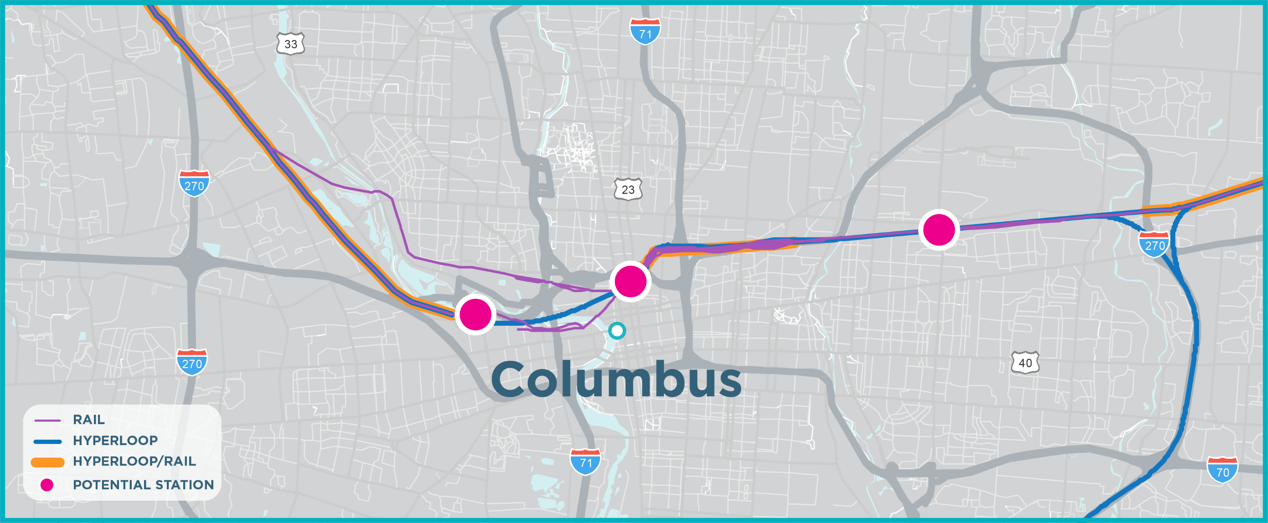
POTENTIAL STATIONS/PORTALS – COLUMBUS

Slide 20
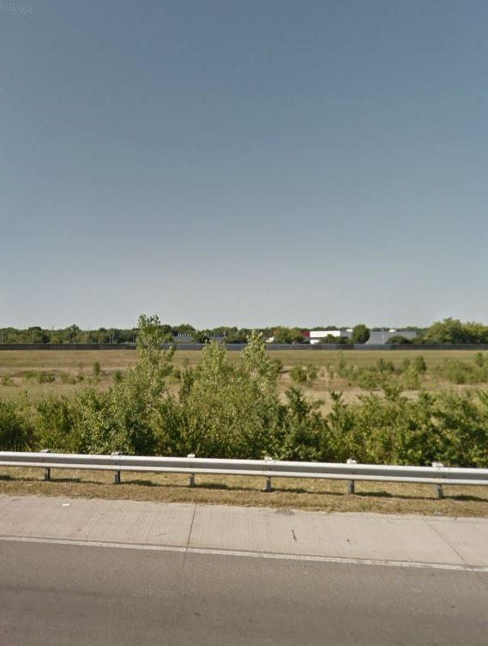
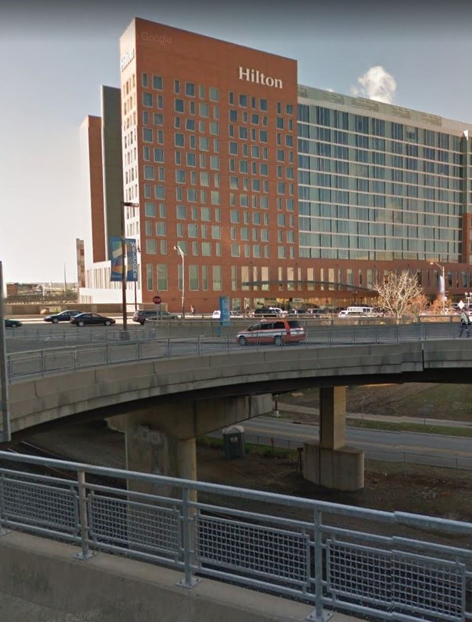
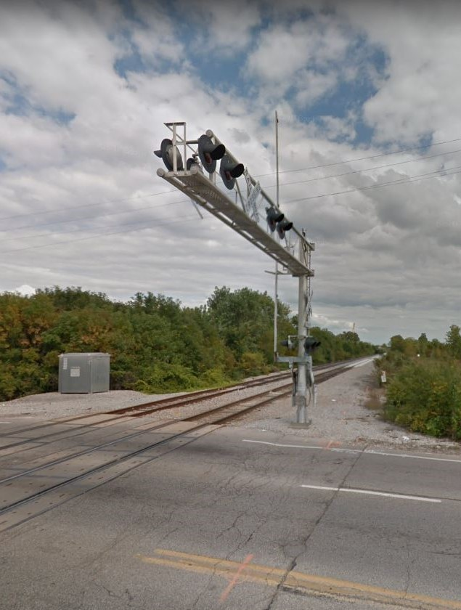
POTENTIAL STATIONS/PORTALS – COLUMBUS
JOHN GLENN INT’L AIRPORT
FRANKLINTON
CONVENTION CENTER

Slide 21
POTENTIAL STATION – DUBLIN
Notes:
Here is the most promising station location(s) in your city. (Only show the city where you are presenting.) We have this information for each of our funding partners but due to time constraints I’m just sharing yours tonight.

Slide 22
POTENTIAL STATION – MARYSVILLE WEST
LOOKING SOUTH ALONG N. MAPLE ST Source: Google Maps
Notes:
Here is the most promising station location(s) in your city. (Only show the city where you are presenting.) We have this information for each of our funding partners but due to time constraints I’m just sharing yours tonight.

Slide 23
POTENTIAL STATION – MARYSVILLE SOUTH
LOOKING NORTH ALONG COLUMBUS AVE Source: Google Maps
Notes:
Here is the most promising station location(s) in your city. (Only show the city where you are presenting.) We have this information for each of our funding partners but due to time constraints I’m just sharing yours tonight.

Slide 24
POTENTIAL STATION – KENTON WEST
LOOKING SOUTH ALONG LIMA ST Source: Google Maps
Notes:
Here is the most promising station location(s) in your city. (Only show the city where you are presenting.) We have this information for each of our funding partners but due to time constraints I’m just sharing yours tonight.

Slide 25
POTENTIAL STATION – KENTON CENTRAL
LOOKING EAST ALONG S. LEIGHTON ST Source: Google Maps
Notes:
Here is the most promising station location(s) in your city. (Only show the city where you are presenting.) We have this information for each of our funding partners but due to time constraints I’m just sharing yours tonight.

Slide 26
POTENTIAL STATION – LIMA
Notes:
Here is the most promising station location(s) in your city. (Only show the city where you are presenting.) We have this information for each of our funding partners but due to time constraints I’m just sharing yours tonight.
PHOTO is behind the Lima Utilities Department – (a former rail station?)

Slide 27
KEY HYPERLOOP STUDY FINDINGS
Notes:
Start of Howard Wood’s Slides

Slide 28
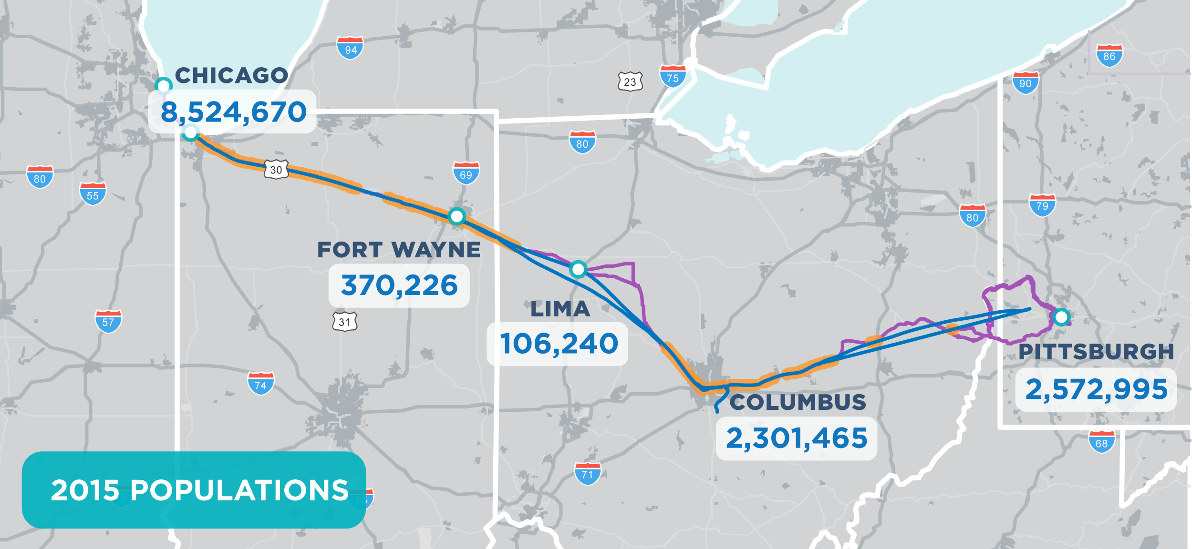
RIDERSHIP market
Notes:
First, here’s what we found for the potential ridership market for both modes. The population along the route is shown here. (don’t read numbers.)

Slide 29
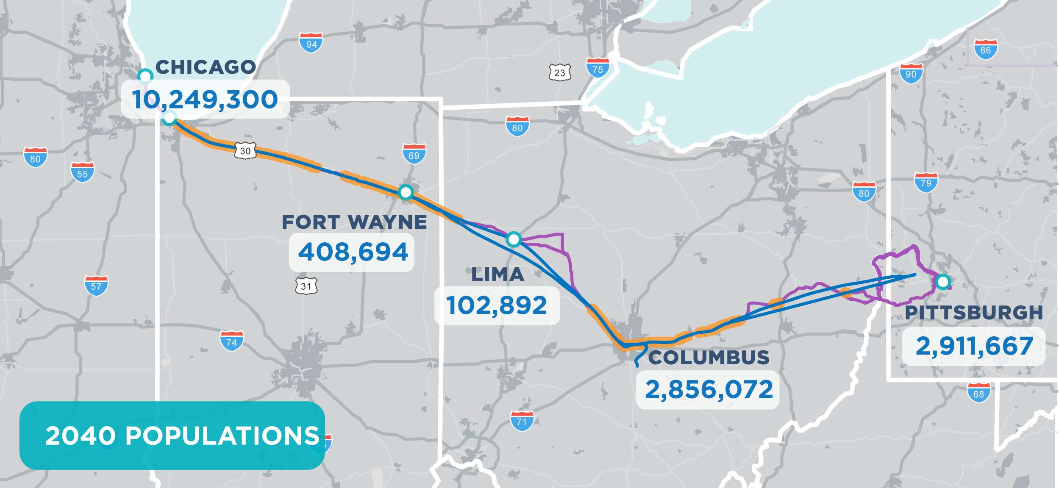
RIDERSHIP market
Label map with Population 2040
Notes:
Here is the population by 2040 – note the percent increases along the route. If we think congestion is bad today, it’s only going to get worse.

Slide 30
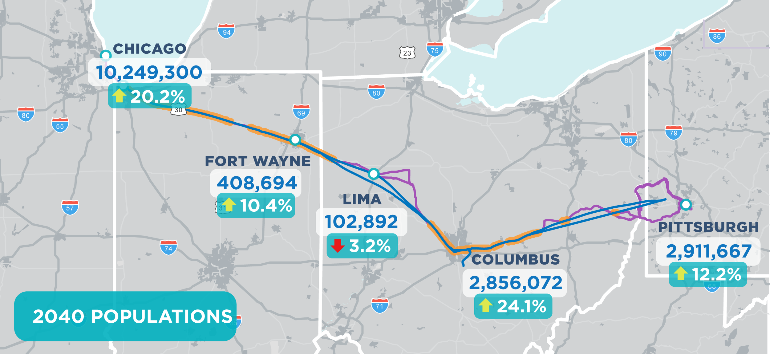
RIDERSHIP market
Label map with Population 2040
Notes:
Here is the population by 2040 – note the percent increases along the route. If we think congestion is bad today, it’s only going to get worse.

Slide 31
RIDERSHIP market
Notes:
Here are today’s jobs

Slide 32
RIDERSHIP market
Notes:
Here are jobs in 2040 – again, note the increases.

Slide 33
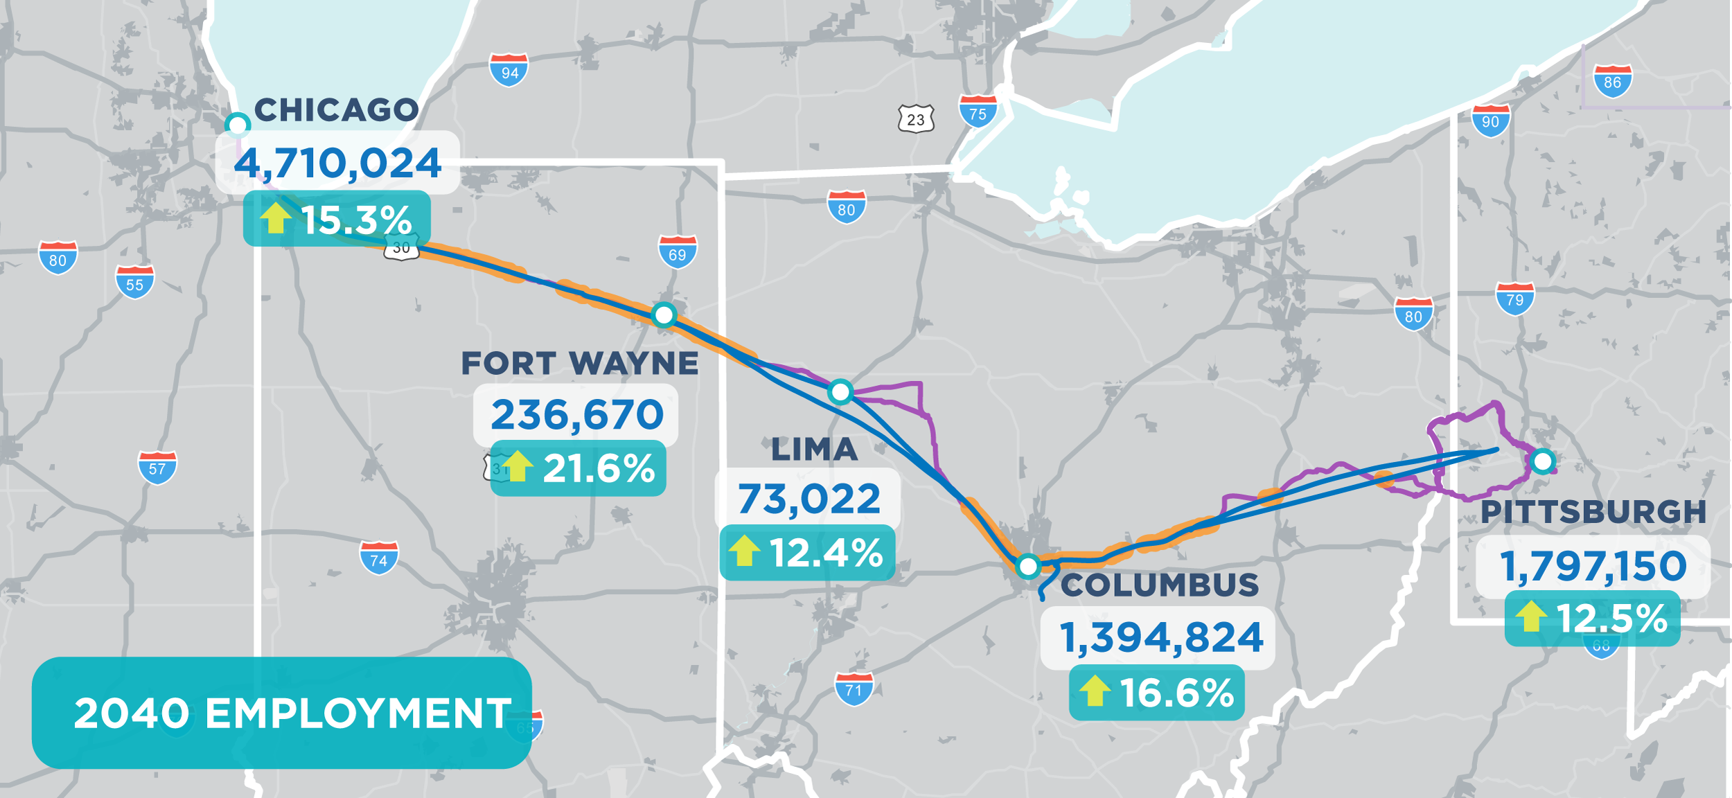
RIDERSHIP market
Notes:
Here are jobs in 2040 – again, note the increases.

Slide 34
Travel time and cost savings
 | Auto |  | Air |  | Conventional Rail |  | Hyperloop
Metro Pair (bi-directional) | Total Travel Time (min.) | Business / Non-Business Total Travel Cost* | Total Travel Time (min.) | Total Fare (Existing) | Total Travel Time (min.) | Total Fare (Existing) | Total Travel Time (min.) | Total Fare (estimated)
Chicago-Fort Wayne | 191 | $98 / $27 | - | - | - | - | 22 | $33
Chicago-Columbus | 336 | $198 / $54 | 249 | $171 | - | - | 38 | $60
Chicago-Pittsburgh | 412 | $256 / $69 | 245 | $177 | 587 | $127 | 55 | $93
Columbus-Fort Wayne | 205 | $96 / $26 | - | - | - | - | 20 | $28
Fort Wayne-Pittsburgh | 317 | $177 / $48 | - | - | - | - | 36 | $60
Columbus-Pittsburgh | 199 | $113 / $31 | - | - | - | - | 20 | $33

Slide 35
Hyperloop STUDY Key findings
Feasible given:
Certification of the technology
Assumed optimal main line speed of 500 mph avg.
Branch lines with slower speeds (portal connectors)
Potential for initial phases with less tunneling
Existing and new right of way, some tunneling (for main line primarily)
Notes:
Feasible at optimal speeds of 500 mph avg.
Needs a combination of existing and new right of way, some tunneling

Slide 36
Hyperloop STUDY Key findings
Once fully operational, over 30 years:
1.9 billion autos shifted to hyperloop passengers
2.4 million tons of reduced CO2 emissions
$19 billion direct transportation benefit
Reduction of 450 million commercial truck vehicles hours traveled
Notes:
Feasible at optimal speeds of 500 mph avg.
Needs a combination of existing and new right of way, some tunneling

Slide 37
Wider Economic benefits
~$300B
Midwest Connect Hyperloop Assessment Corridor Build Scenario
Midwest Connect Hyperloop Assessment Corridor Baseline Scenario
Notes:
Feasible at optimal speeds of 500 mph avg.
Needs a combination of existing and new right of way, some tunneling

Slide 38
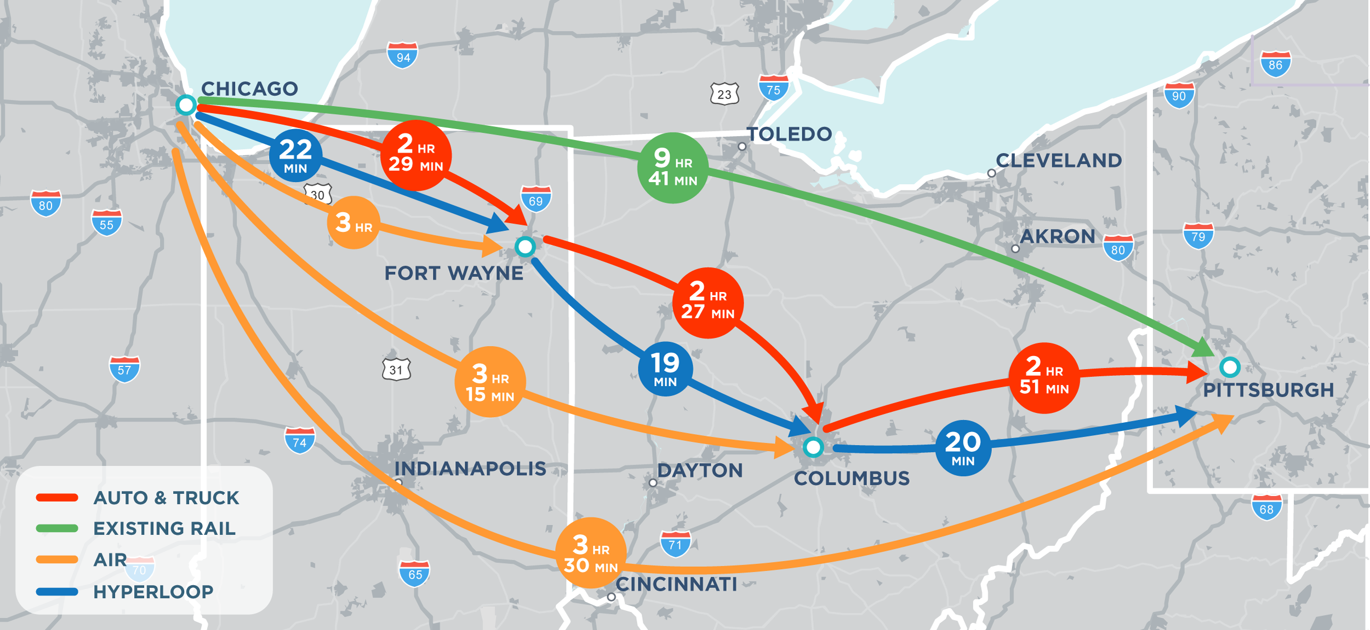
FINDINGS: travel time savings
Notes:
We found the travel times were very favorable when you compare cars to trains to hyperloop. For example, note it takes a car about xxx hours to get between Columbus and Chicago today. With passenger rail, with a number of stops, that trip would take xxx. It would take 38 minutes by hyperloop.

Slide 39
Estimated Hyperloop Fares*
Average Hyperloop Service Characteristics by Metro Pair
Metro Pair | Line Haul Travel Time (min) | Line Haul Distance (miles) | Fare Cost (dollars)
Chicago-Fort Wayne | 22 | 163 | $33
Chicago-Columbus | 38 | 302 | $60
Chicago-Pittsburgh | 58 | 465 | $93
Fort Wayne-Columbus | 19 | 139 | $28
Fort Wayne-Pittsburgh | 39 | 302 | $60
Columbus-Pittsburgh | 22 | 163 | $33
* 2019 dollars. Based on an assumed $0.20/mile, as calculated by AECOM with input from Virgin Hyperloop One
Notes:
Fare calculated based on USDOT value of time, or 20 cents per mile

Slide 40
Emissions Savings
Environmental Sustainability
Mode Shift Emissions Savings (Auto to Hyperloop) | $113.9M
Mode Shift Emissions Savings (Air to Hyperloop) | $0.3M
Mode Shift Emissions Savings (Train to Hyperloop) | $7.8M
Mode Shift Emissions Savings (Commercial Truck to Hyperloop) | $4.6M
Notes:
Emphasize these savings were calculated using DOT Benefit Cost Analysis methodology standards

Slide 41
HYPERLOOP NEXT STEPS
Public meetings
VHO certification segment – R&D collaboration opportunity
Create a travel demand advisory panel (public agencies, academic institutions, VHO)
Monitor NETT Council activities and opportunities to engage in federal regulatory framework
Advance regulatory framework with appropriate agencies
Continue to facilitate collaboration
Notes:
Certification segment – Research and development collaboration opportunity with Virgin Hyperloop One
3 different certification segments between 5 and 10 miles to be considered
Creation of a travel demand advisory panel (collaboration between public agencies, academic institutions, and Virgin Hyperloop One)
Continued facilitation of Central Ohio/VHO collaboration opportunities
Coordination with DOT agencies to advance regulatory framework (potential to do this through a certification segment project)

Slide 42
Passenger rail NEXT STEPS
Public meetings
Secure funding to complete the environmental studies necessary for the federal construction approval process
Engage and secure the support of communities east of Columbus
Develop a strategy with other surrounding states to secure regulatory guidance

Slide 43
QUESTIONS?

Slide 44
DINA LOPEZ
Strategic Projects Manager
Mid-Ohio Regional Planning Commission
T: 614.233.4149 | M: 614.603.0947
dlopez@morpc.org
111 Liberty Street, Suite 100
Columbus, OH 43215

