Slide 1
WEBMAP RESULTS & STRATEGY DEVELOPMENT
SEPTEMBER 2019

Slide 2
WHAT ARE WE ASKING OF YOU TODAY?
Information only
Summary of cost estimating and revenue forecasting processes

Slide 3
FISCAL BALANCE
Key determinant in what projects can be included in MTP
  Project cost estimates & forecast of available funding resources
  Maintain the existing system and expand the system
Primary sources of project funding
  Federal – generally controlled by ODOT or MORPC
  State – controlled by ODOT or through programs like OPWC or CEAO
  Local government or private
Forecasts of funding available via various programs through 2050

Slide 4
COST ESTIMATES
Current estimates when possible
(TIP, CIP, Plans, etc.)
Develop unit costs per mile, bridge based on
similar projects already constructed
Year of expenditure dollars (annual inflation factors)

Slide 5
REVENUES
Short-term: Assume similar funding levels as previous years
Long-term: Assume more substantial legislation is passed at federal level, modest growth from state, local and private sector

Slide 6

PLAN COMPONENTS
Goals, Objectives & Targets
Future Growth
Strategies
  System Development
    Projects
  System Management
    Operations & Maintenance
    Safety/Security
    Demand Management
    Freight
Financial Forecast

Slide 7
WHAT’S NEXT?
Evaluate candidate projects
Develop cost estimates and revenue forecast
Draft list of strategies and projects--Fall 2019
MTP adoption--May 2020

Slide 8
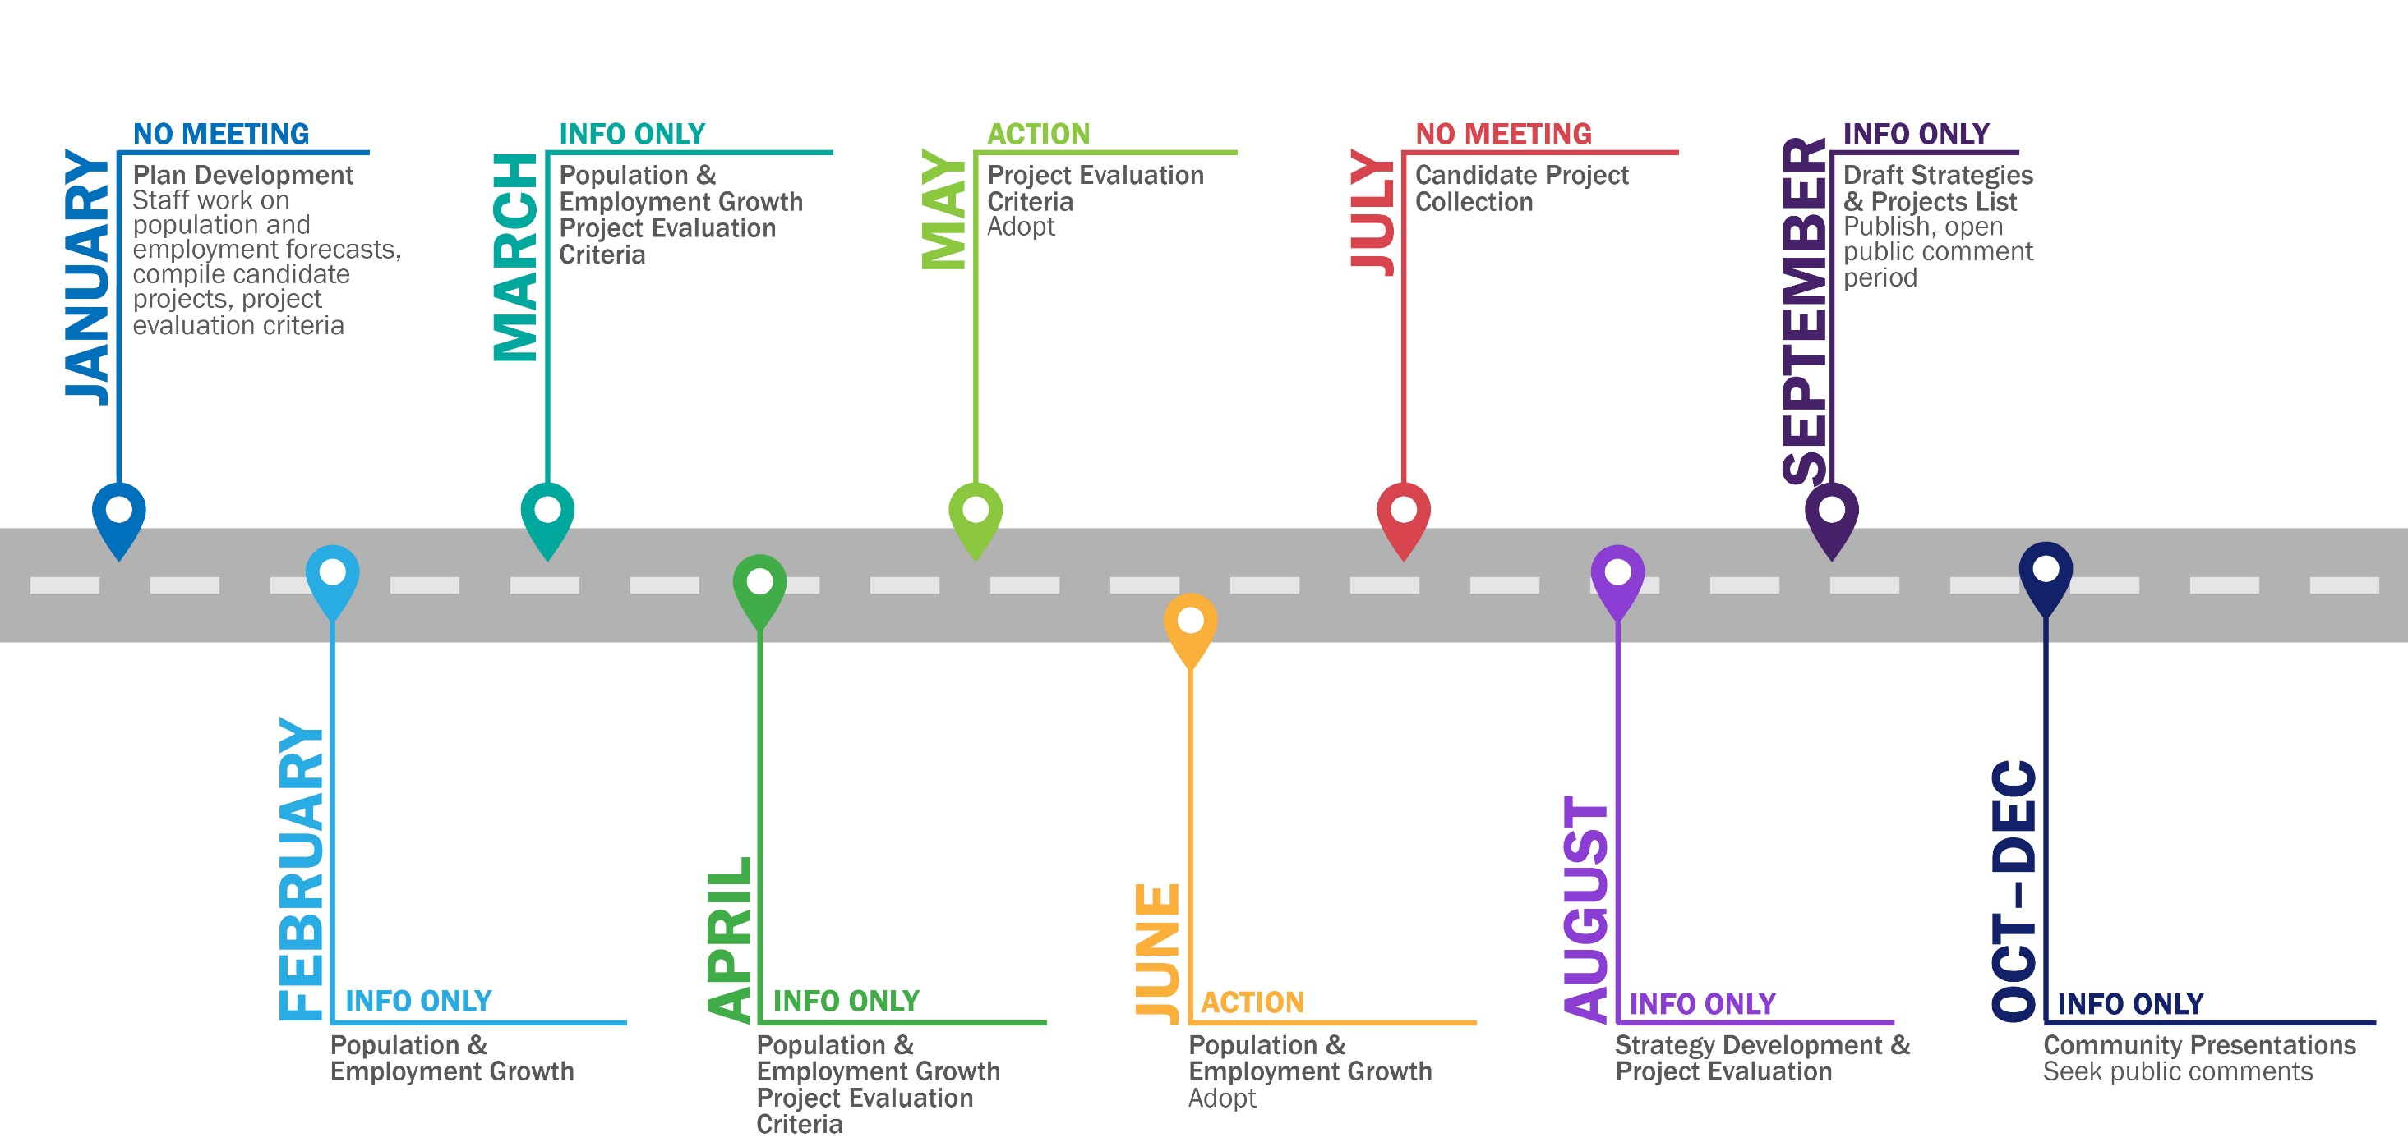
2020-2050 MTP TIMELINE 2019

Slide 9
Maria Schaper, AICP
TRANSPORTATION PLANNING MANAGER
MSCHAPER@morpc.org
P. 614.233.4153
111 Liberty Street, Suite 100
Columbus, OH 43215
www.morpc.org

