Slide 1
Midwest Connect
Hyperloop Feasibility
Study
MORPC Transportation Advisory Committee
February 5, 2020

Slide 2
PURPOSE
For information only
Recap Rapid Speed Transportation Initiative (RSTI)
Share updates and preliminary findings
Discuss next steps
Notes:
Tonight we’re here to….

Slide 3
WHAT IS RSTI?
Notes:
First – let me recap what the Rapid Speed Transportation Initiative is.

Slide 4

ABOUT RSTI
$2.5-million studies of rapid-speed technology options (traditional rail and hyperloop)
Chicago-Columbus-Pittsburgh Corridor
Two initial phases:
  Hyperloop Feasibility Study
  Components of Tier 1 EIS

Slide 5
RSTI: TWO MODAL OPTIONS
Passenger rail
  Conduct preliminary environmental analysis
  Identify route & station alternatives
  Minimize impacts & costs
Hyperloop
  Determine feasibility of new technology; leverage rail environmental analysis
  Identify routes & station alternatives
  Minimize impacts & costs
  Explore freight & economic impacts
Notes:
So the RSTI initiative is looking at two modal options: passenger rail and hyperloop.
Passenger rail (see slide)
And hyperloop (see slide)

Slide 6
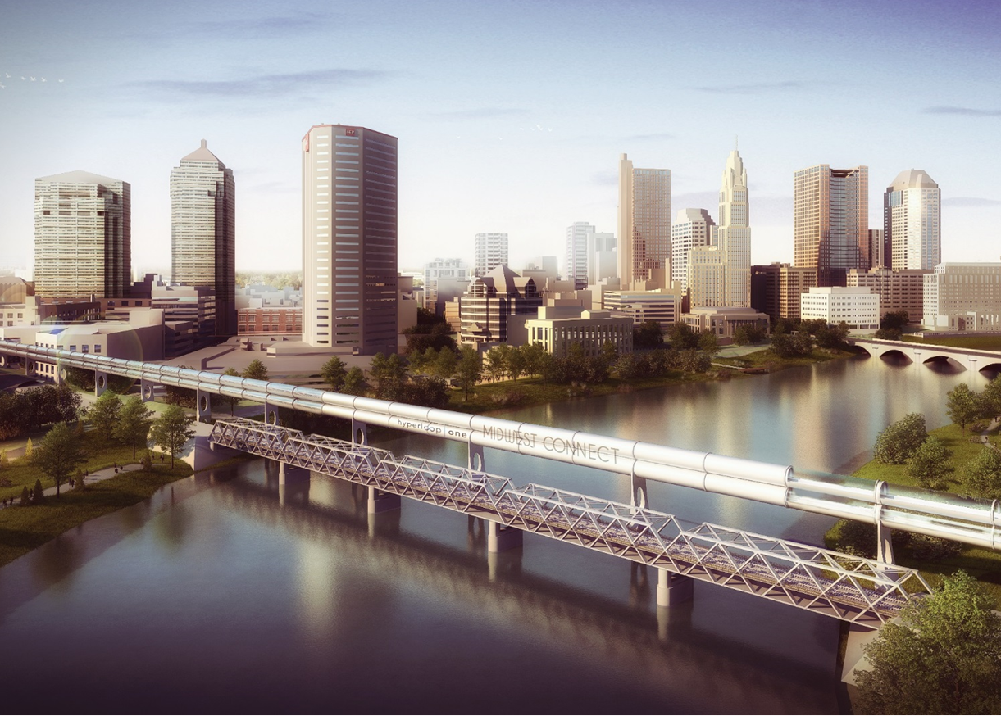
HYPERLOOP FEASIBILITY STUDY
Task 1 – Visioning and Technology Application
Task 2 – Route Planning
Task 3 – Transportation Demand and Economic Benefit Analysis
Task 4 – Regulatory Framework and Implementation Strategy
Project Management, Stakeholder, and Public Engagement
Consultant selected:
AECOM

Slide 7

COMPONENTS OF A TIER I EIS
Task 1 – Project Management
Task 2 – Preliminary Data Collection
Task 3 – Purpose and Need Statement
Task 4 – Route Alternatives
Task 5 – Service Alternatives
Task 6 – Infrastructure Investments
Task 7 – Public Involvement
Consultant selected:
WSP USA, Inc

Slide 8
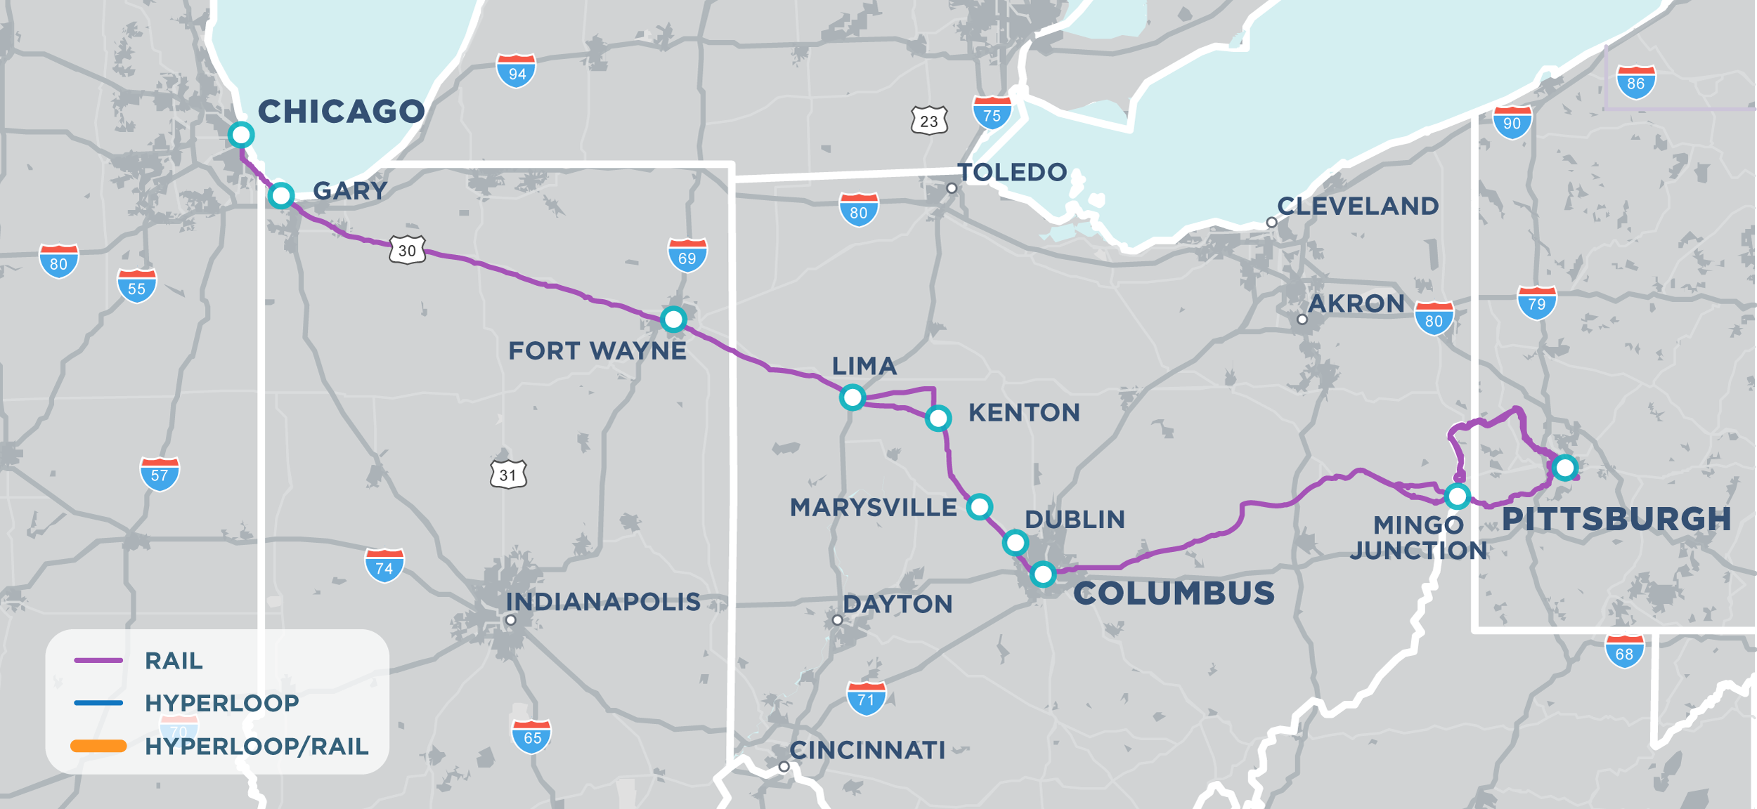
RAPID SPEED TRANSPORTATION

Slide 9
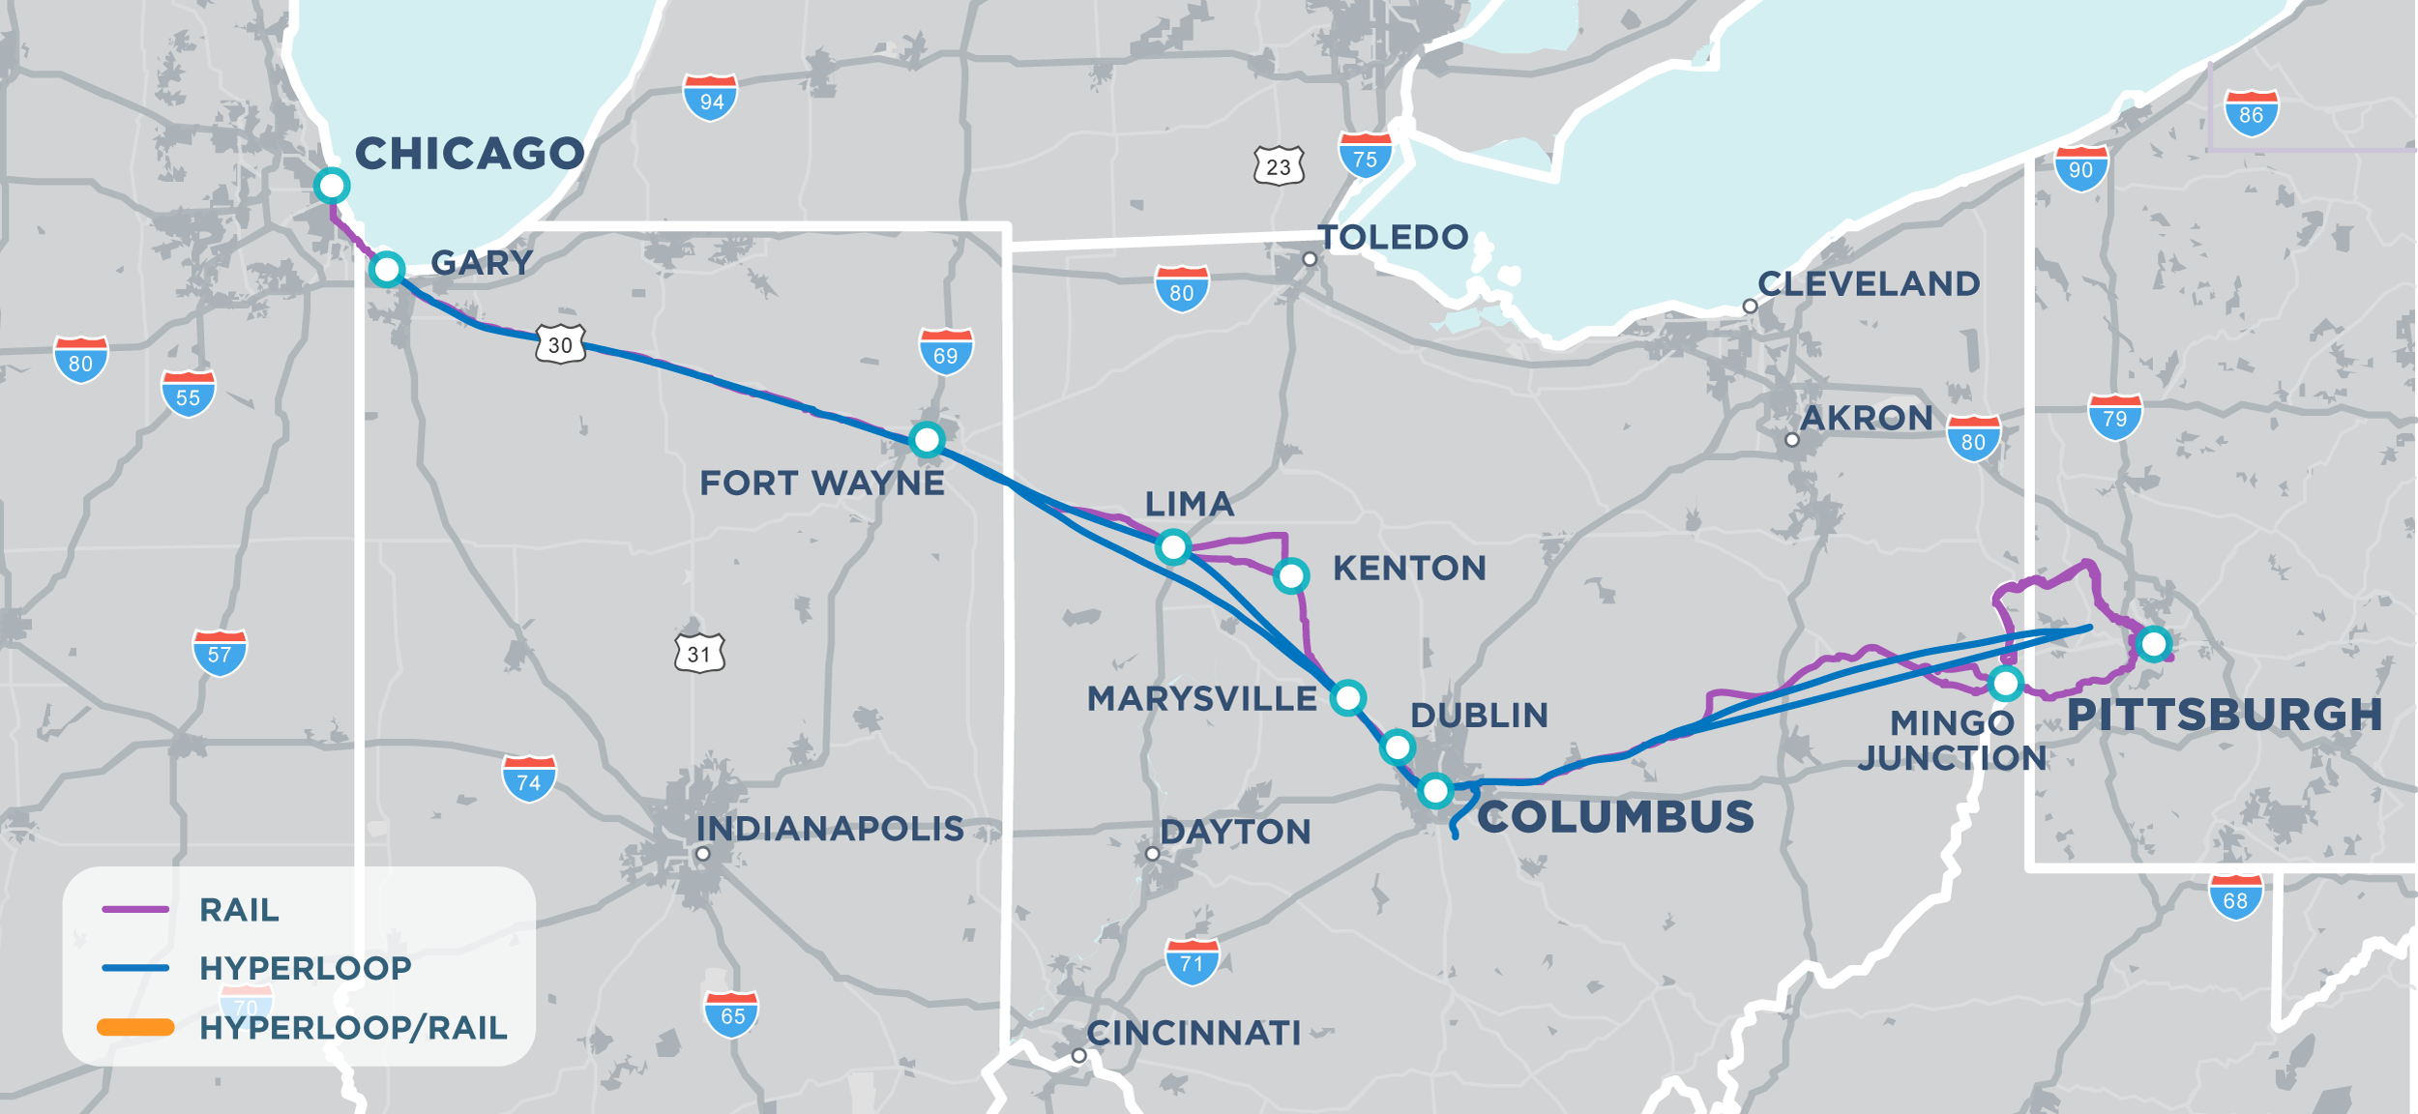
RAPID SPEED TRANSPORTATION
Notes:
So what is the Rapid Speed Transportation Initiative? It’s a look at how to introduce high speed connections between Chicago, Columbus and Pittsburgh.

Slide 10
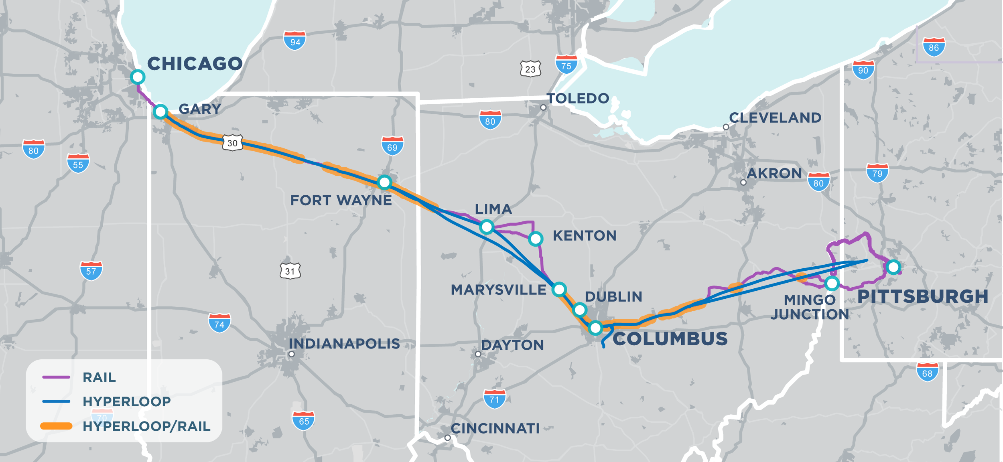
RAPID SPEED TRANSPORTATION
Notes:
So what is the Rapid Speed Transportation Initiative? It’s a look at how to introduce high speed connections between Chicago, Columbus and Pittsburgh.

Slide 11
ROUTE ALTERNATIVES

Slide 12
Route Screening Criteria
For Hyperloop and Rail
  Route circuity
  Corridor communities & land use
  Environmental constraints
  Comparative cost
  Engineering complexity
  Right-of-way and railroad ownership
  Right of way width and availability
  Number of bridge, underpass, or tunnel structures
For Rail Only
  Track class/speed
  Track ownership
  Train volumes
  Track capacity
  Number of at-grade crossings
  Signaling
Notes:
FOR both modes we considered these route screening criteria to determine the most viable routes. Hyperloop had a few more criteria because of its engineering complexity.
Howard – Please emphasize engineering complexity as a high ranking criteria for the hyperloop project

Slide 13
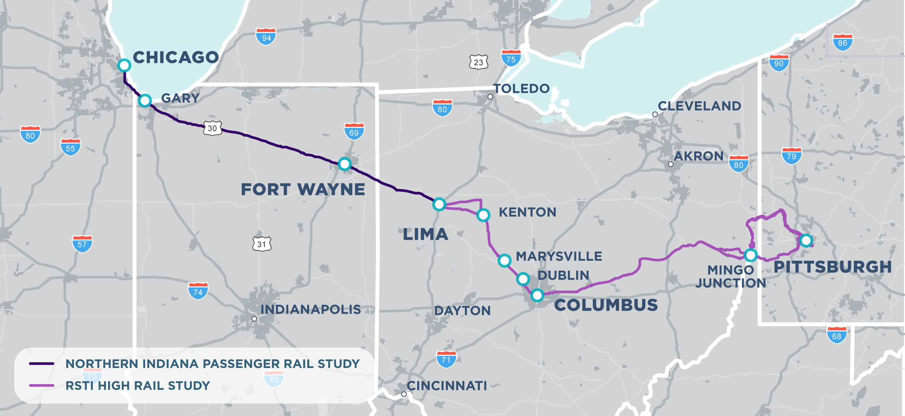
route ALTERNATIVES
Notes:
Recall the route screening criteria I mentioned earlier. Here are the most promising route alternatives for passenger rail.

Slide 14
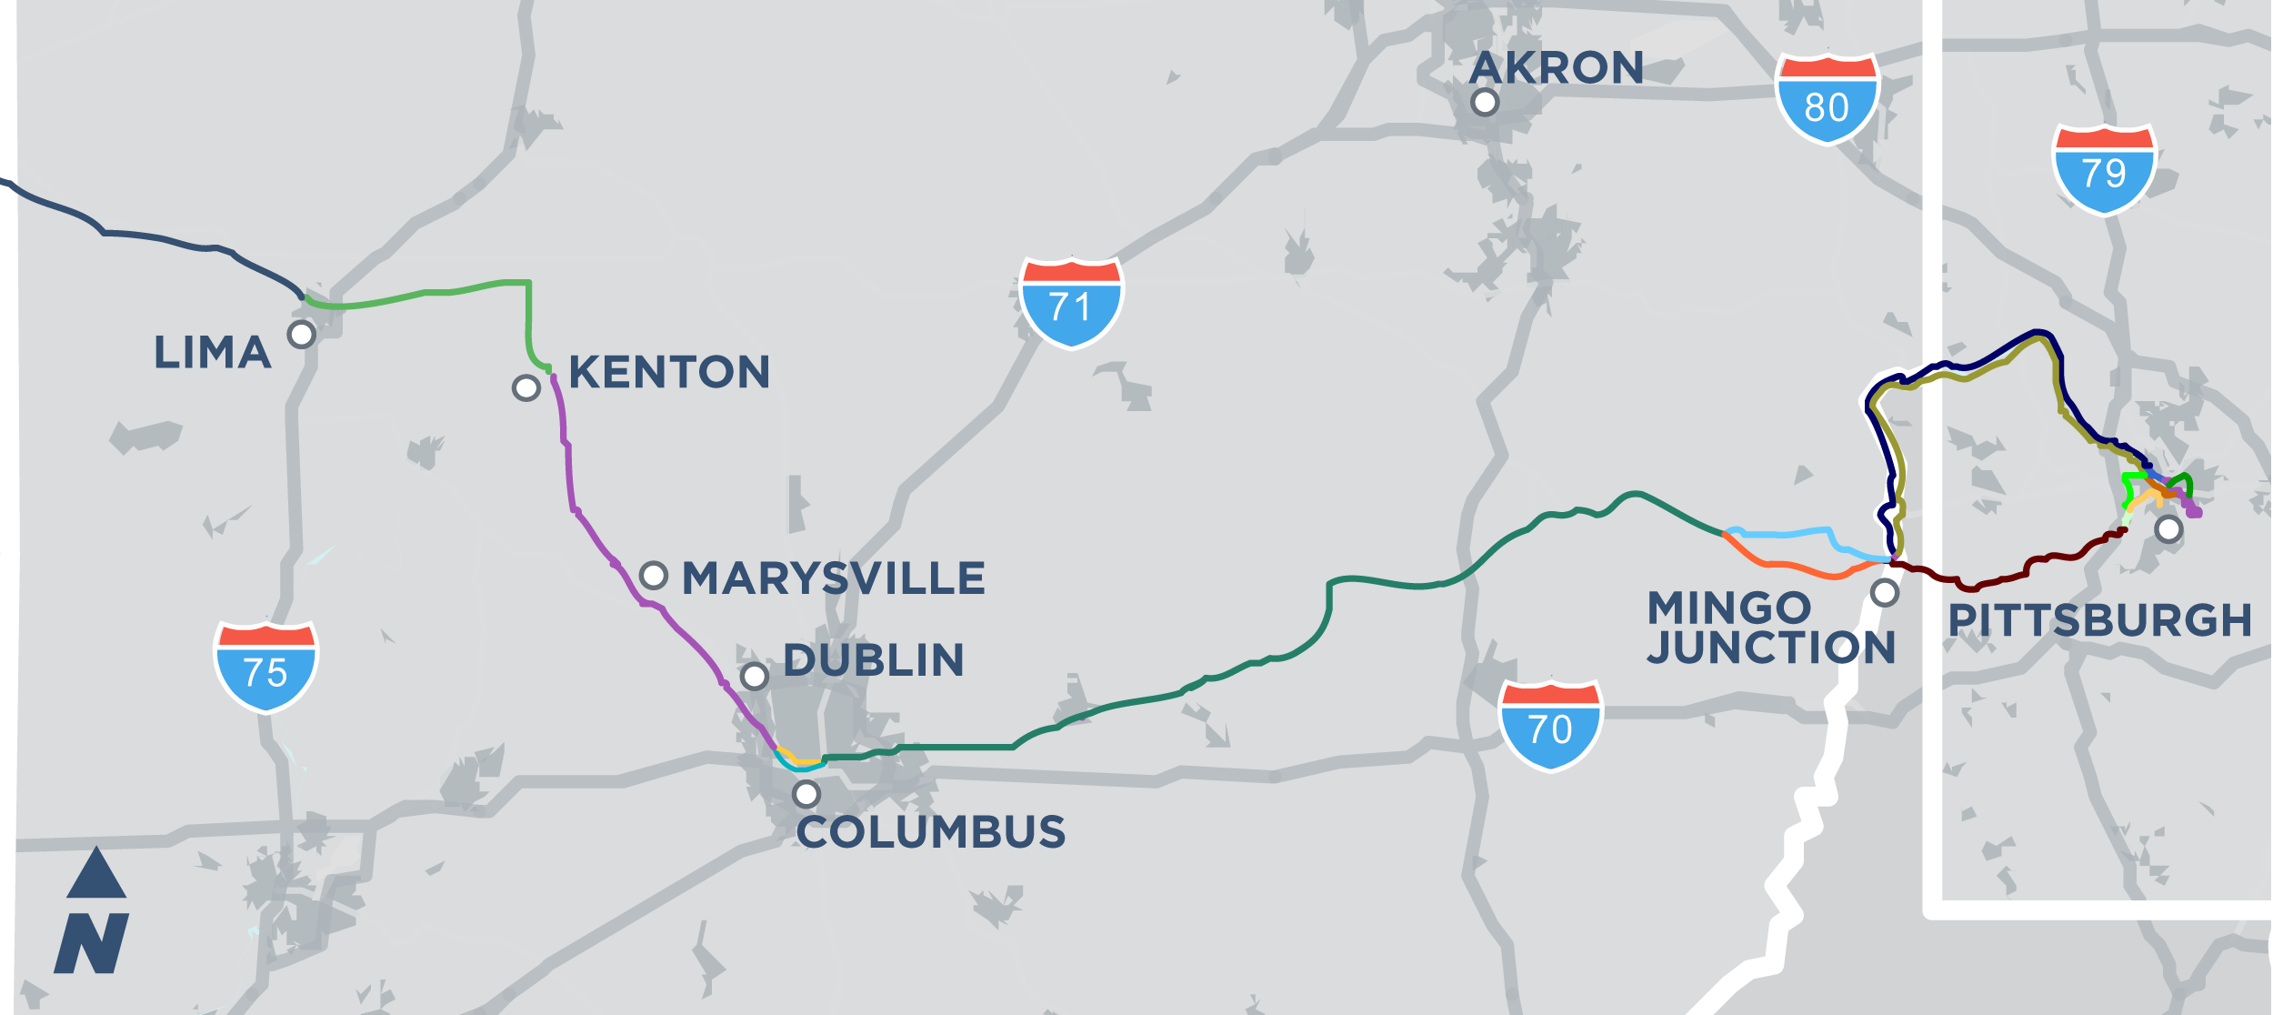
route ALTERNATIVES
Notes:
The RSTI study identified 15 potential corridor segments from Lima to Pittsburgh, some of which are options, like the north and south corridors through Columbus.

Slide 15
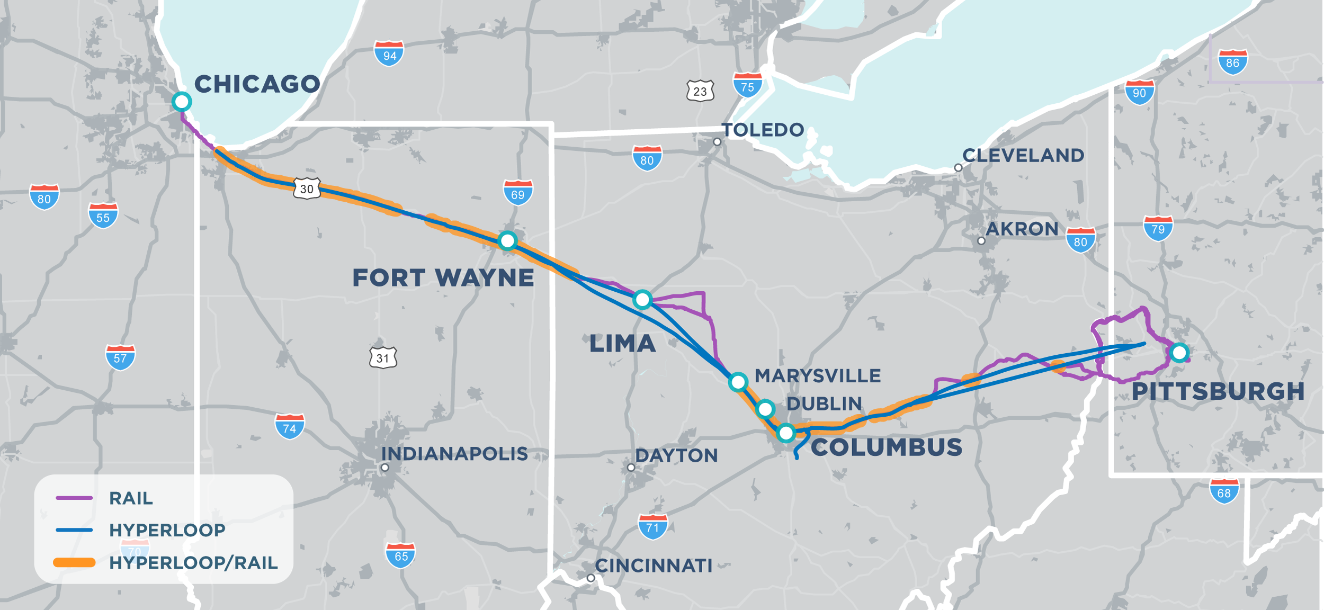
route ALTERNATIVES
Notes:
NOTE: The community insert maps show more than one potential location for a station. We need to make this more clear in the public information – that we have not narrowed down station location at this phase of the project.

Slide 16
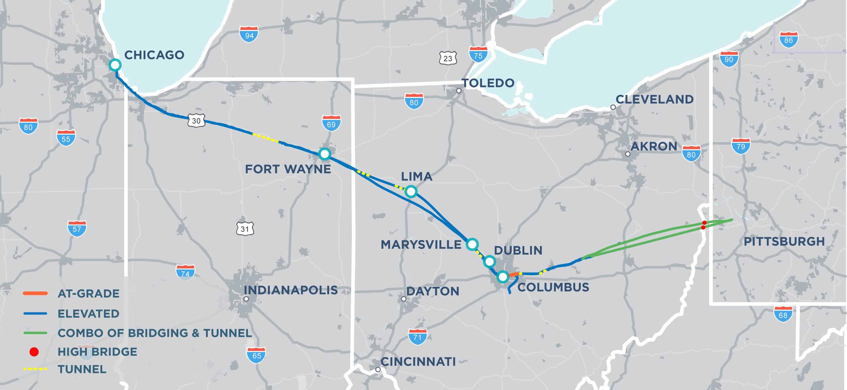
route ALTERNATIVES

Slide 17
STATION/PORTAL ALTERNATIVES

Slide 18
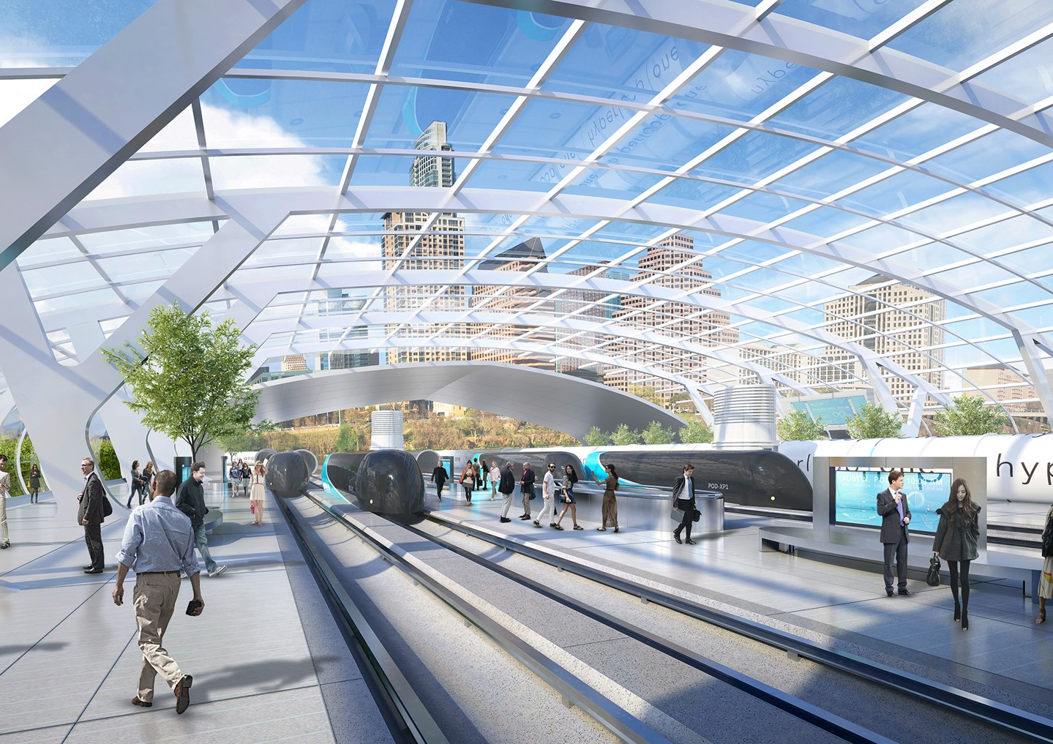
STATION/PORTAL CRITERIA
Market demand
Local preference
Former station location and reuse potential
Tangent (straight) right-of-way/ track
Adjacent land use
Distance between portals/ stations
Population centers and logistics potential
Access to connecting infrastructure/multimodal potential
Overall travel time

Slide 19
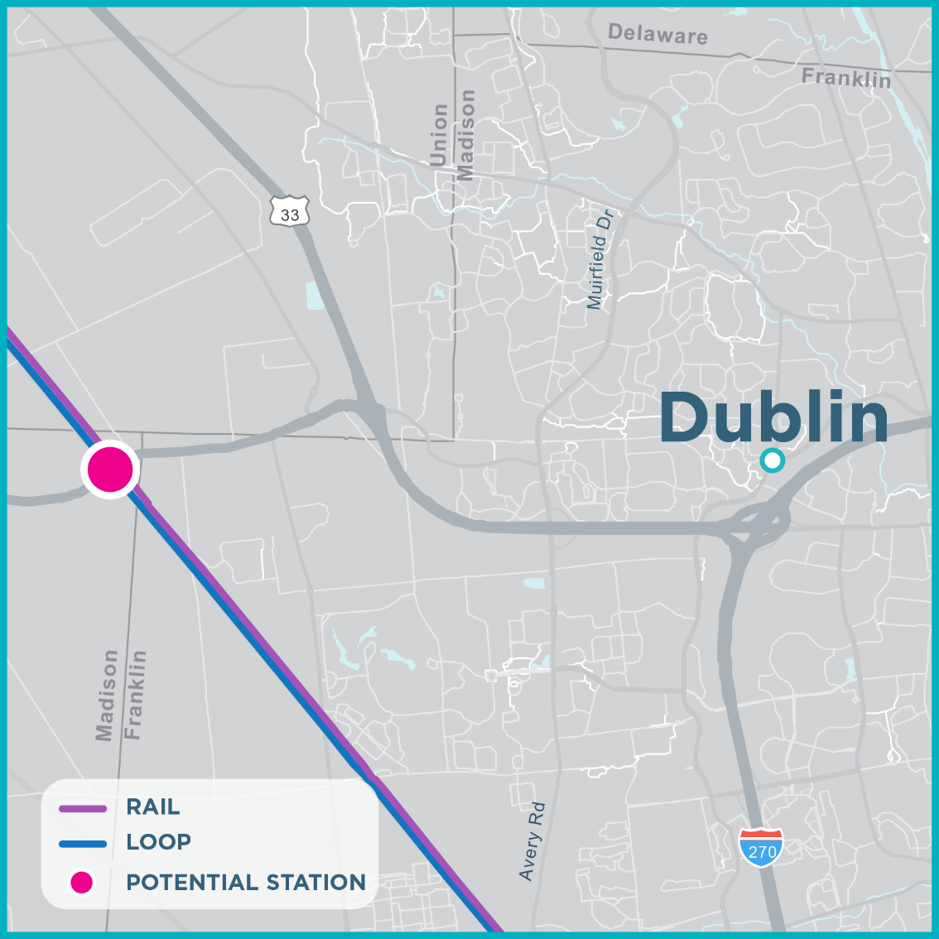
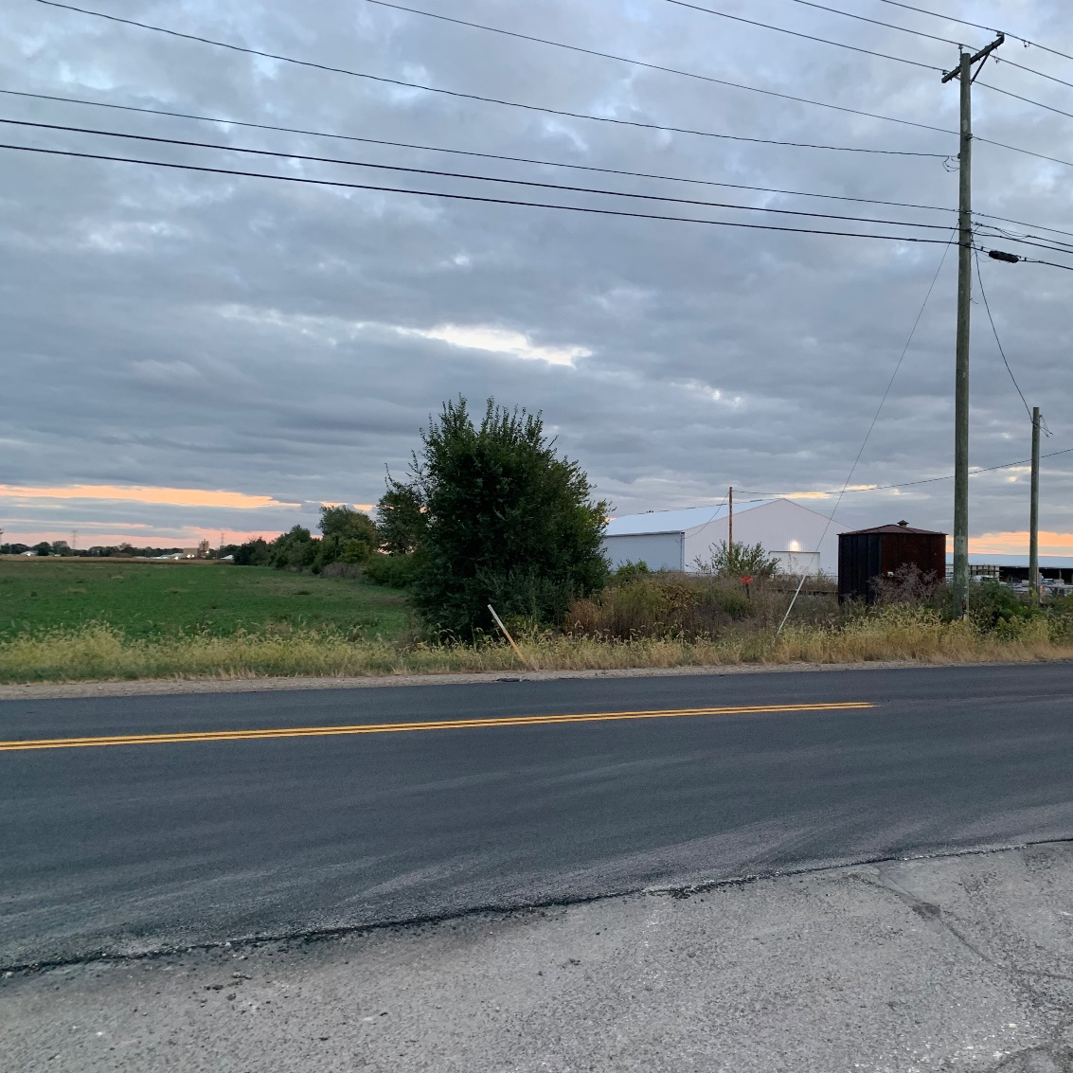
POTENTIAL STATION/PORTAL – DUBLIN
Notes:
Note this portion of the Hyperloop will be elevated.

Slide 20
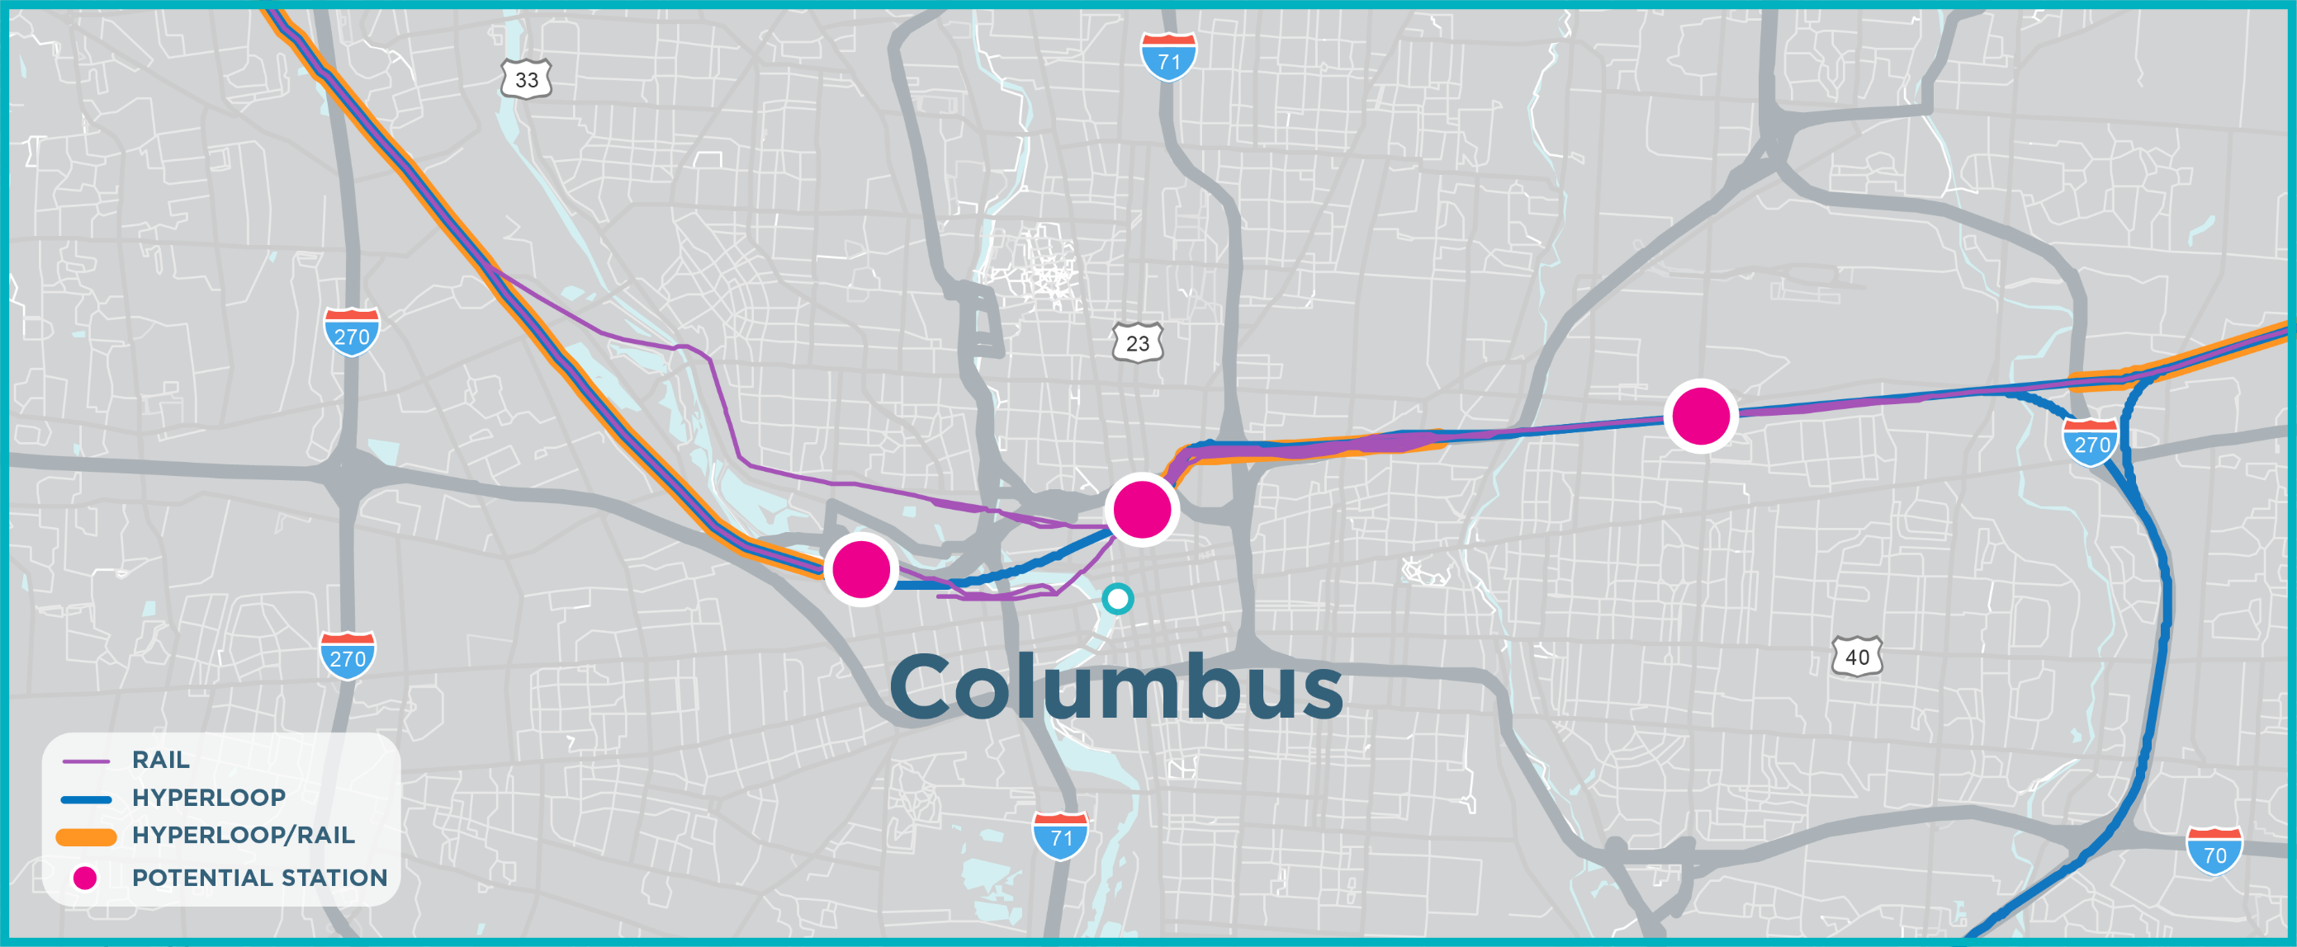
POTENTIAL STATIONS/PORTALS – COLUMBUS

Slide 21
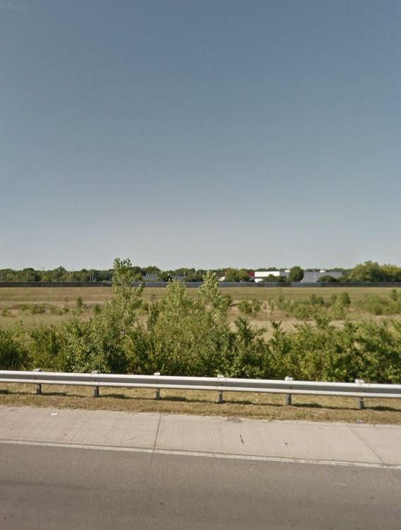
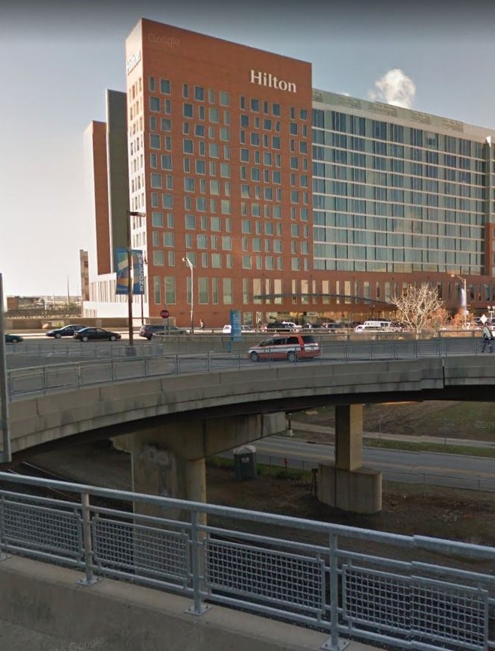
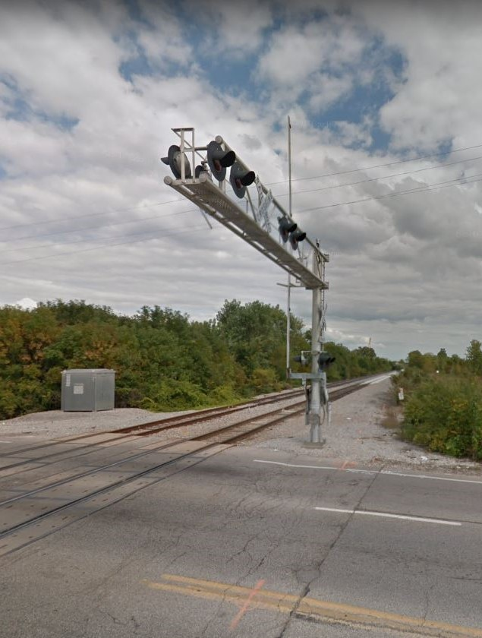
POTENTIAL STATIONS/PORTALS – COLUMBUS
JOHN GLENN INT’L AIRPORT
FRANKLINTON
CONVENTION CENTER

Slide 22
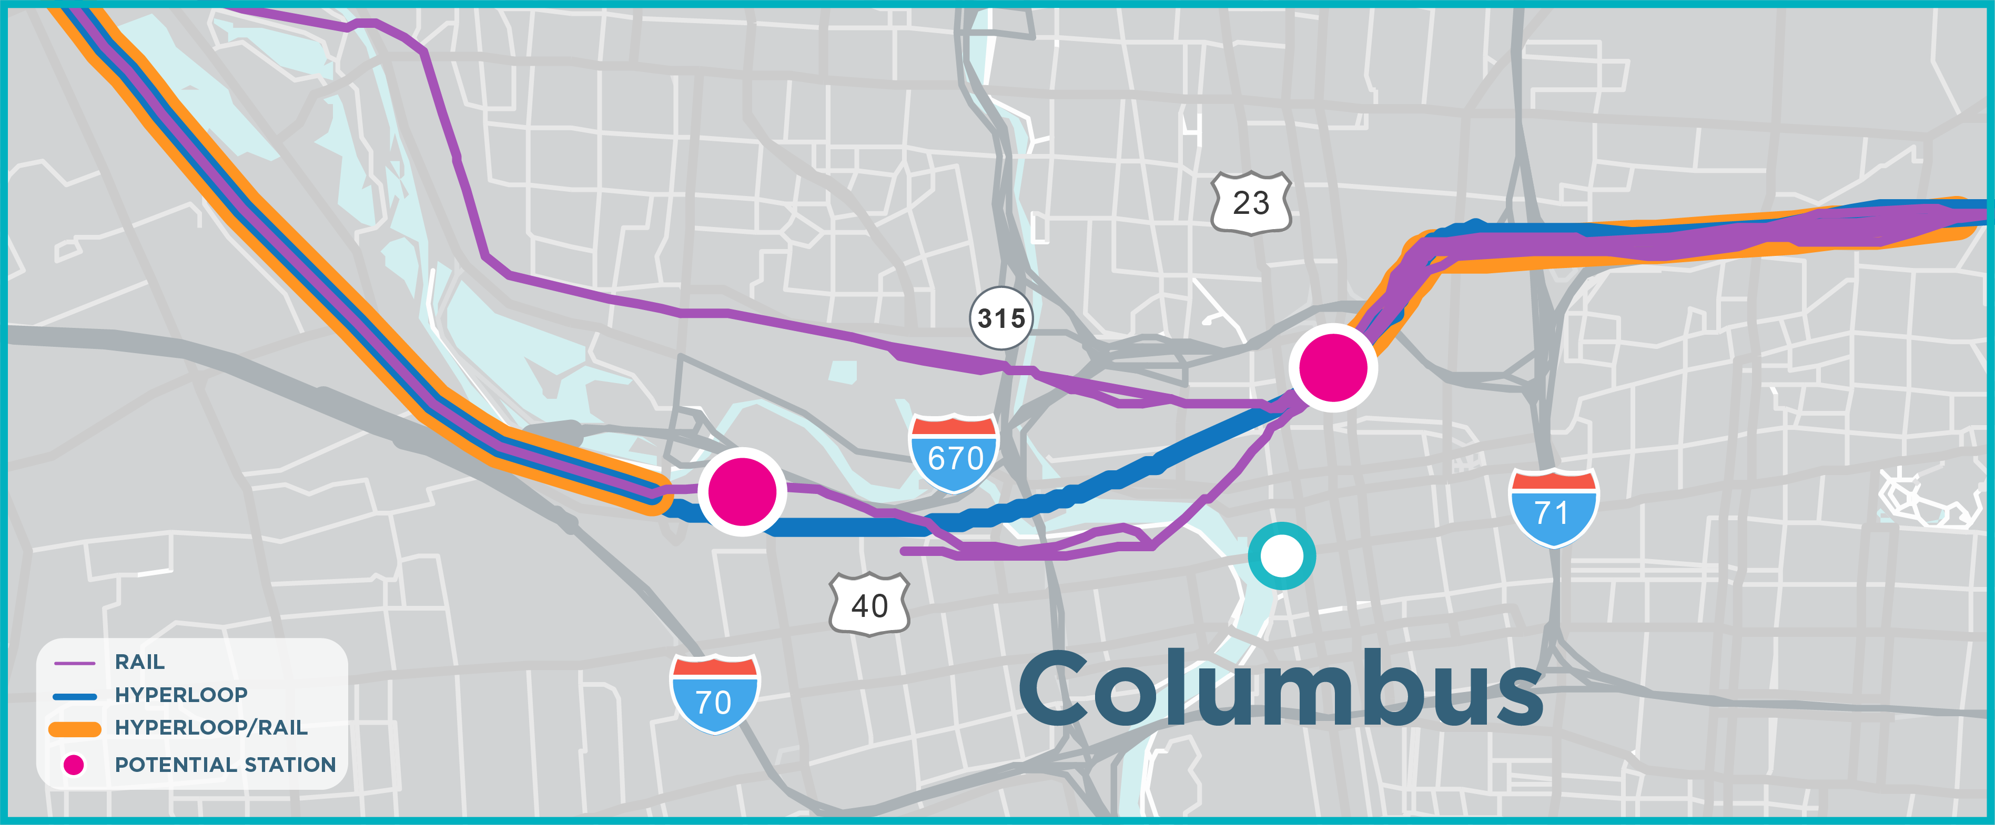
POTENTIAL STATIONS/PORTALS – COLUMBUS

Slide 23
KEY HYPERLOOP STUDY FINDINGS
Notes:
Start of Howard Wood’s Slides

Slide 24
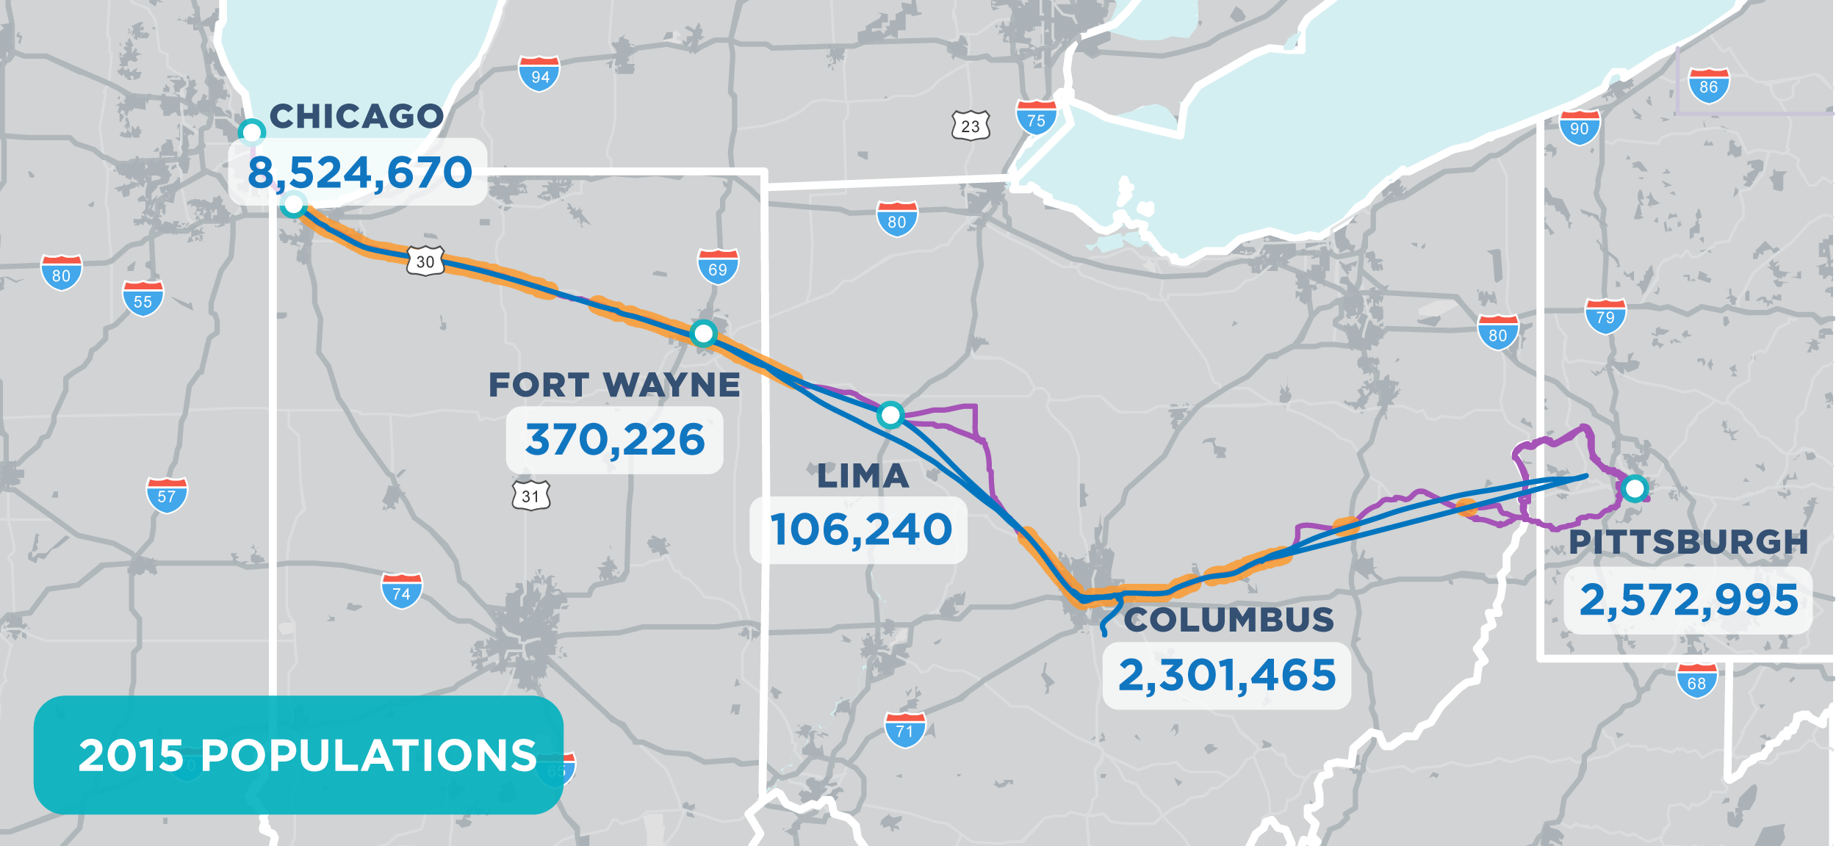
RIDERSHIP market
Notes:
First, here’s what we found for the potential ridership market for both modes. The population along the route is shown here. (don’t read numbers.)

Slide 25
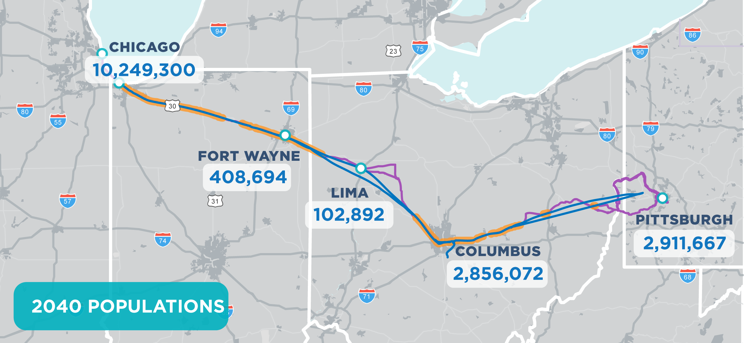
RIDERSHIP market
Label map with Population 2040
Notes:
Here is the population by 2040 – note the percent increases along the route. If we think congestion is bad today, it’s only going to get worse.

Slide 26
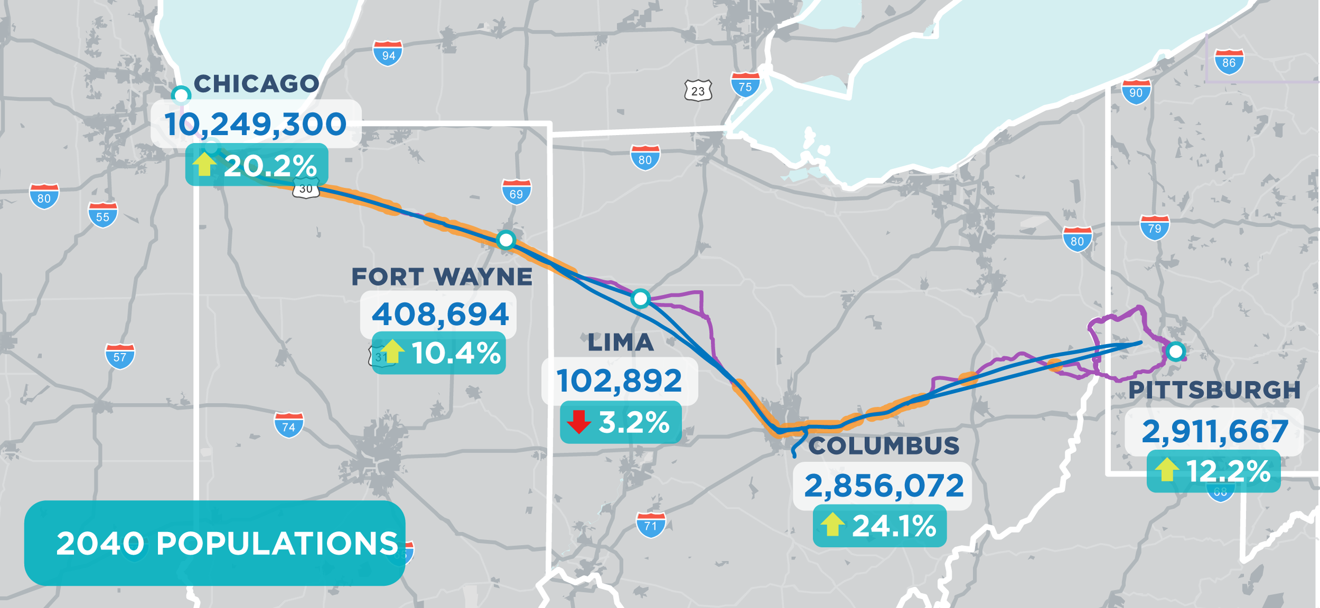
RIDERSHIP market
Label map with Population 2040
Notes:
Here is the population by 2040 – note the percent increases along the route. If we think congestion is bad today, it’s only going to get worse.

Slide 27

RIDERSHIP market
Notes:
Here are today’s jobs

Slide 28

RIDERSHIP market
Notes:
Here are jobs in 2040 – again, note the increases.

Slide 29
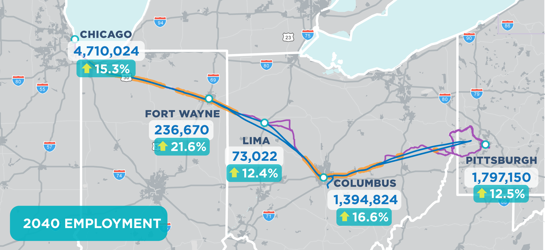
RIDERSHIP market
Notes:
Here are jobs in 2040 – again, note the increases.

Slide 30
Need for transportation options
2015 Passenger Flows By Mode for Sample Trips
2040 Passenger Flows By Mode for Sample Trips
Origin/Destination Pairing | Auto | Airline | Total
Chicago-Columbus | 190,562 | 414,750 | 605,312
Chicago-Pittsburgh | 26,597 | 396,600 | 423,197
Columbus- Pittsburgh | 479,973 | 0 | 479,973
Total | 697,132 | 811,350 | 1,508,482
Origin/Destination Pairing | Auto | Airline | Total
Chicago-Columbus | 239,632 | 521,548 | 761,180
Chicago-Pittsburgh | 32,635 | 486,628 | 519,263
Columbus- Pittsburgh | 577,407 | 0 | 577,407
Total | 849,674 | 1,008,176 | 1,857,850
Sources: Auto - Ohio Statewide Traffic Forecasting Model; Airline - Applied an average growth rate on the 2015 flows based on the population growths specified in the latest MPO plans for the three cities.
Notes:
These tables exclude the rail trips between Pittsburgh and Chicago.

Slide 31
Travel time and cost savings
 | Auto |  | Air |  | Conventional Rail |  | Hyperloop
Metro Pair (bi-directional) | Total Travel Time (min.) | Business / Non-Business Total Travel Cost* | Total Travel Time (min.) | Total Fare (Existing) | Total Travel Time (min.) | Total Fare (Existing) | Total Travel Time (min.) | Total Fare (estimated)
Chicago-Fort Wayne | 191 | $98 / $27 | - | - | - | - | 22 | $33
Chicago-Columbus | 336 | $198 / $54 | 249 | $171 | - | - | 38 | $60
Chicago-Pittsburgh | 412 | $256 / $69 | 245 | $177 | 587 | $127 | 55 | $93
Columbus-Fort Wayne | 205 | $96 / $26 | - | - | - | - | 20 | $28
Fort Wayne-Pittsburgh | 317 | $177 / $48 | - | - | - | - | 36 | $60
Columbus-Pittsburgh | 199 | $113 / $31 | - | - | - | - | 20 | $33

Slide 32
Hyperloop STUDY Key findings
Feasible given:
  Certification of the technology
  Assumed optimal main line speed of 500 mph avg.
  Branch lines with slower speeds (portal connectors)
  Potential for initial phases with less tunneling
Existing and new right of way, some tunneling (for main line primarily)
Notes:
Feasible at optimal speeds of 500 mph avg.
Needs a combination of existing and new right of way, some tunneling

Slide 33
Hyperloop STUDY Key findings
Once fully operational, over 30 years:
  1.9 billion autos shifted to hyperloop passengers
  2.4 million tons of reduced CO2 emissions
  $19 billion direct transportation benefit
  Reduction of 450 million commercial truck vehicles hours traveled
Notes:
Feasible at optimal speeds of 500 mph avg.
Needs a combination of existing and new right of way, some tunneling

Slide 34
Wider Economic benefits
~$300B
Midwest Connect Hyperloop Assessment Corridor
Build Scenario
Midwest Connect Hyperloop Assessment Corridor
Baseline Scenario
Notes:
Feasible at optimal speeds of 500 mph avg.
Needs a combination of existing and new right of way, some tunneling

Slide 35
Hyperloop BENEFITS BREAKDOWN
 | State of Good Repair
 | Economic Competitiveness
 | Safety
 | Environmental Protection
Columbus to Chicago Only
Full Corridor
Chicago - Fort Wayne – Columbus (Partial Corridor)
Chicago - Fort Wayne - Columbus – Pittsburgh (full corridor)
1%
4%
1%
3%
31%
23%
Safety
Env. Protect.
Safety
Env. Protect.
Econ. Comp.
Econ. Comp.
73%
64%
State of Good Repair
State of Good Repair

Slide 36
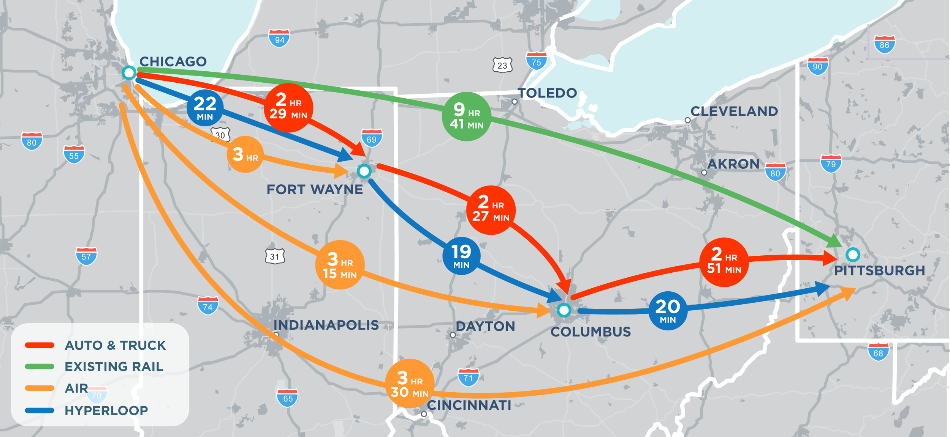
FINDINGS: travel time savings
Notes:
We found the travel times were very favorable when you compare cars to trains to hyperloop. For example, note it takes a car about xxx hours to get between Columbus and Chicago today. With passenger rail, with a number of stops, that trip would take xxx. It would take 38 minutes by hyperloop.

Slide 37
Estimated Hyperloop Fares*
Average Hyperloop Service Characteristics by Metro Pair
Metro Pair | Line Haul Travel Time (min) | Line Haul Distance (miles) | Fare Cost (dollars)
Chicago-Fort Wayne | 22 | 163 | $33
Chicago-Columbus | 38 | 302 | $60
Chicago-Pittsburgh | 58 | 465 | $93
Fort Wayne-Columbus | 19 | 139 | $28
Fort Wayne-Pittsburgh | 39 | 302 | $60
Columbus-Pittsburgh | 22 | 163 | $33
* 2019 dollars. Based on an assumed $0.20/mile, as calculated by AECOM with input from Virgin Hyperloop One
Notes:
Fare calculated based on USDOT value of time, or 20 cents per mile

Slide 38
Emissions Savings
Environmental Sustainability
Mode Shift Emissions Savings (Auto to Hyperloop) | $113.9M
Mode Shift Emissions Savings (Air to Hyperloop) | $0.3M
Mode Shift Emissions Savings (Train to Hyperloop) | $7.8M
Mode Shift Emissions Savings (Commercial Truck to Hyperloop) | $4.6M
Notes:
Emphasize these savings were calculated using DOT Benefit Cost Analysis methodology standards

Slide 39
HYPERLOOP NEXT STEPS
Public meetings
VHO certification segment – R&D collaboration opportunity
Create a travel demand advisory panel (public agencies, academic institutions, VHO)
Monitor NETT Council activities and opportunities to engage in federal regulatory framework
Advance regulatory framework with appropriate agencies
Continue to facilitate collaboration
Notes:
Certification segment – Research and development collaboration opportunity with Virgin Hyperloop One
3 different certification segments between 5 and 10 miles to be considered
Creation of a travel demand advisory panel (collaboration between public agencies, academic institutions, and Virgin Hyperloop One)
Continued facilitation of Central Ohio/VHO collaboration opportunities
Coordination with DOT agencies to advance regulatory framework (potential to do this through a certification segment project)

Slide 40
Passenger rail NEXT STEPS
Public meetings
Secure funding to complete the environmental studies necessary for the federal construction approval process
Engage and secure the support of communities east of Columbus
Develop a strategy with other surrounding states to secure regulatory guidance

Slide 41
QUESTIONS?

Slide 42
DINA LOPEZ
Strategic Projects Manager
Mid-Ohio Regional Planning Commission
T: 614.233.4149 | M: 614.603-0947
dlopez@morpc.org
111 Liberty Street, Suite 100
Columbus, OH 43215

