Slide 1
Air Quality
February, 2020
Notes:
How many of you have heard about an Air Quality Alert that was issued? Raise your hands.
How many of you get AQA emails or texts?
How many of you heard about it on TV?
On the radio?
On Facebook or Twitter?
On a highway sign?

Slide 2
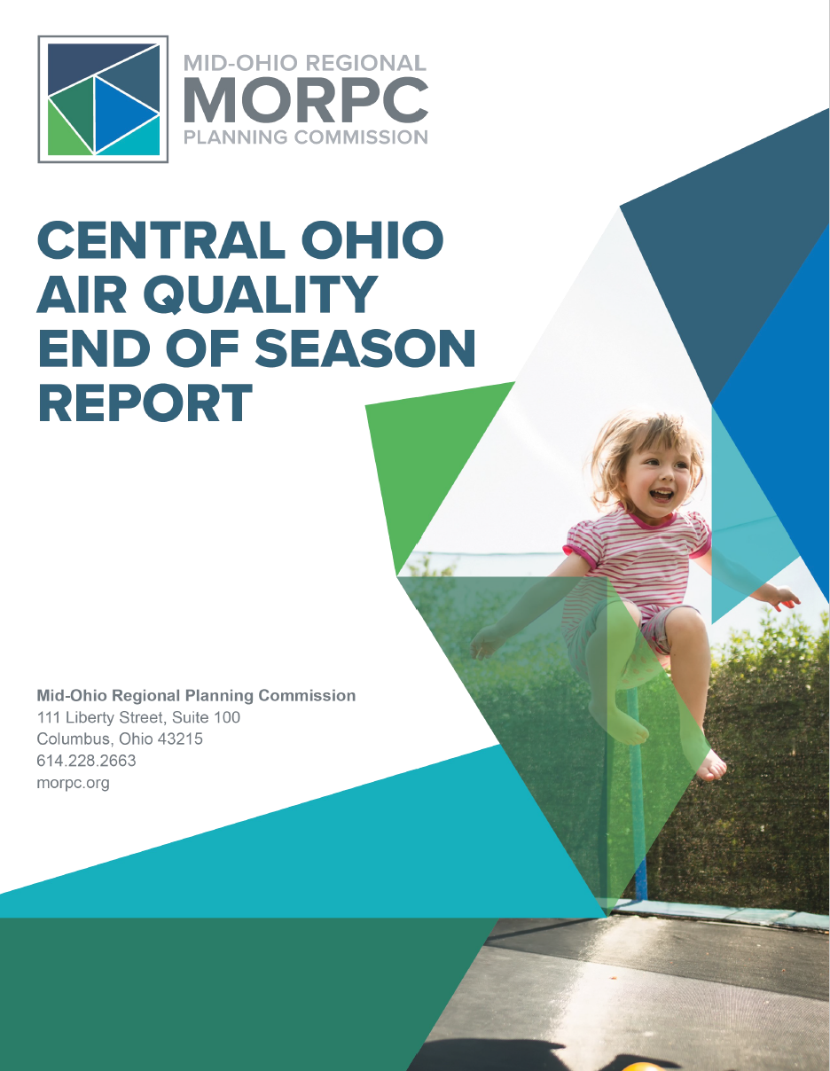
End of Year Air Quality Report

Slide 3
Air Quality Alert Subscribers
AQA Subscribers
2017 existing: 2,272
2018-2019 added: 1,281
Notes:
We’ve added more than 50% of all existing confirmed subscribers in the last two years using nimble advertising,
Strategies included are:
-Nimble advertising to take advantage of air quality ‘opportunities’:
push out ads when AQ goes to moderate or higher with appropriately keyed graphics and language to drive users to sign up, example on screen
-Incentivizing sign ups –
we had great success last year with a green weekend giveaway that drove high levels of interest. However, it was difficult to fully convert those interested (get them to sign up). This year, we’ll experiment with smaller, repeated incentives (e.g. monthly giveaways) that are appropriately messaged.
-More content directed at older, breathing illness demographic –
we learned last year that this is one of our most engaged demographics

Slide 4
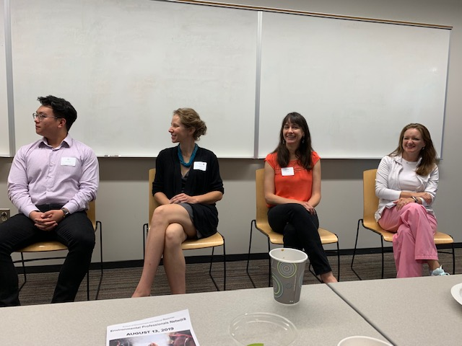
Air Quality Alert Partnerships and Outreach
Notes:
We’ve also created recent partnerships with Franklin County Emergency Management (similar to NWS last year)
Held events with OSU’s EPN and CURA
Continued to staff events around town

Slide 5
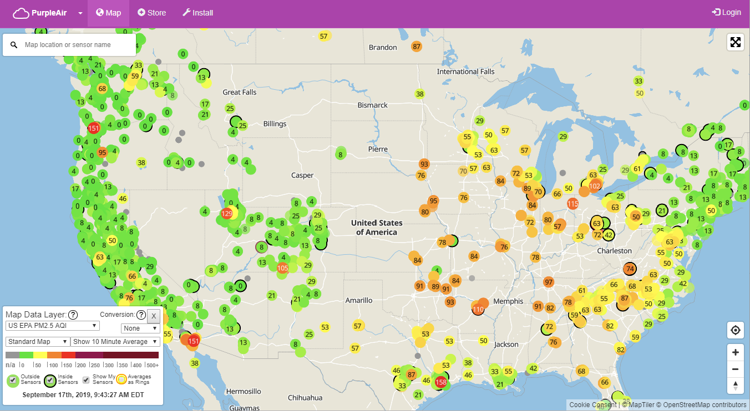
Low-Cost Air Quality Monitors
Notes:
Exploring role of Low Cost Air Quality Monitors to increase awareness and education

Slide 6
Brooke White, PhD
Senior Air Quality Specialist
Mid-Ohio Regional Planning Commission
T: 614.233.4168
bwhite@morpc.org
111 Liberty Street, Suite 100
Columbus, OH 43215

Slide 7
Air Quality Program Strategy
Equity
Vulnerable Populations
Education and Outreach
Health
Technology and Data
Climate
Notes:
We’ve added more than 50% of all existing confirmed subscribers in the last two years using nimble advertising,
Strategies included are:
-Nimble advertising to take advantage of air quality ‘opportunities’:
push out ads when AQ goes to moderate or higher with appropriately keyed graphics and language to drive users to sign up, example on screen
-Incentivizing sign ups –
we had great success last year with a green weekend giveaway that drove high levels of interest. However, it was difficult to fully convert those interested (get them to sign up). This year, we’ll experiment with smaller, repeated incentives (e.g. monthly giveaways) that are appropriately messaged.
-More content directed at older, breathing illness demographic –
we learned last year that this is one of our most engaged demographics

