Slide 1
Air Quality
Update
Community/Transportation Advisory Committees
October 2019

Slide 2
Information Only

Slide 3
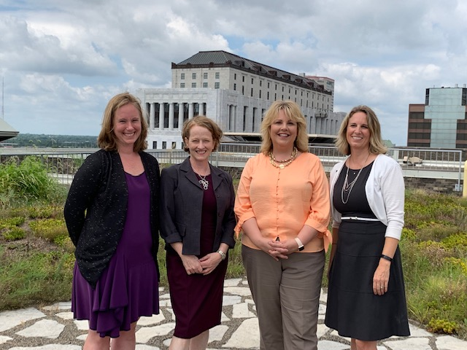

First in Nation – Air Quality Attainment

Slide 4

Air Quality Alert Subscribers
AQA Subscribers
2017 existing: 2,272
2018-2019 added: 1,281

Slide 5

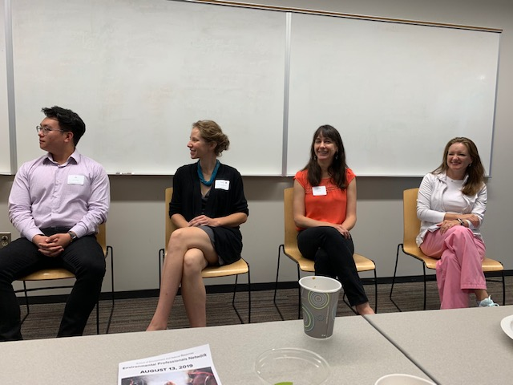
Air Quality Alert Partnerships and Outreach

Slide 6
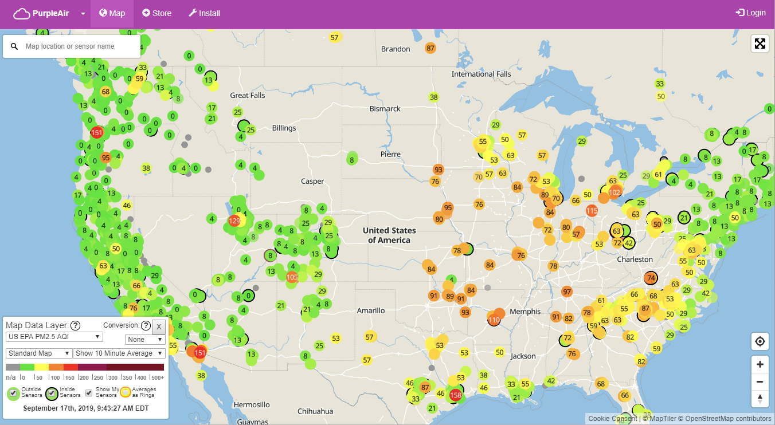
Low-Cost Air Quality Monitors
Notes:
Exploring role of Low Cost Air Quality Monitors to increase awareness and education

Slide 7
Brooke White, PhD
Senior Air Quality Specialist
Mid-Ohio Regional Planning Commission
T: 614.233.4168
bwhite@morpc.org
111 Liberty Street, Suite 100
Columbus, OH 43215

