Slide 1
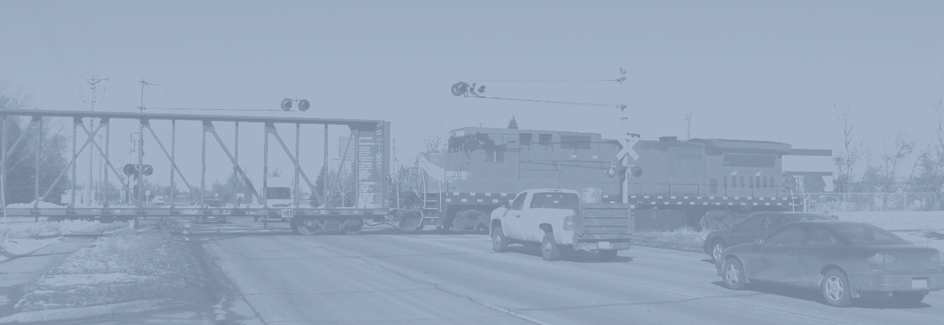


Ohio Rail Grade
Crossing Pilot Study
August 2020 Update

Slide 2
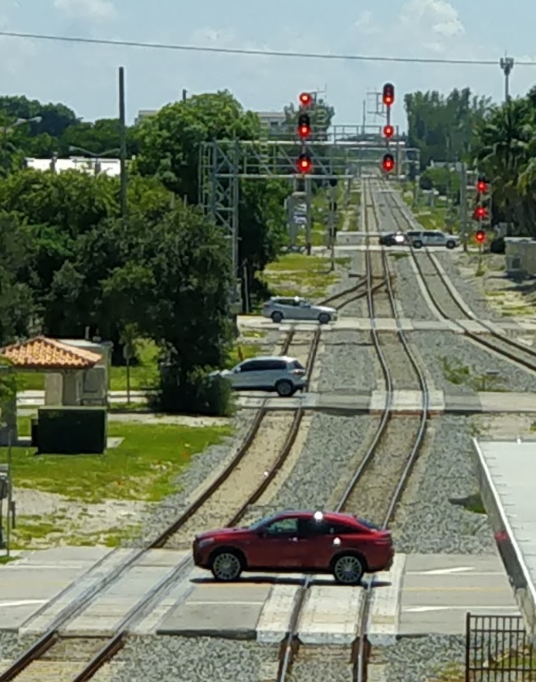
Study Objective
Develop a methodology to
evaluate rail-road grade crossings
in Ohio and produce an adaptive capacity tool (and resulting score) that assesses at-grade crossing importance, redundancy, and overall adaptability.

Slide 3
Study Overview
Phase 1 Inputs
7
Identify Pilot Areas
8
Develop/Test Adaptive
Capacity Assessment Tool
9
Test and Validate Methodology in Pilot Areas
10
Final Report
Notes:
Phase I: Assess current conditions/research; identify data availability/gaps; develop methodology

Slide 4
Adaptive Capacity Score Methodology
Adaptive Capacity Score
Public Importance
Redundancy
Delay to Road Users
Safety
For Motorized Road users
For EMS/Fire Services
For
Community
Road Type
(Functional Class)
Facility Proximity
to Crossing
Community
Cohesion
Proximity to Grade-Separated Facility
Rail Traffic Volume
(Day Trains)
PUCO/ODOT Grade Crossing Hazard Index
Road
Demand (AADT)
Road Demand (AADT)
Proximity to Signals, Sidings and Yards
Road Demand (AADT)
Notes:
For Non-Motorized Users, the Public Importance category considers non-motorized infrastructure (shoulders, bike lanes, foot trails, sidewalks); distance to non-motorized traffic generators (schools/parks/rec centers); pedestrian volume (where/when available)

Slide 5
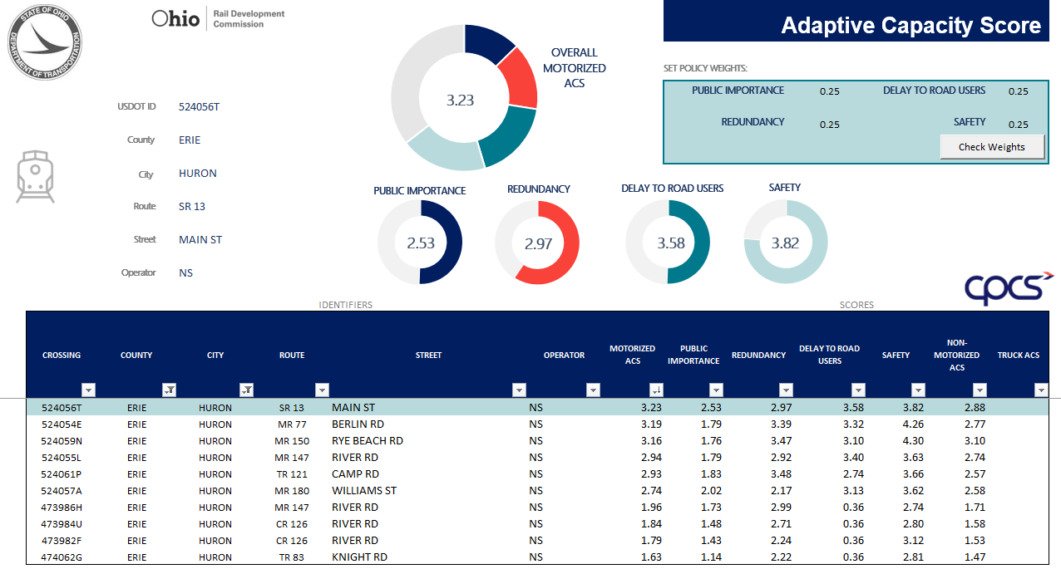
Adaptive Capacity Score Output

Slide 6
What’s Next
Final Stakeholder Workshop
Final Report
Final Evaluation Tool & User Manual
Develop metrics to compare ACS outputs across a set of crossings (city/county/rail corridor/statewide)
Incorporate ACS output into evaluation of potential projects
Notes:
We will NOT use the ACS to: determine grade crossing safety; choose projects. It will be an input. Room for future data gathering & research: pedestrians, actual vehicle delay, etc.

Slide 7
Contact Information
Megan McClory
Ohio Rail Development Commission
Megan.McClory@dot.ohio.gov
(614) 644-0289

Slide 8
Annex: Adaptive Capacity Score Methodology
Adaptive Capacity Score
Public Importance
Redundancy
Delay to Road Users
Safety
For Motorized Road users
For EMS/Fire Services
For
Community
Road Type
(Functional Class)
Facility Proximity
to Crossing
Community
Cohesion
Proximity to Grade-Separated Facility
Rail Traffic Volume
(Day Trains)
PUCO/ODOT Grade Crossing Hazard Index
Road
Demand (AADT)
Road Demand (AADT)
Proximity to Signals, Sidings and Yards
Road Demand (AADT)
Notes:
For Non-Motorized Users, the Public Importance category considers non-motorized infrastructure (shoulders, bike lanes, foot trails, sidewalks); distance to non-motorized traffic generators (schools/parks/rec centers); pedestrian volume (where/when available)

Slide 9
Annex: Adaptive Capacity Score Methodology
Public Importance
For Motorized Road Users
× w_{M}+
For EMS/Fire Services
× w_{E}+
For Community
× w_{c}
Motorized Road Users
To be included in the calculation of the Adaptive Capacity Score for Motorized Road Users only
Facility Proximity
to Crossing
Community
Cohesion
Road Type
Functional Class of a road
Inverse of the Distance to Hospitals / Fire Stations
Percentage of population split by rail line
×
Road Demand
Average Annual Daily Traffic (AADT)
Adaptive Capacity Score
Legend:
Component
Public Importance
Redundancy
Delay to Road Users
Safety
Sub-Component
For Motorized Road users
For EMS/Fire Services
For
Community
Performance Category
Road Type
(Functional Class)
Facility Proximity
to Crossing
Community
Cohesion
Proximity to Grade-Separated Facility
Rail Traffic Volume
(Day Trains)
PUCO/ODOT Grade Crossing Hazard Index
Performance Measure
Road
Demand (AADT)
Road Demand (AADT)
Proximity to Signals, Sidings and Yards
Road Demand (AADT)

Slide 10
Annex: Adaptive Capacity Score Methodology
Redundancy
Proximity to
Grade-Separated Facility
Road Demand
Distance to Closest Grade-Separated Crossing
×
Average Annual Daily Traffic (AADT)
Legend:
Adaptive Capacity Score
Component
Public Importance
Redundancy
Delay to Road Users
Safety
Sub-Component
For Motorized Road users
For EMS/Fire Services
For
Community
Performance Category
Road Type
(Functional Class)
Facility Proximity
to Crossing
Community
Cohesion
Proximity to Grade-Separated Facility
Rail Traffic Volume
(Day Trains)
PUCO/ODOT Grade Crossing Hazard Index
Performance Measure
Road
Demand (AADT)
Road Demand (AADT)
Proximity to Signals, Sidings and Yards
Road Demand (AADT)

Slide 11
Annex: Adaptive Capacity Score Methodology
Delay to Road Users
Rail Traffic Volume
Proximity to Signals, Sidings and Yards
Road Demand
Number of Day Trains
×
Inverse distance to closest rail signal, yard or siding
×
Average Annual Daily Traffic (AADT)
Legend:
Adaptive Capacity Score
Component
Public Importance
Redundancy
Delay to Road Users
Safety
Sub-Component
For Motorized Road users
For EMS/Fire Services
For
Community
Performance Category
Road Type
(Functional Class)
Facility Proximity
to Crossing
Community
Cohesion
Proximity to Grade-Separated Facility
Rail Traffic Volume
(Day Trains)
PUCO/ODOT Grade Crossing Hazard Index
Performance Measure
Road
Demand (AADT)
Road Demand (AADT)
Proximity to Signals, Sidings and Yards
Road Demand (AADT)

Slide 12
Annex: Adaptive Capacity Score Methodology
Safety
PUCO/ODOT Grade Crossing Hazard Index
PUCO/ODOT Hazard Index
Legend:
Adaptive Capacity Score
Component
Public Importance
Redundancy
Delay to Road Users
Safety
Sub-Component
For Motorized Road users
For EMS/Fire Services
For
Community
Performance Category
Road Type
(Functional Class)
Facility Proximity
to Crossing
Community
Cohesion
Proximity to Grade-Separated Facility
Rail Traffic Volume
(Day Trains)
PUCO/ODOT Grade Crossing Hazard Index
Performance Measure
Road
Demand (AADT)
Road Demand (AADT)
Proximity to Signals, Sidings and Yards
Road Demand (AADT)

