Slide 1
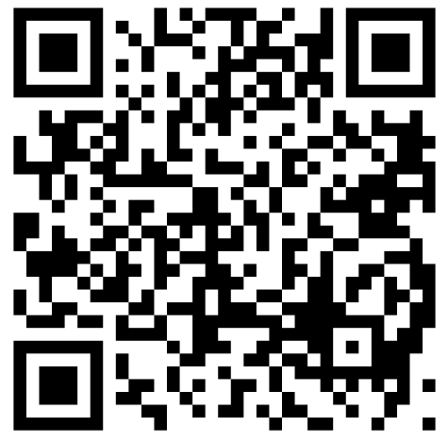


MORPC and
Franklin University
are excited to offer MORPC member’s employees the following discounts!
Contact Partners@franklin.edu for more information:
MORPC
Benefit Offerings:
Undergraduate: 20% Tuition Discount
Graduate: 20% Tuition Discount
Doctoral: 10% Tuition Discount
Free Textbooks
www.franklin.edu/morpc

